Slide 1
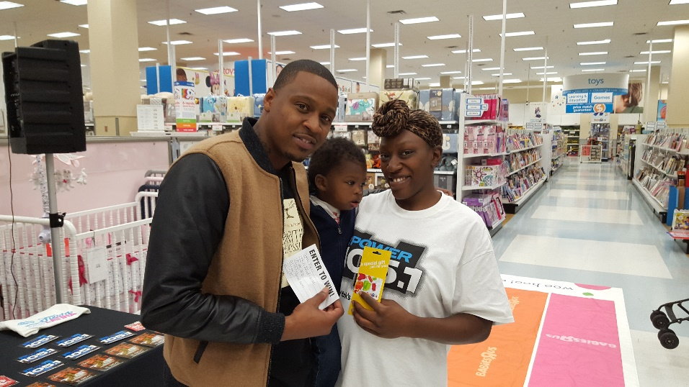
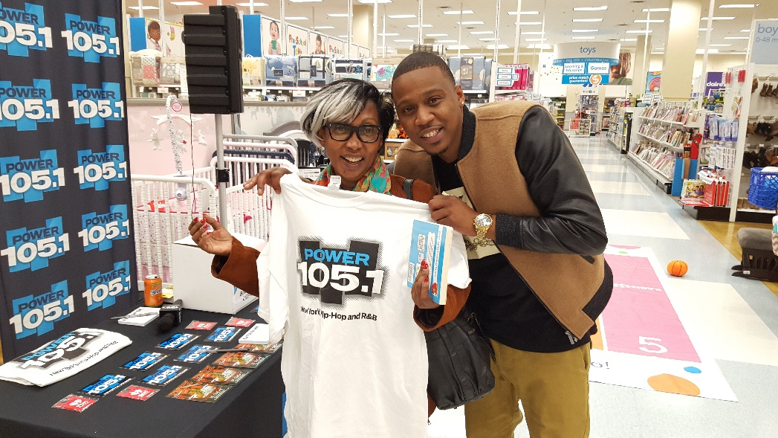
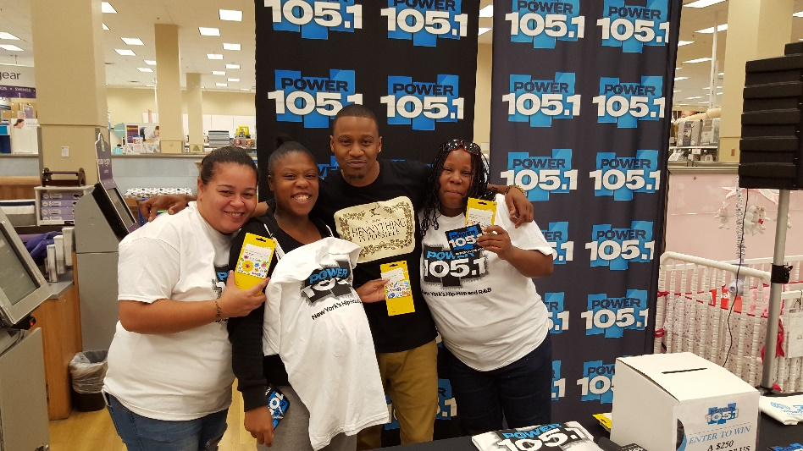
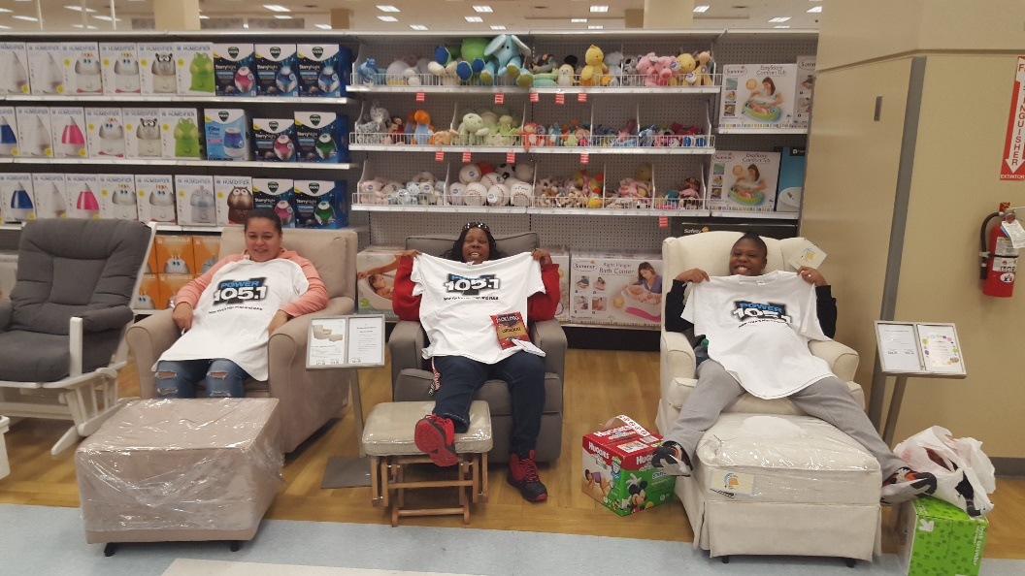
WWPR-FM-New York September 30th 12p-2p Huggies at Babies R Us 610 Exterior Street, Bronx, NY
Emez Call in
Promo Air Check

Slide 2
