Slide 1
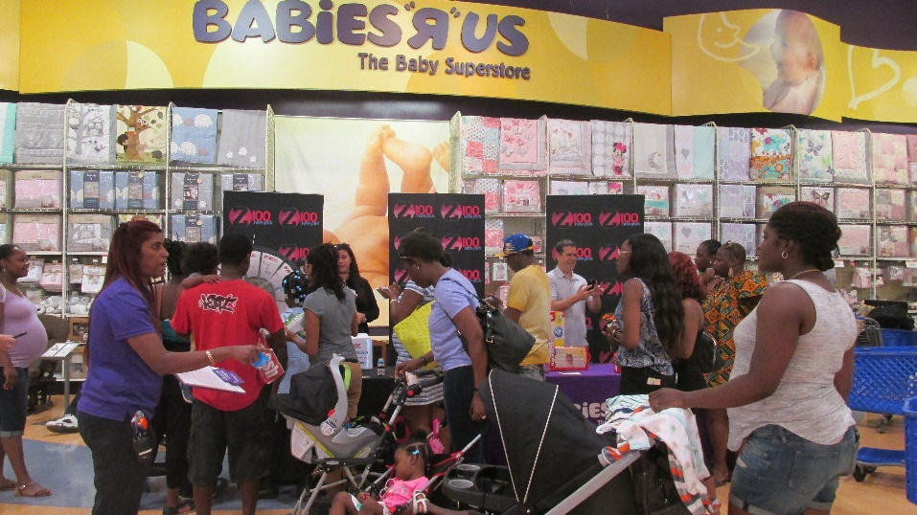
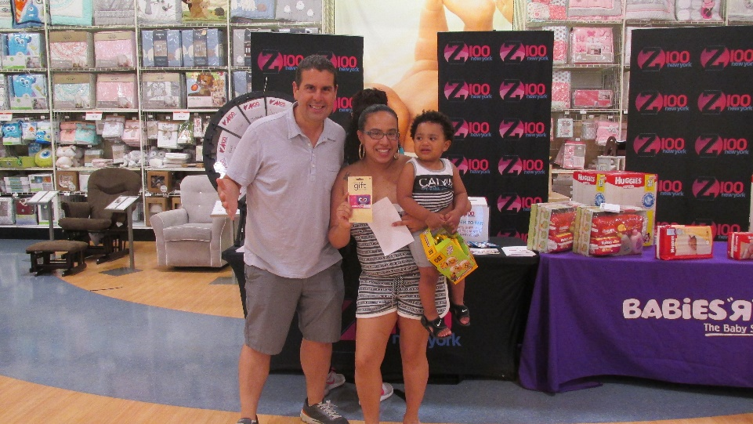
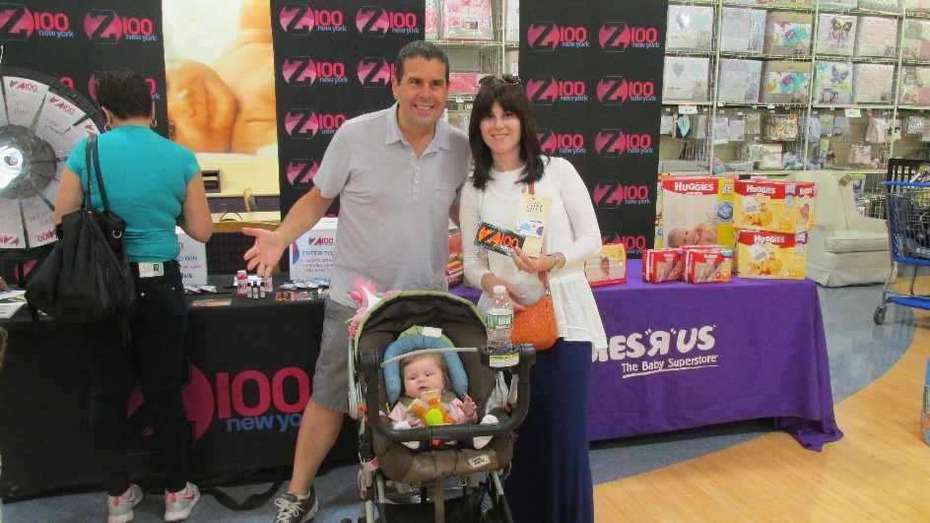
WHTZ-FM-New York June 15th 2p-4p Huggies at Babies R Us 395 Gateway Drive, Brooklyn
Skeery Jones
Call in
Promo Air Check

Slide 2
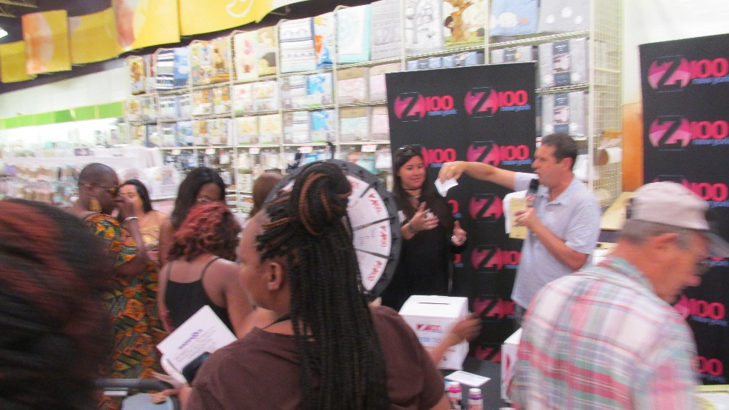
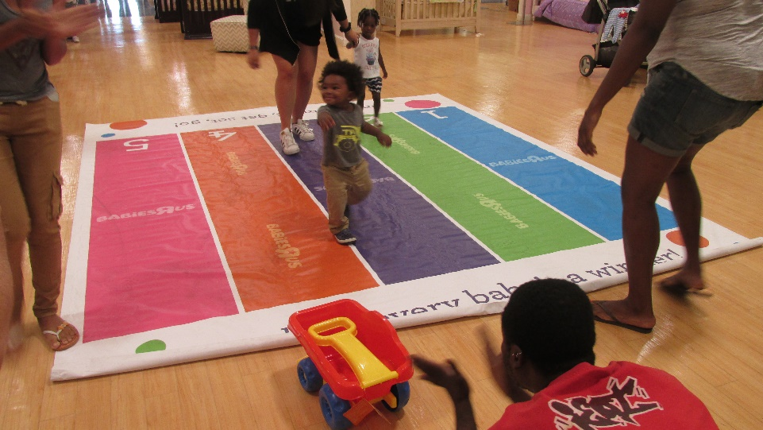
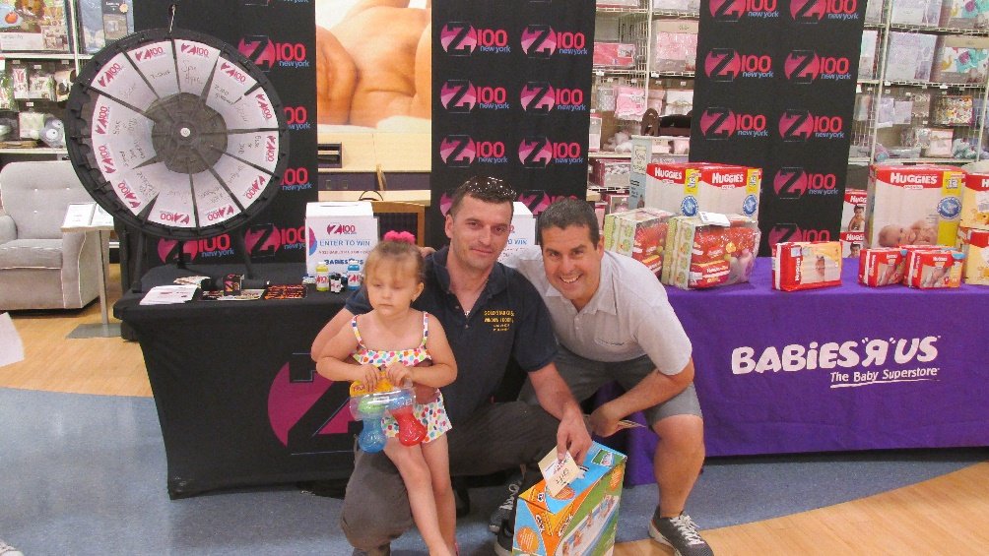
WHTZ-FM-New York June 15th 2p-4p Huggies at Babies R Us 395 Gateway Drive, Brooklyn
Skeery Jones
Call in
Promo Air Check

Slide 3
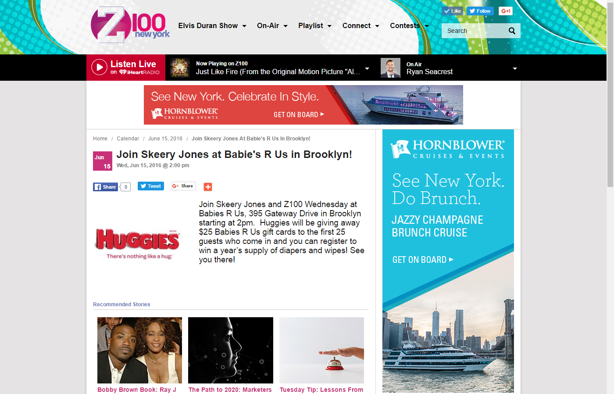

Slide 4
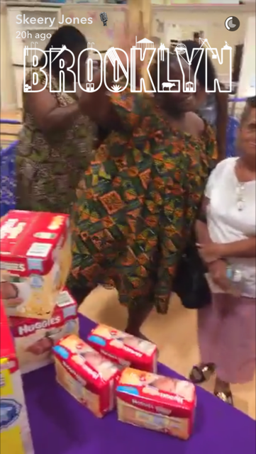
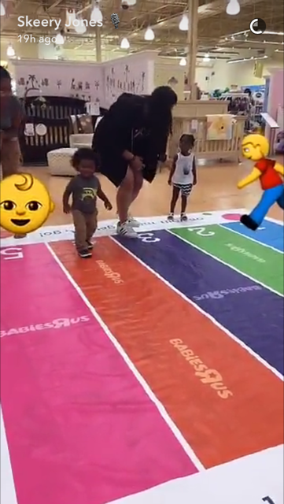
Skeery Jones Snapchat

Slide 5
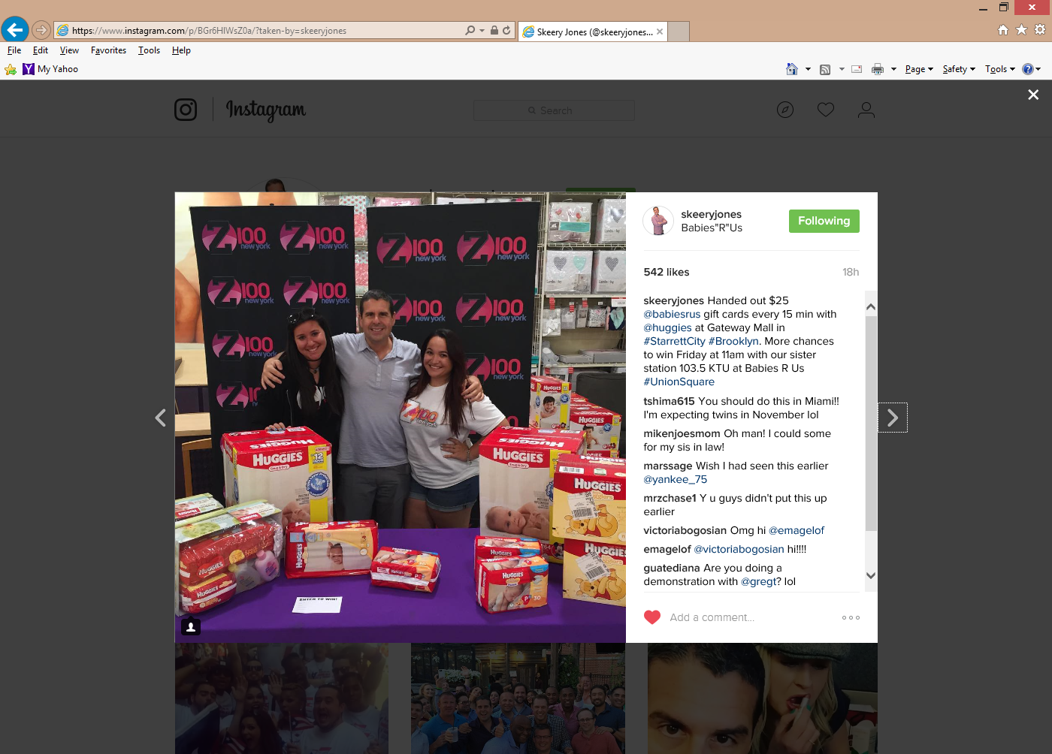
Skeery Jones Instagram

Slide 6
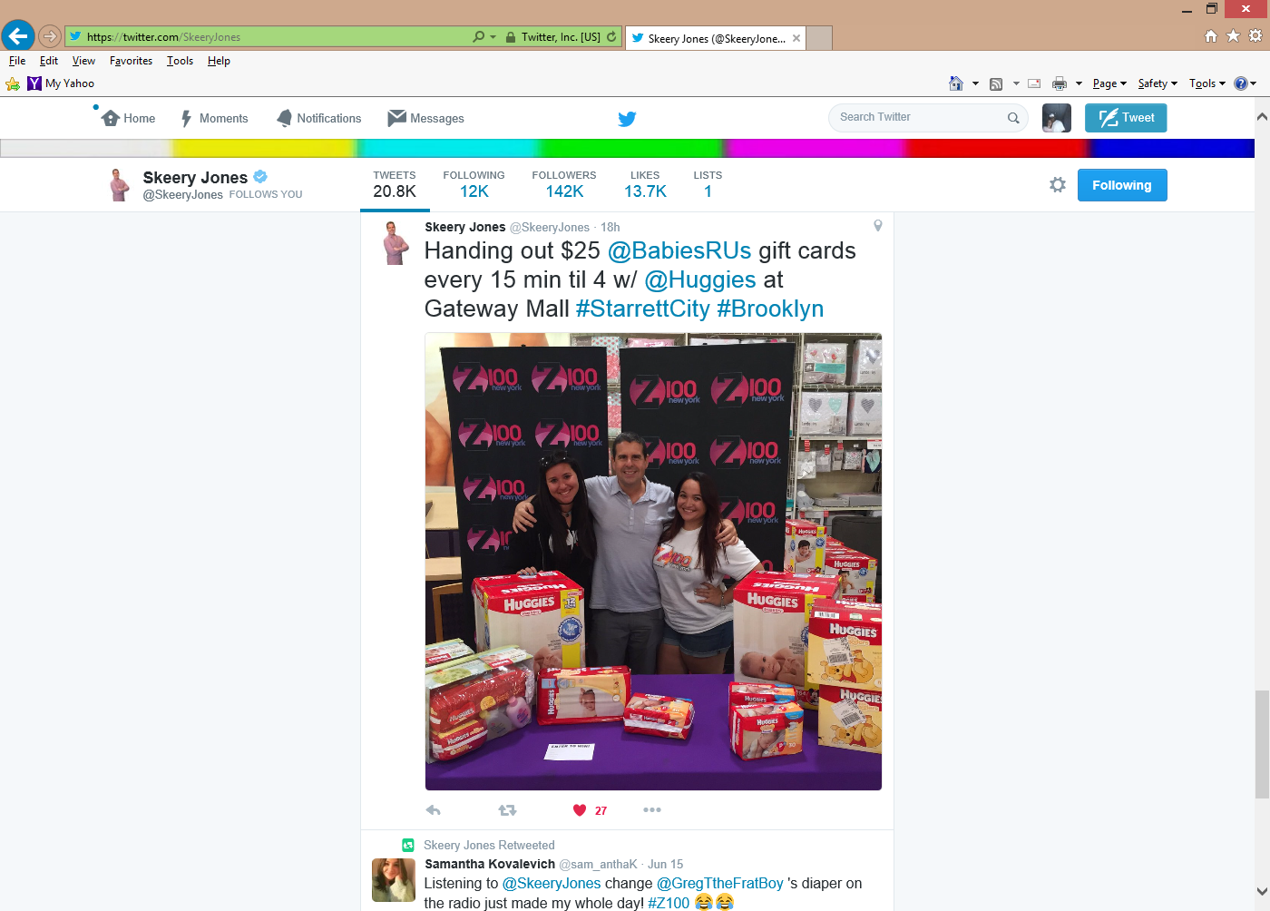
Skeery Jones Twitter

