Slide 1
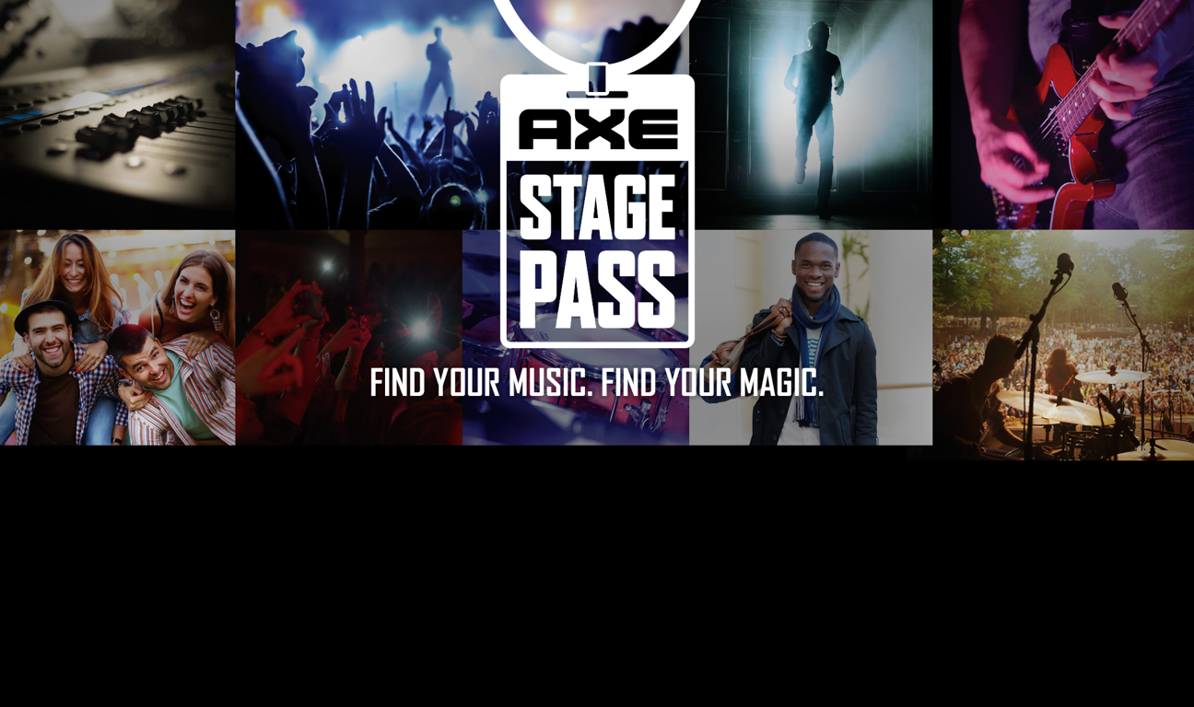
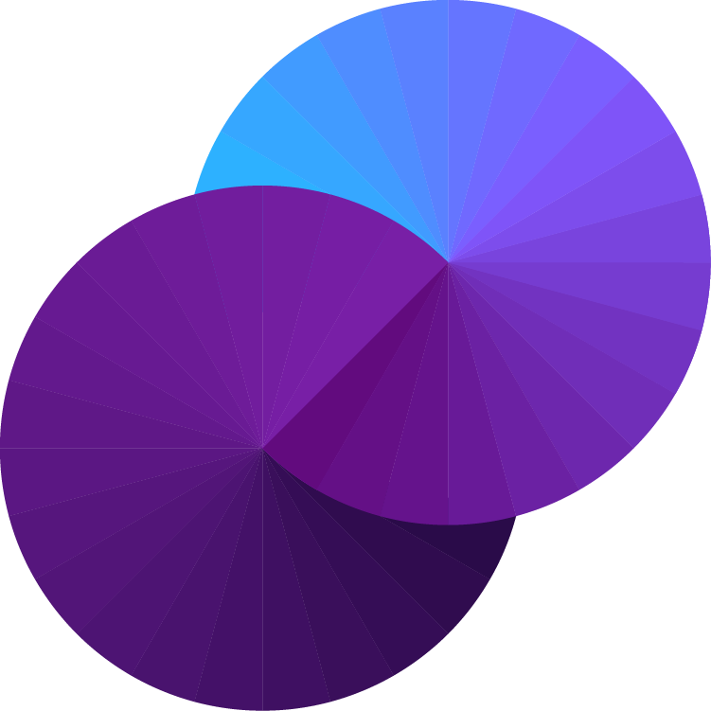
Unilever Shopper Marketing
Axe Concert Series
Walmart Personal Care Week
Radio Promotion

Slide 2
The Unilever Shopper2Buyer team
had a great opportunity
but not much time

Slide 3
To celebrate “Personal Care Week”
Unilever’s Brand was bringing
free concerts to Parking lots
in Phoenix and Springfield IL
IN ONLY TWO WEEKS

Slide 4
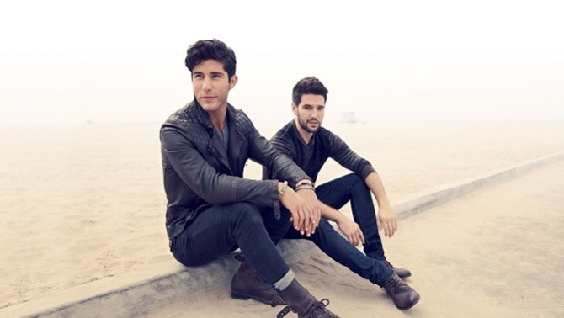
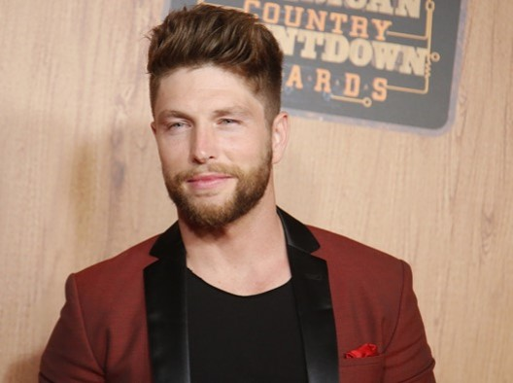
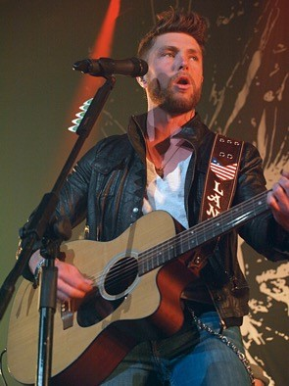
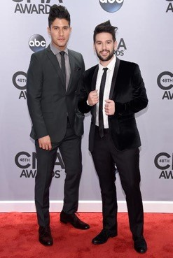
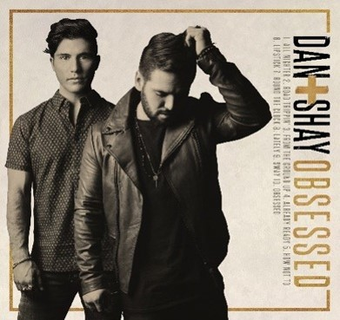
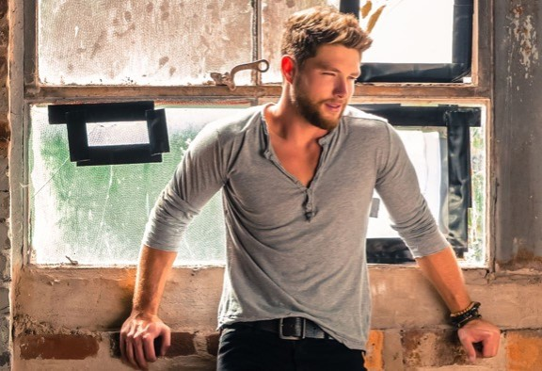
Dan + Shay
Scottsdale AZ
Chris Lane
Springfield IL

Slide 5
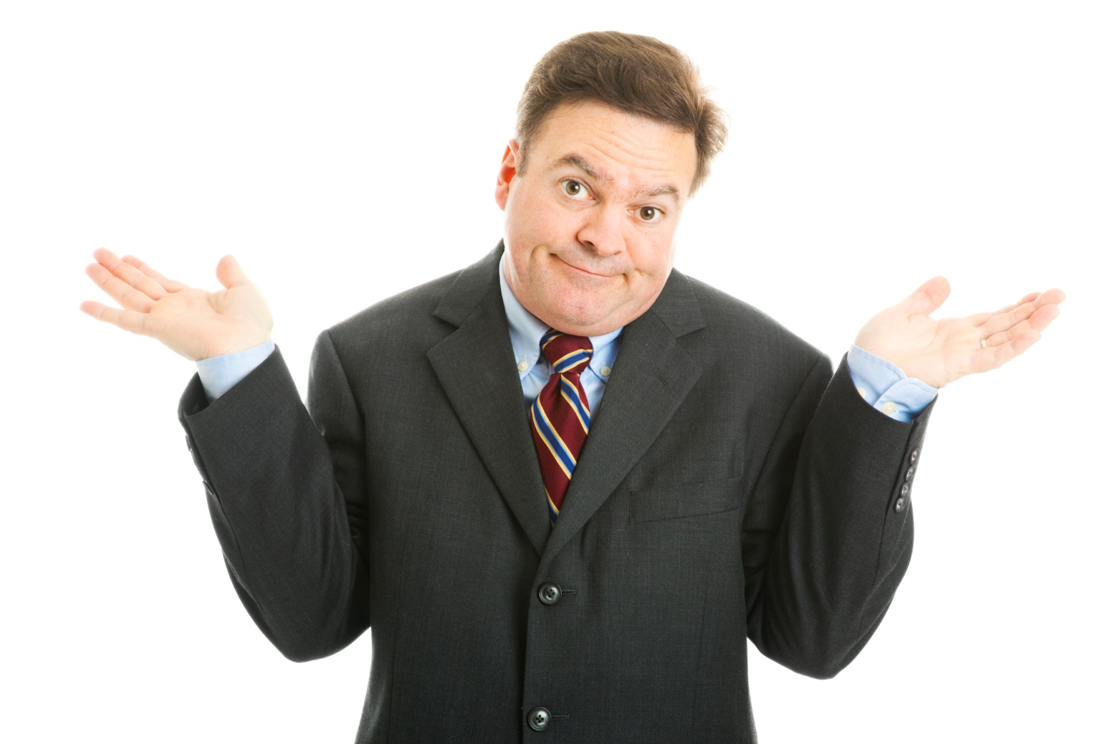
But what good was that
if no one knew about it?

Slide 6
Music was the focus
Radio was the right place for the message

Slide 7
But it was past the deadline
to place spot radio
What was the Shopper2Buyer team to do?

Slide 8
They contacted

Slide 9
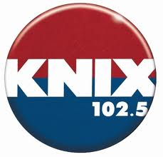
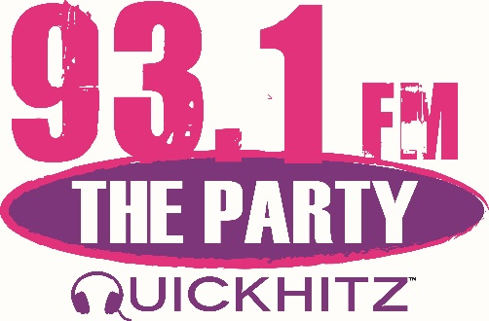
In just two days
found multiple stations to do a “remote” from onsite for the concert
Good! People will hear about it!

Slide 10
But that’s not all…
Negotiated into each remote package
was a bank of announcements
used to promote the concert,
the brand and the product.

Slide 11
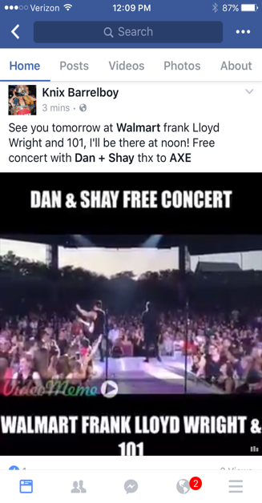
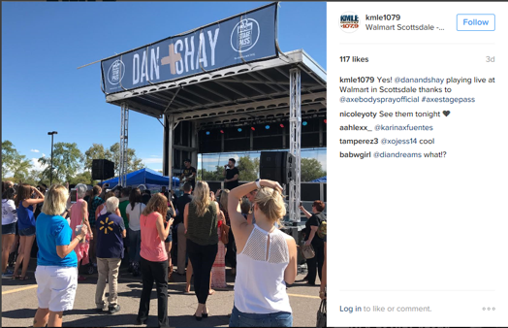
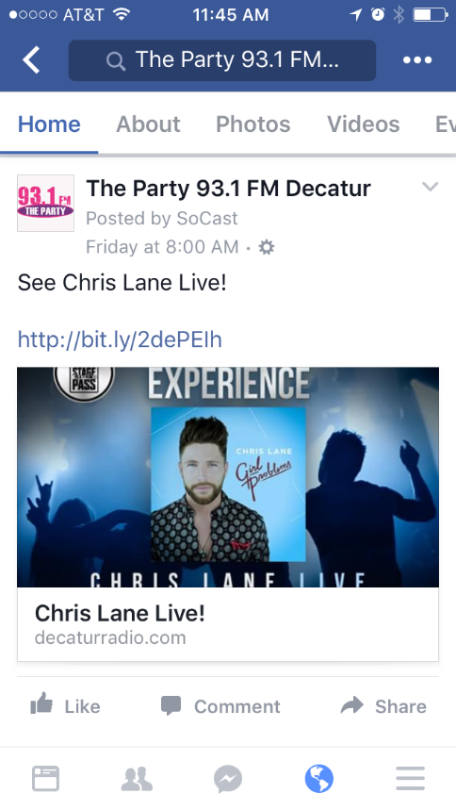
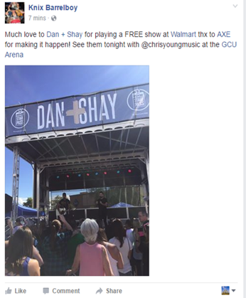
But that’s not all…
The stations posted provided copy and artwork in their social media …

Slide 12
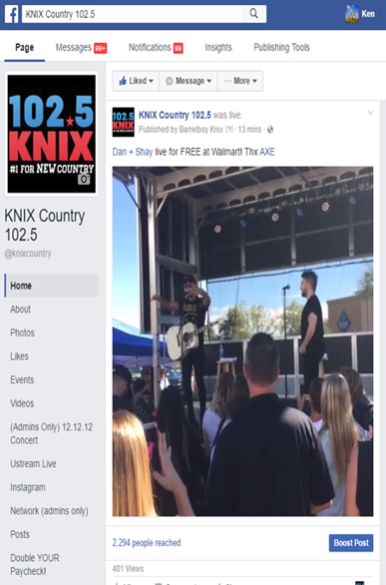
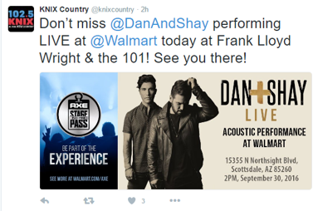
But that’s not all…
The stations posted provided copy and artwork in their social media …

Slide 13
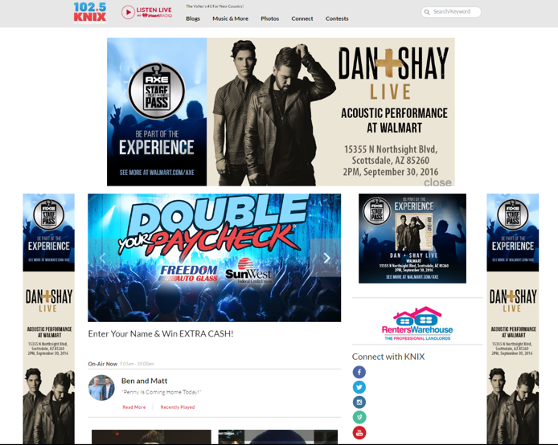
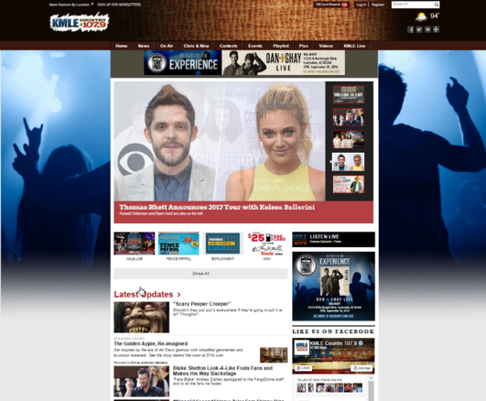
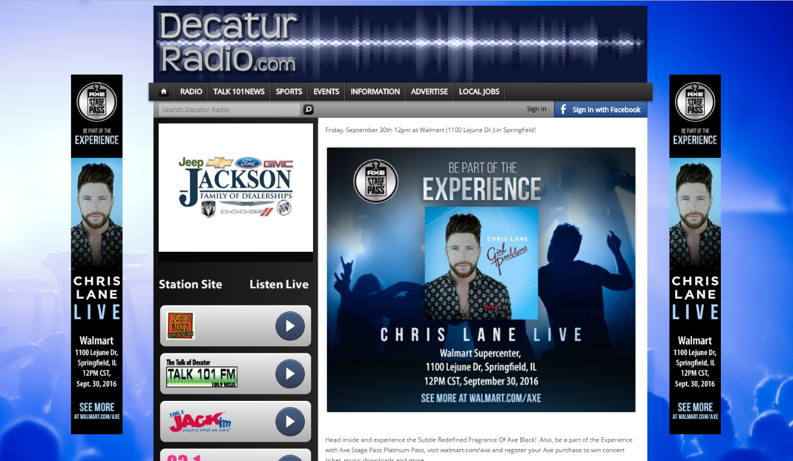
But that’s not all…
and on their websites…

Slide 14
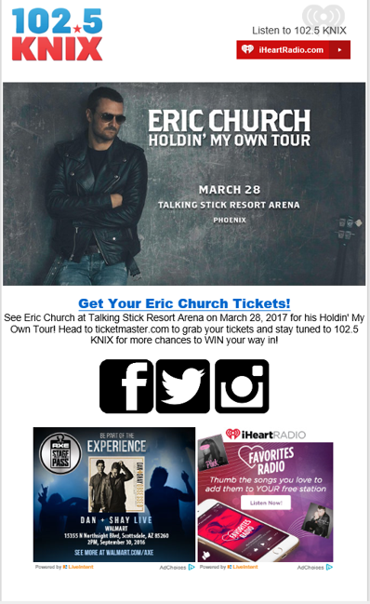
But that’s not all…
and in their e-mail blasts

Slide 15
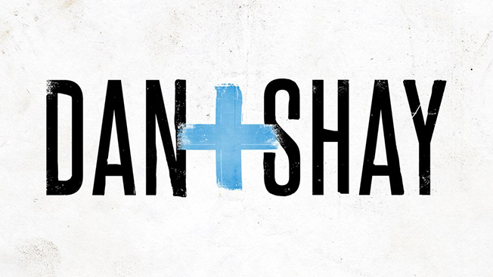
But that’s not all…
They interviewed the artists on air

Slide 16
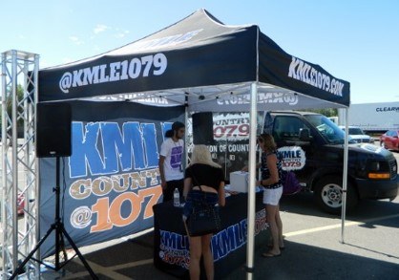
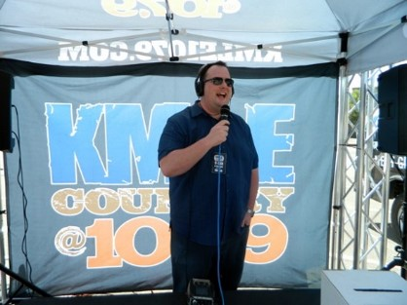
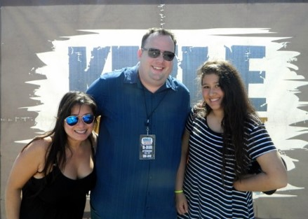
But that’s not all…
The stations appeared on site
at the concerts
in the parking lots
with their station event team

Slide 17
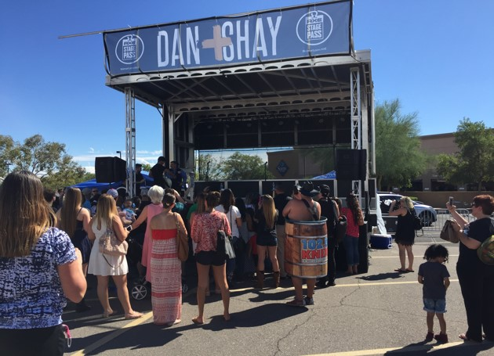
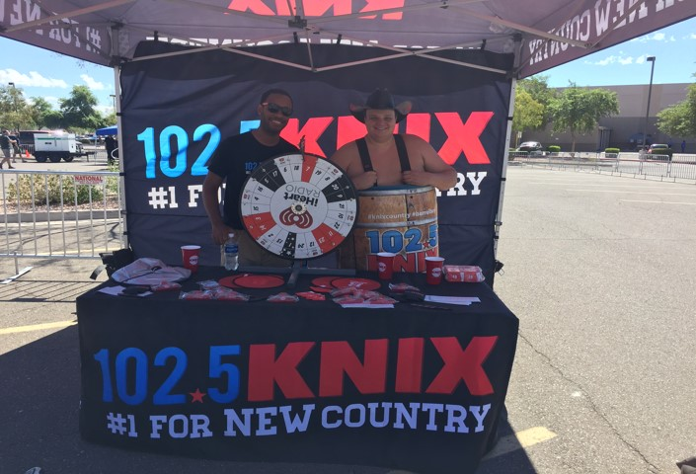
But that’s not all…
The stations appeared on site
at the concerts
in the parking lots
with their station event team

Slide 18
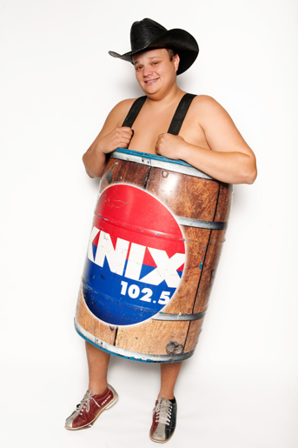
But that’s not all…
A DJ from each station
broadcasts live from the event …

Slide 19
But that’s not all…
Posted
Facebook
Live
video

Slide 20
But that’s not all…
Posted on Social Media from the event

Slide 21
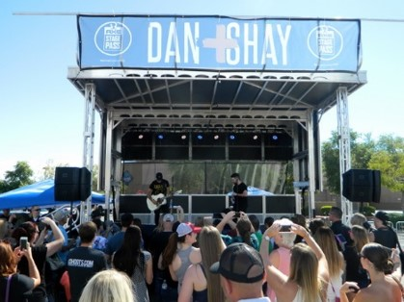
But that’s not all…
And introduced the bands before they played

Slide 22
By using
the Unilever Shopper2Buyer team
was able to promote the event
directly to the audience
most likely to attend
via broadcast, digital, social, video
and on site event marketing
with only two weeks
from planning to execution.

Slide 23
50% UNDER BUDGET!!
Radio Promotions
were the answer for Unilever
Any questions?

