Slide 1
BBVA Compass
On Air, Web & Social Media Recap February & March 2015

Slide 2
On Air, Website & Social Media Recap:
Station: KLNZ-FM 103.5-FM La Tricolor-Puros Trancazos!
DJ Endorser: Daniel Perez “El Garbanzo” Co-Host Erazno y La Chokolata Show 3p-7p!
Banners Display on www.tricolor1035.com 300X250 & 120X240
Social Media Support on https://www.facebook.com/tricolor1035
2.23.15 to 2.27.15 (20) :60 sec endorsed spots 3p-7p
3.23.15 to 3.27.15 (20) :60 sec endorsed spots 3p-7p
Air-check’s sent to Carrie Zampich via email MP3 formats
Spots sent to Carrie Zampich via email MP3 formats
Screen shots (please see next slides)

Slide 3
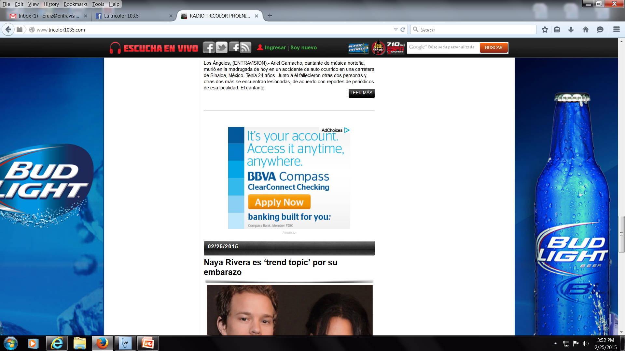
WEBSITE:
http://www.tricolor1035.com/

Slide 4
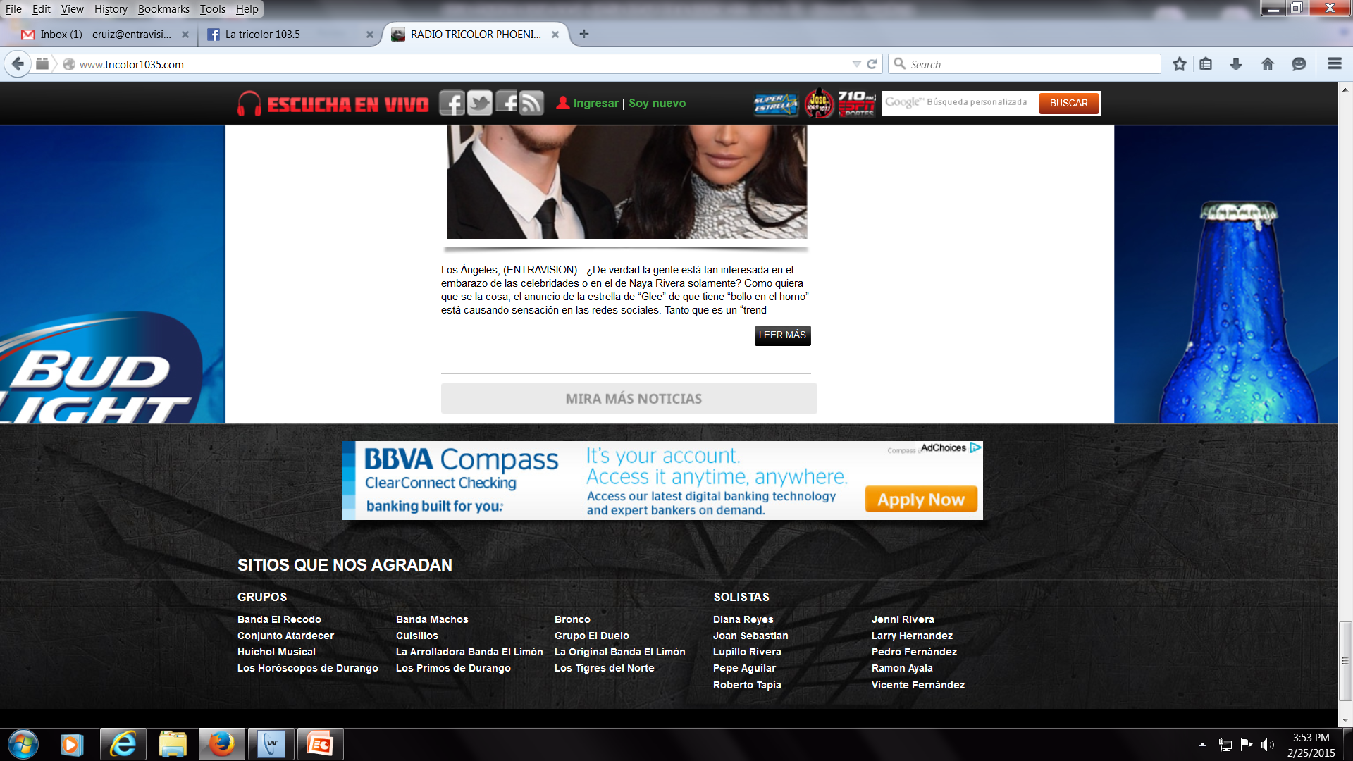
WEBSITE:
http://www.tricolor1035.com/

Slide 5
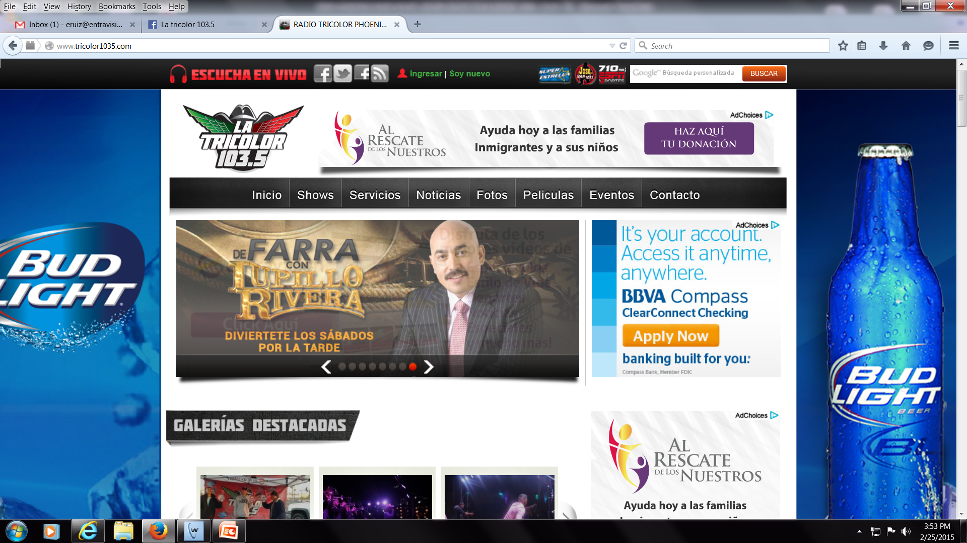
WEBSITE:
http://www.tricolor1035.com/

Slide 6
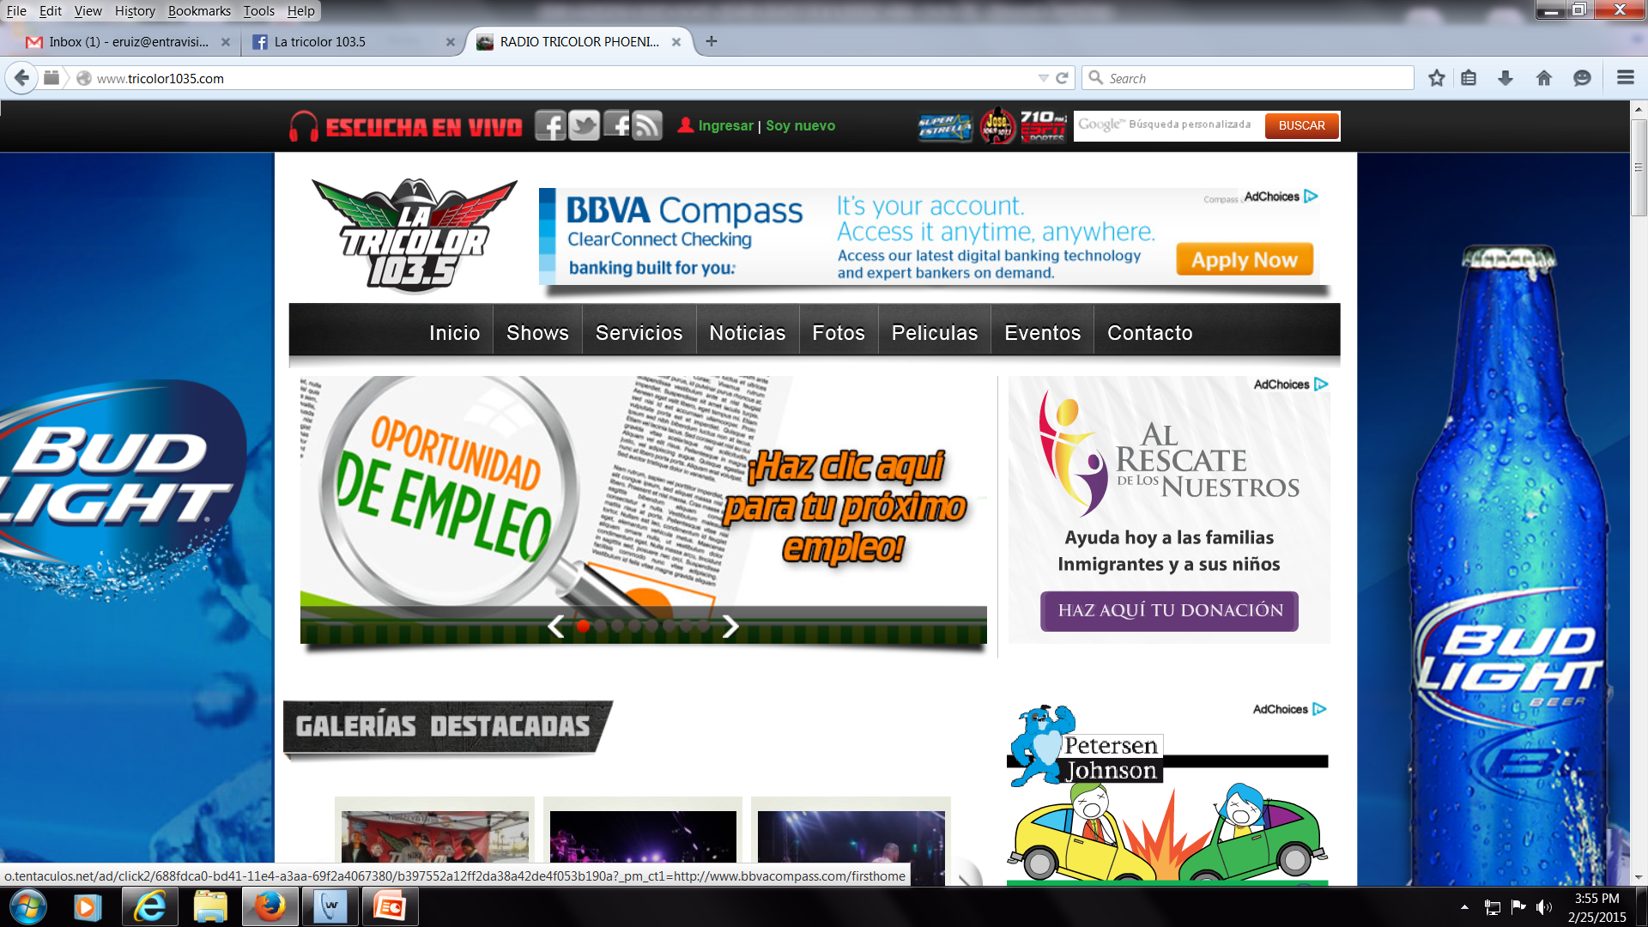
WEBSITE:
http://www.tricolor1035.com/

Slide 7
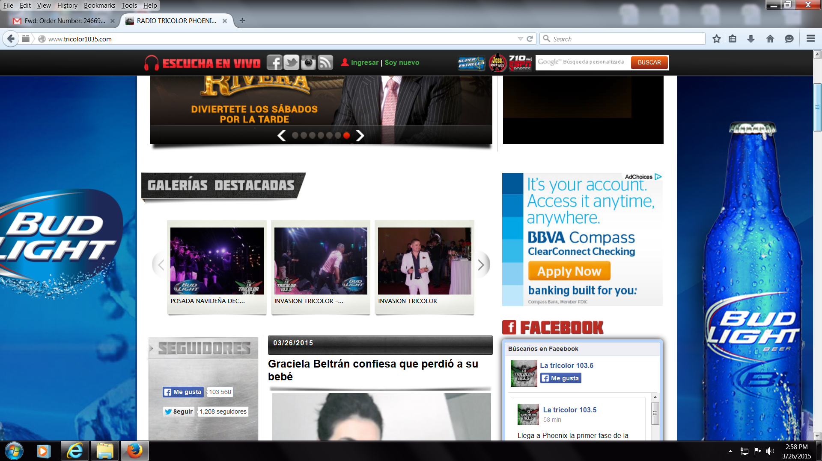
WEBSITE:
http://www.tricolor1035.com/

Slide 8
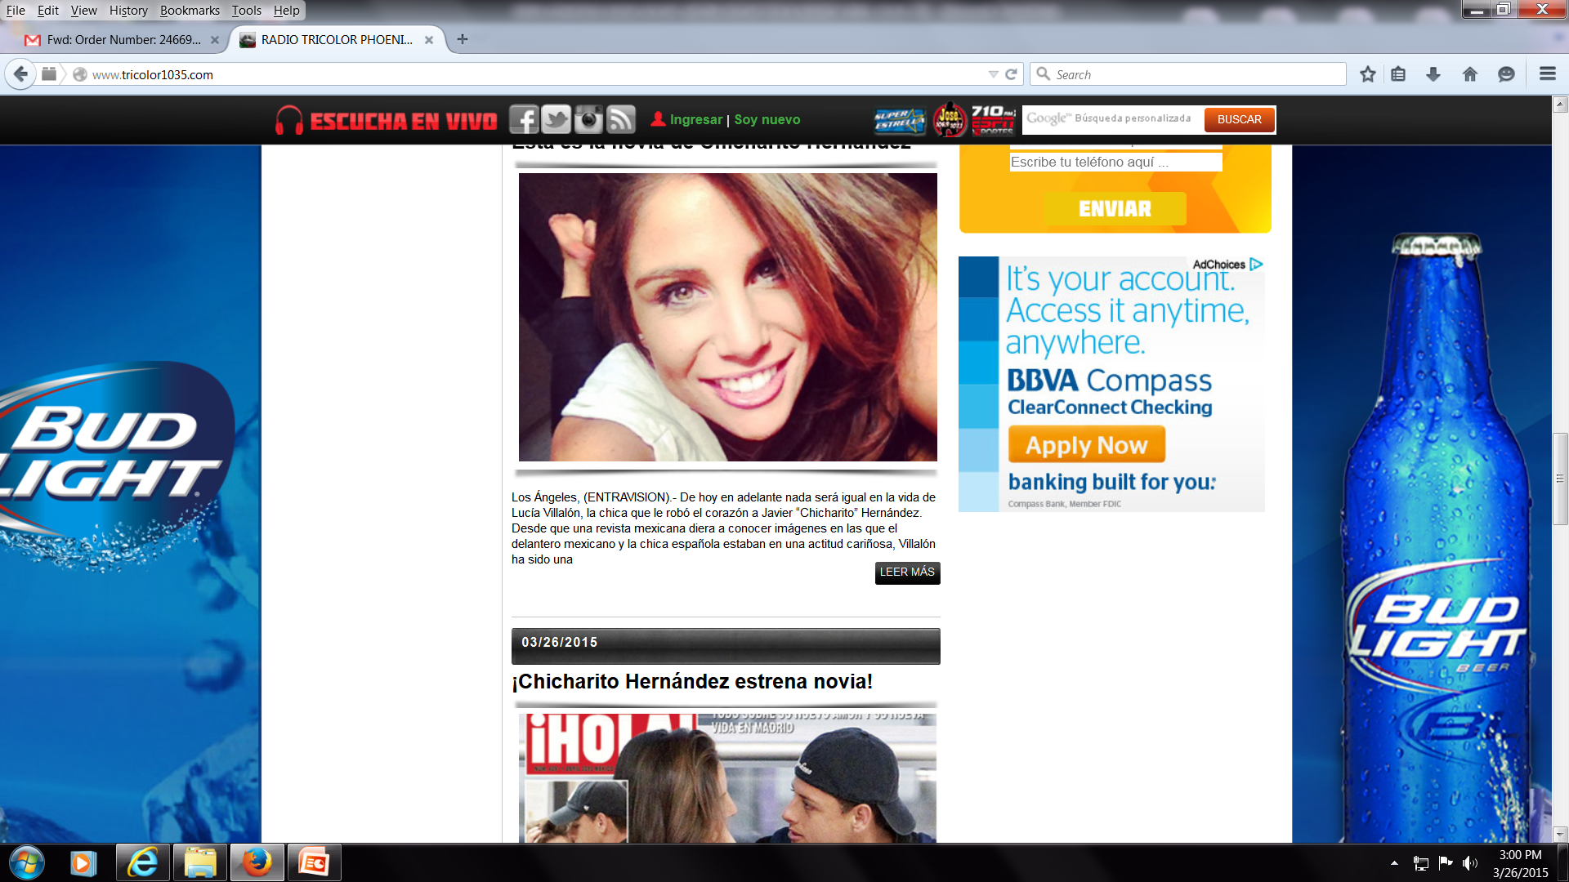
WEBSITE:
http://www.tricolor1035.com/

Slide 9
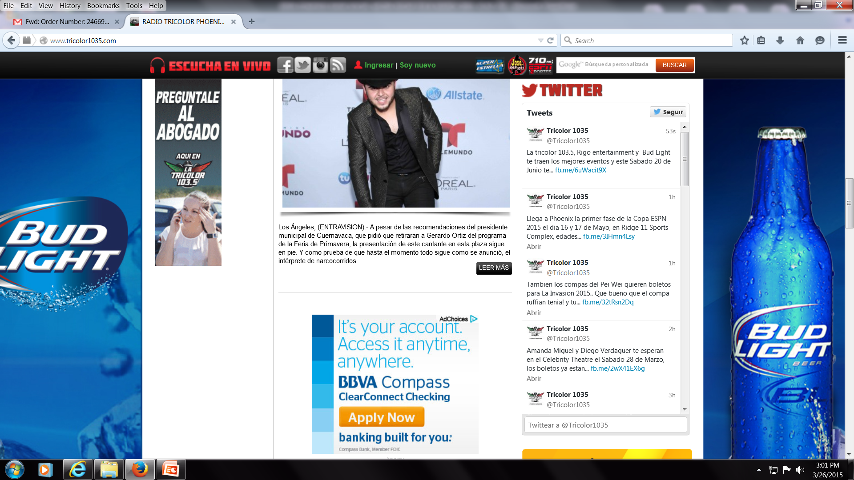
WEBSITE:
http://www.tricolor1035.com/

Slide 10
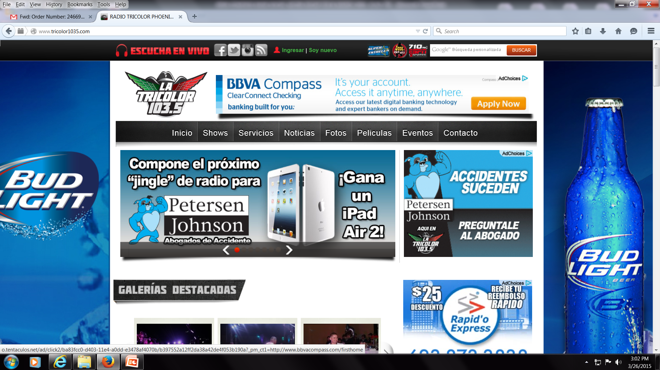
WEBSITE:
http://www.tricolor1035.com/

Slide 11
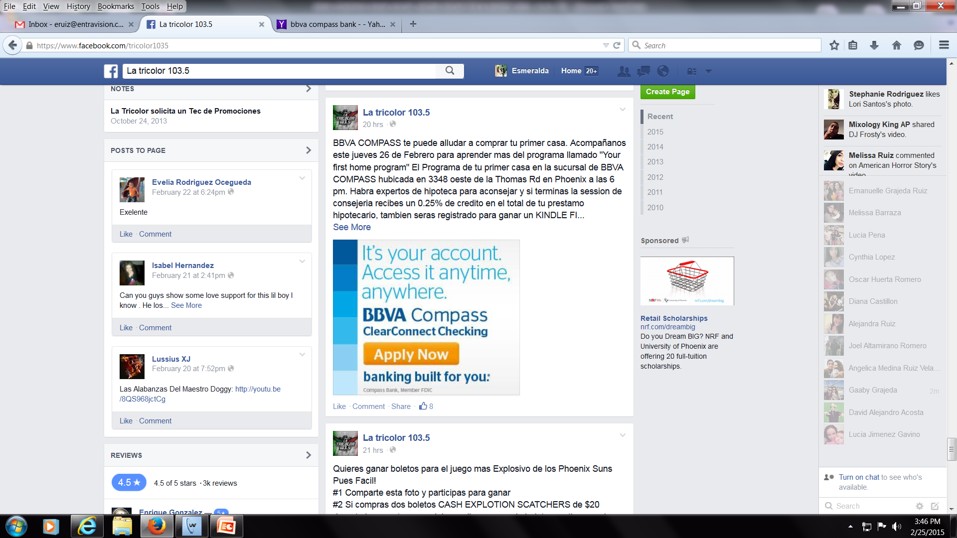
SOCIAL MEDIA POST: 2.24.15

Slide 12
SOCIAL MEDIA POST: 2.25.15

Slide 13
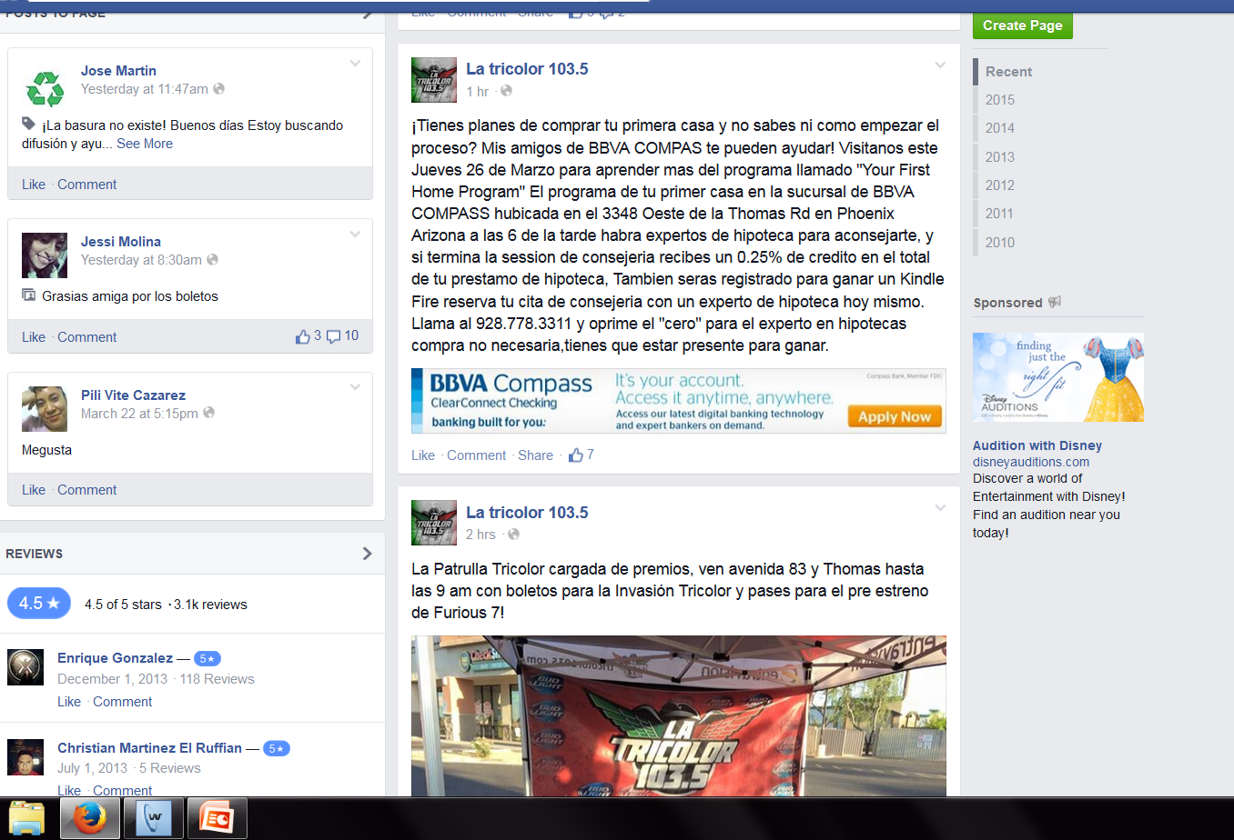
SOCIAL MEDIA POST: 3.26.15

Slide 14
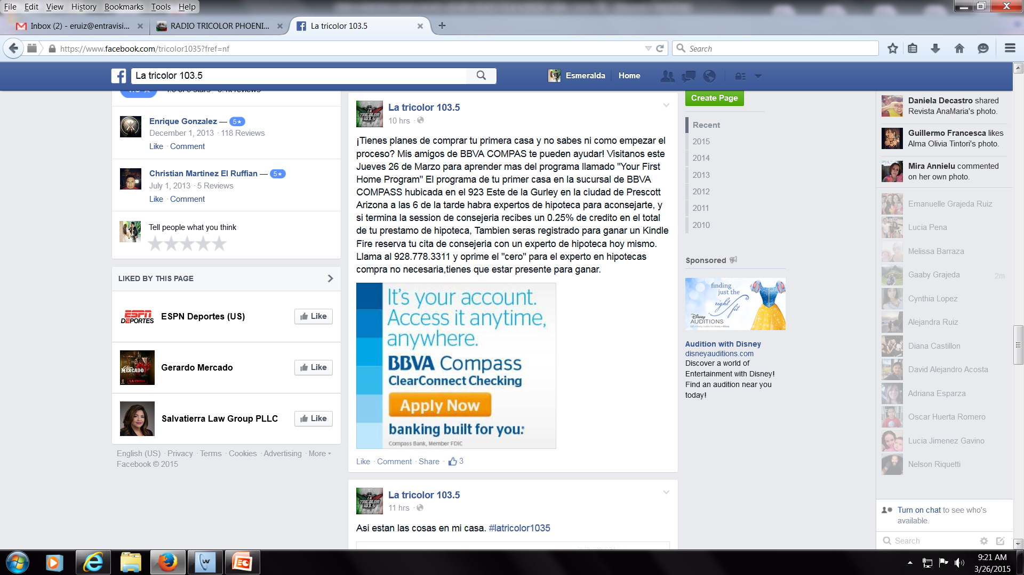
SOCIAL MEDIA POST: 3.26.15

Slide 15
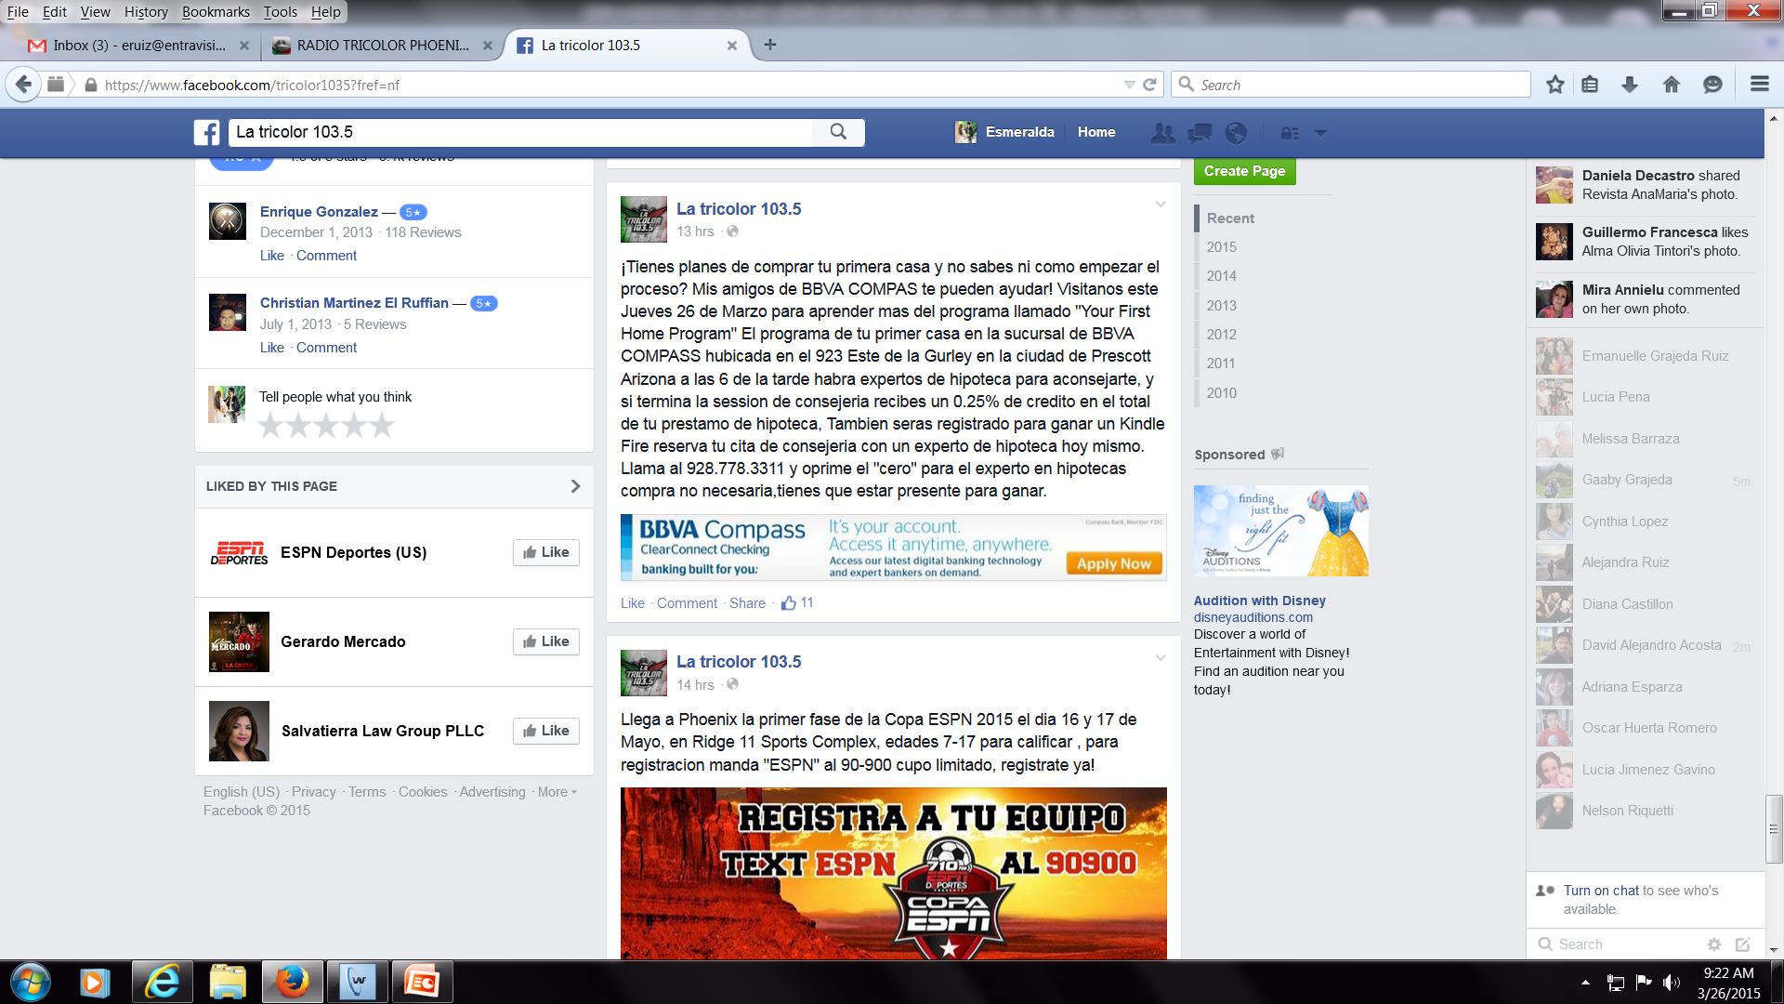
SOCIAL MEDIA POST: 3.26.15

Slide 16
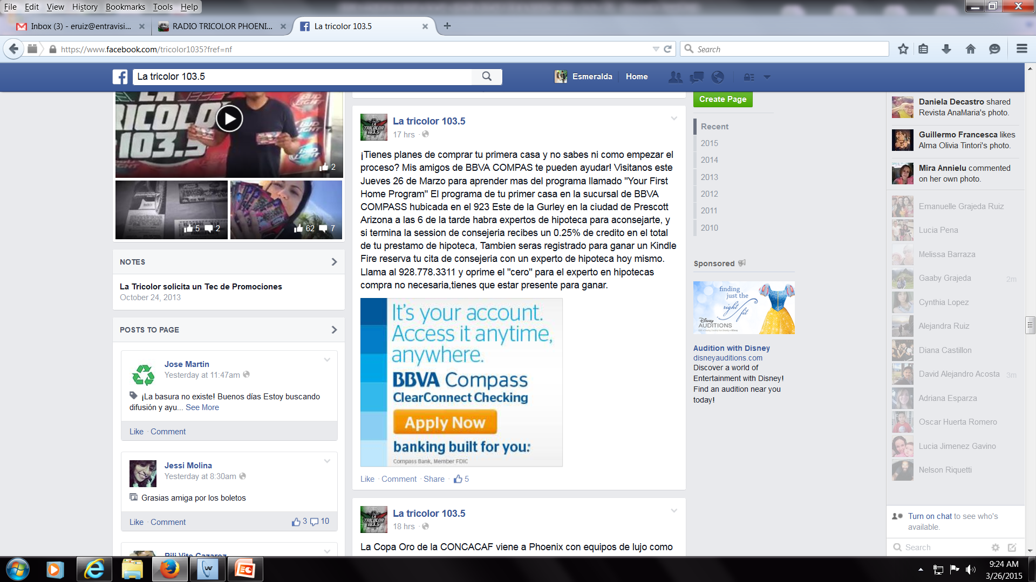
SOCIAL MEDIA POST: 3.26.15

Slide 17
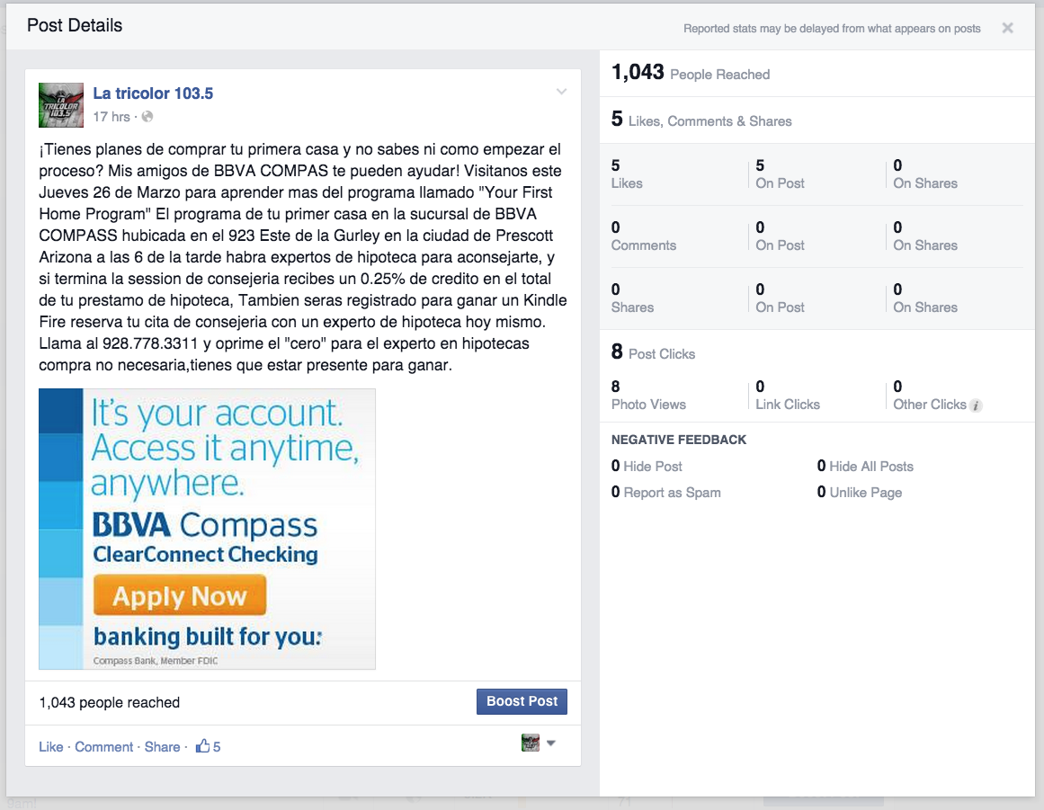
SOCIAL MEDIA POST: 3.26.15

Slide 18
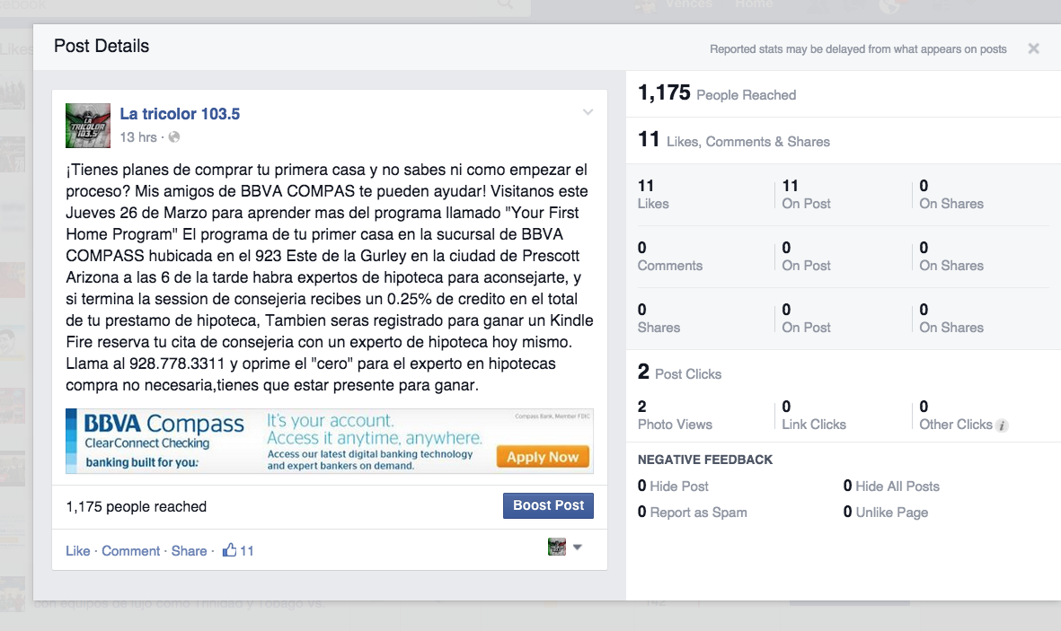
SOCIAL MEDIA POST: 3.26.15

Slide 19
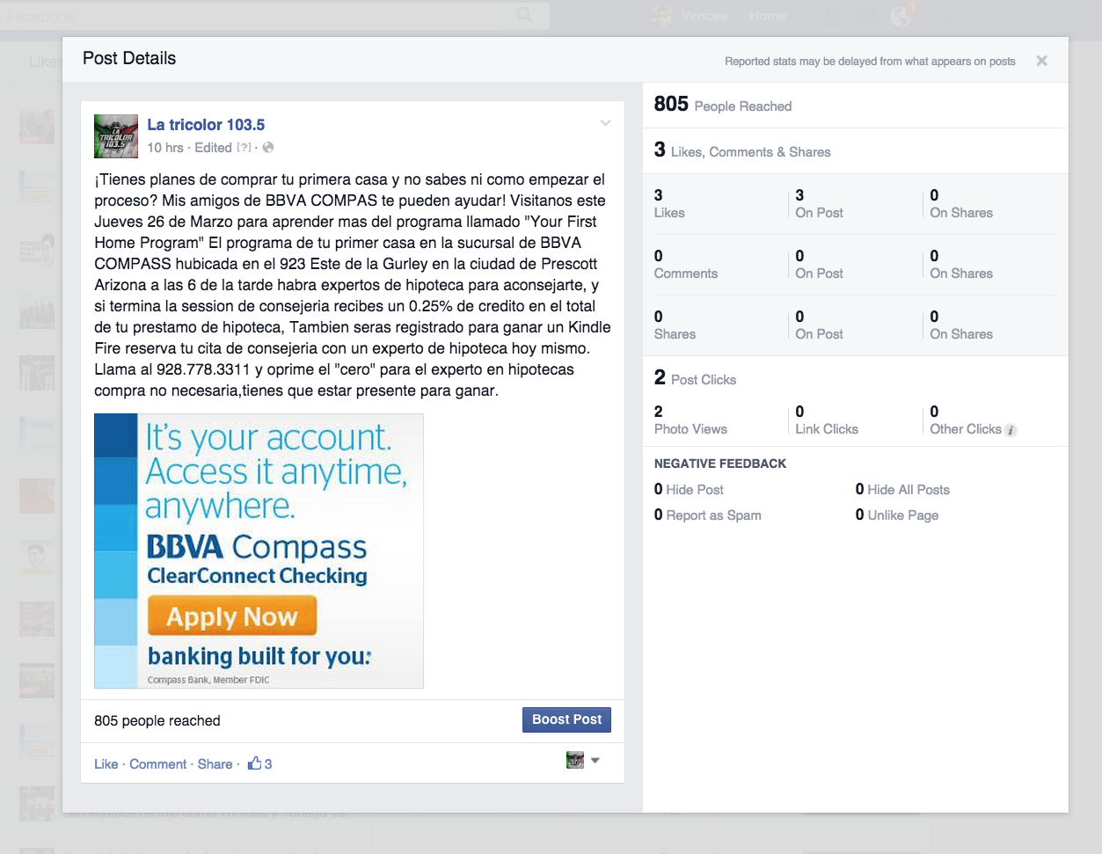
SOCIAL MEDIA POST: 3.26.15

Slide 20
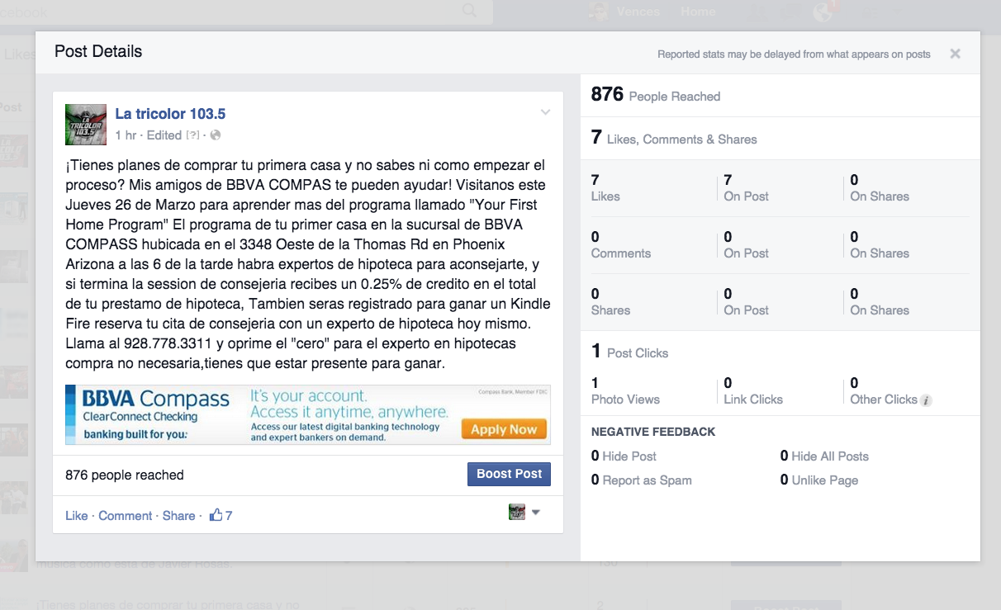
SOCIAL MEDIA POST: 3.26.15

Slide 21
Thank you!
Gracias!

