Slide 1
WCFB-FM/Lionsgate: Single Mom’s Club Promotion 3/10/14 – 3/16/14

Slide 2
WCFB-FM/Lionsgate: Single Mom’s Club Promotion 3/10/14 – 3/16/14

Slide 3
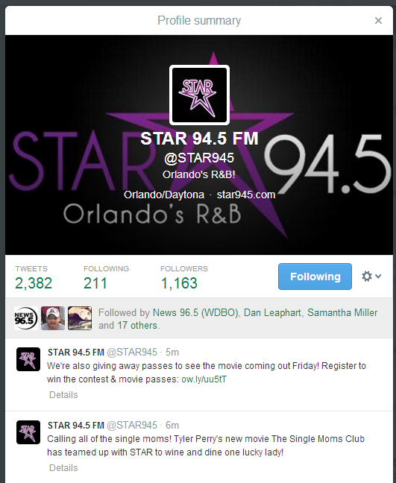
WCFB-FM/Lionsgate: Single Mom’s Club Promotion 3/10/14 – 3/16/14

Slide 4
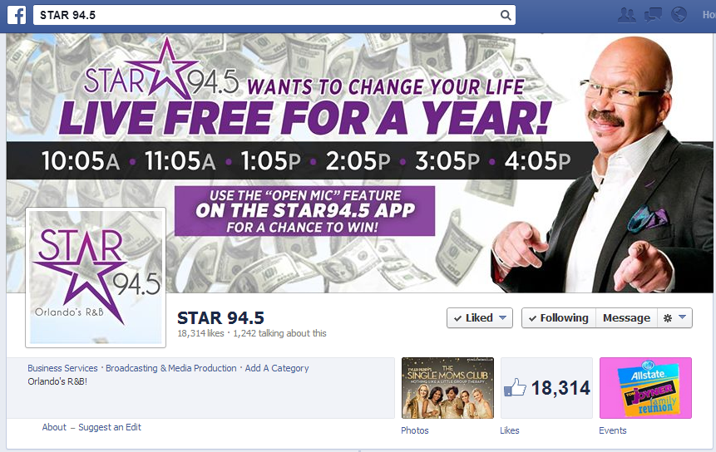
WCFB-FM/Lionsgate: Single Mom’s Club Promotion 3/10/14 – 3/16/14

Slide 5
WCFB-FM/Lionsgate: Single Mom’s Club Promotion 3/10/14 – 3/16/14

