Slide 1
95.7 R&B and Liongate
Promotional Recap for Tyler Perry’s
THE SINGLE MOMS CLUB!

Slide 2
PROMOTIONAL ITEMS:
Girls Night Out Moms need a break and 95.7 R&B wants to give it to them! Starting March 5TH to March 14TH listen to Theressa Brown & Charles Black for your chance to win tickets to see "Tyler Perry's Single Moms Club", The Tyler movie pack and be entered for the Grand prize of dinner for two of Palm Gardens Restaurant for a second chance to win go www.957rnb.com and enter online. 3/5/2014 to 3/14/2014.
MENTIONS: For this promotion I will we will air (40) :30 sec promotional announcements and (10) :15 sec promotions.
# Mentions: 50 40 x :30 10 x :15 GRAND PRIZE (Station Provides): We are going to treat our listener to either dinner out on the town or a spa day.
DIGITAL PROMOTION
Flipper to article page with video link, Movie trailer added to Station’s Website media player! Click here to see the video link on the website! SOCIAL PROMOTIONS
Social Media post promoting both the contest and the release fo the movie starting March 5th.
3/5/2014 to 3/14/2014
LIONSGATE PROVIDED PRZING:
Survival Kits
ROE Passes 12*
Mini Posters 20
Nail Files 10
Chocolate Bar 10
Hand Wipe 10
Tyler DVD Pack
Romantic DVD Pack 10

Slide 3
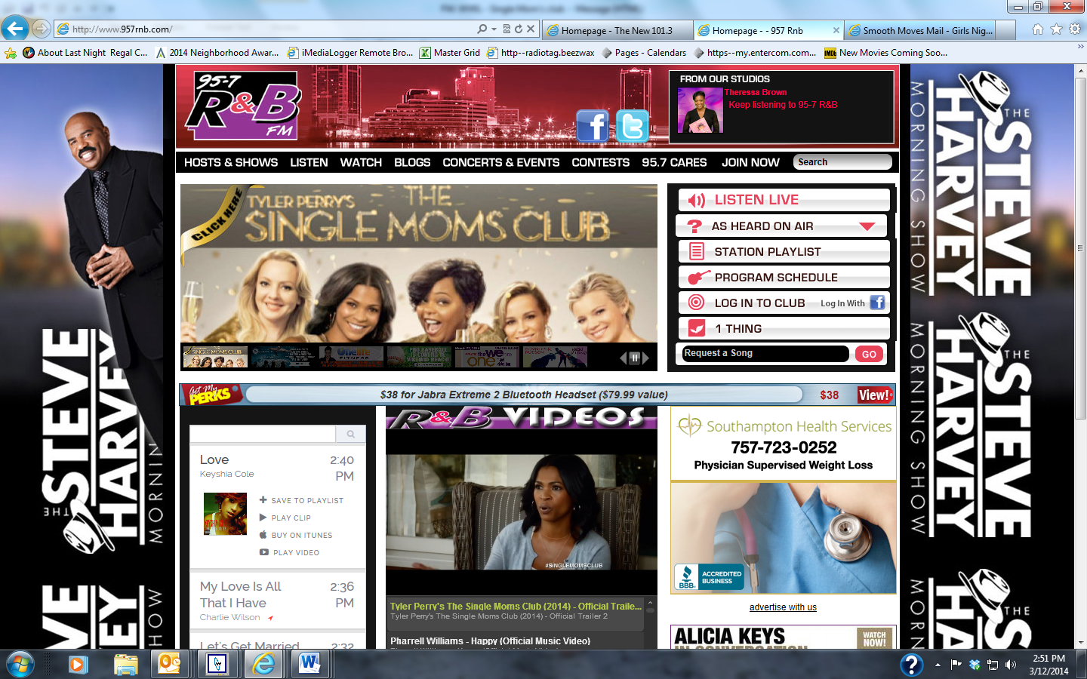
Social media post linked to the official trailer
Main Flipper on 95.7 R&B and trailer in our Media Player

