Slide 1
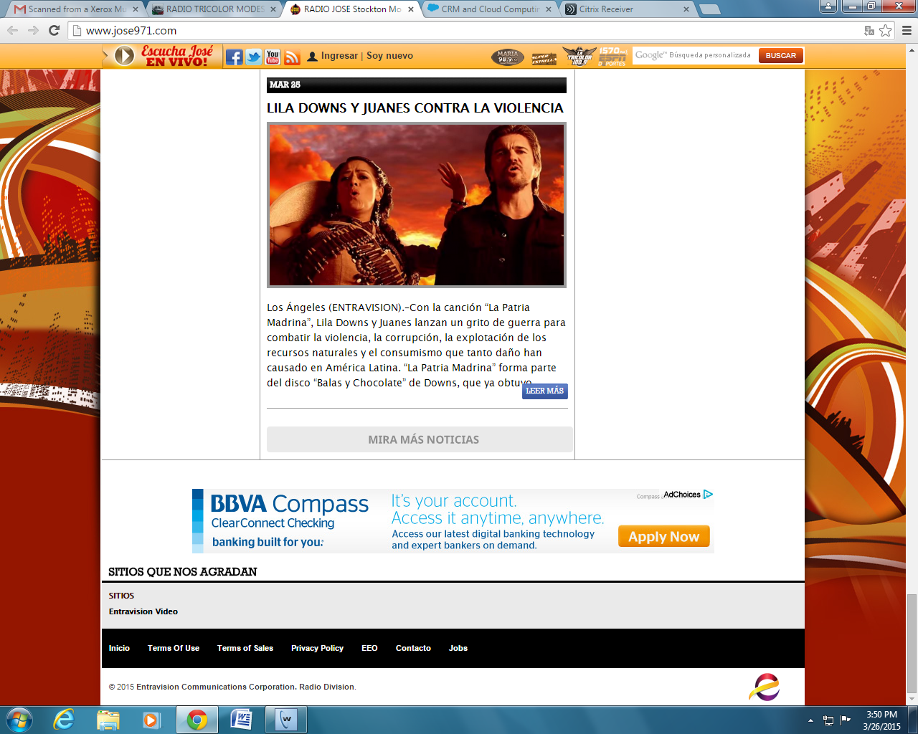
BBVA Compass Radio Promotion Recap on KTSE Jose 97.1FM for
3/26 Event

