Slide 1
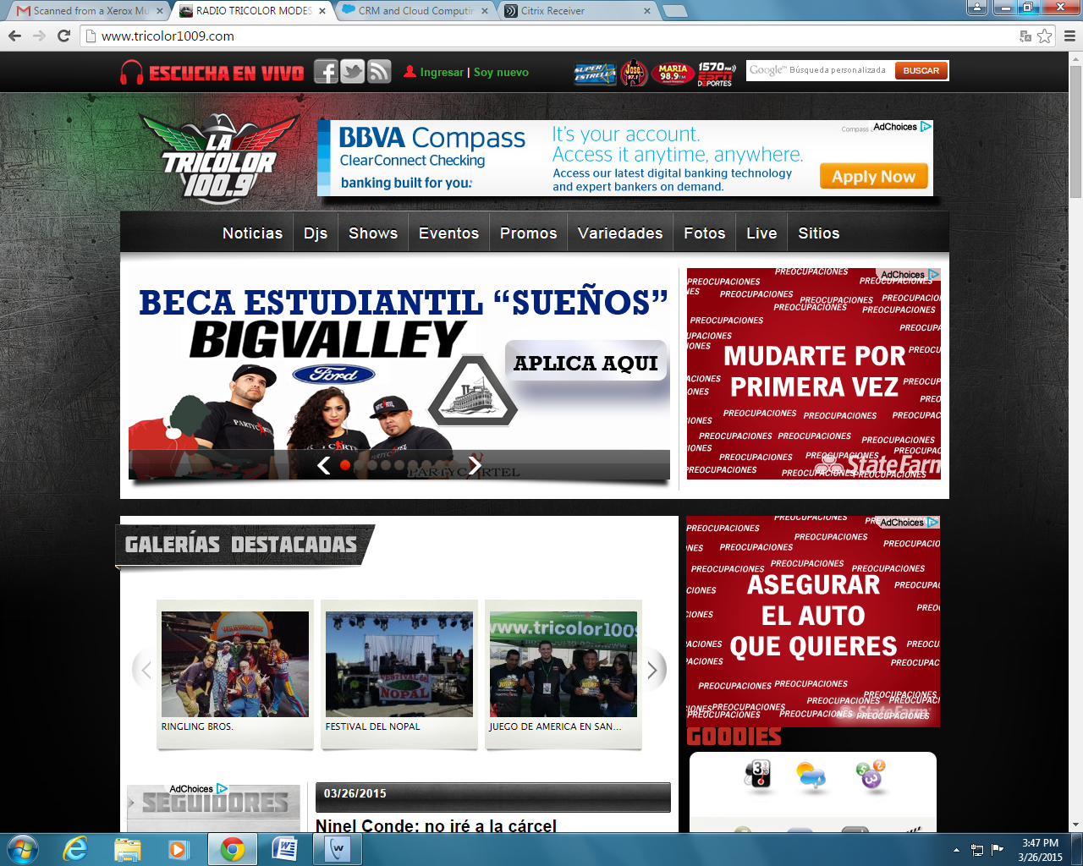
BBVA Compass Radio Promotion Recap on KMIX La Tricolor 100.9FM for 3/26 Event

