Slide 1
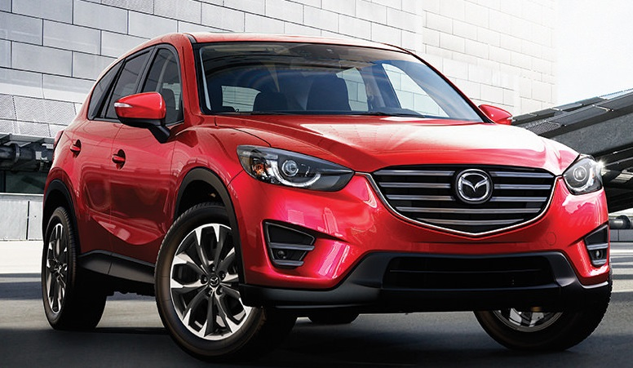
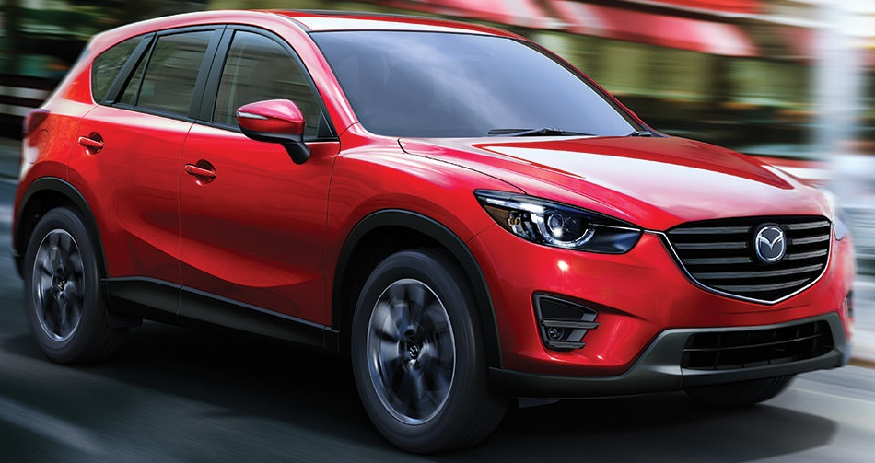
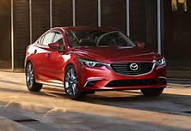
3Q16 MINNEAPOLIS DJ ENDORSEMENT RECAP

Slide 2
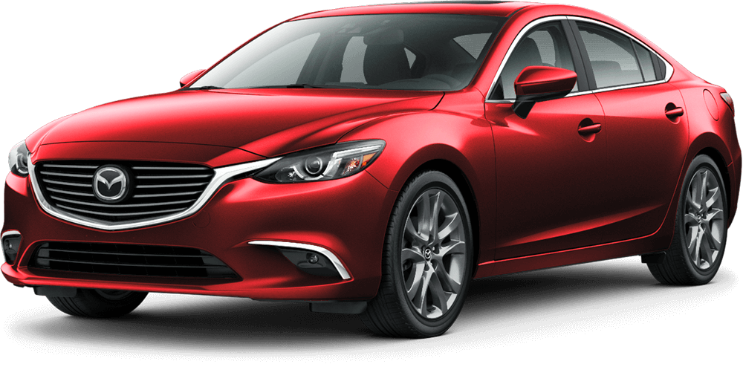
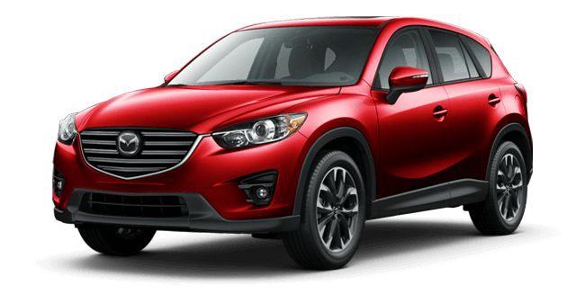
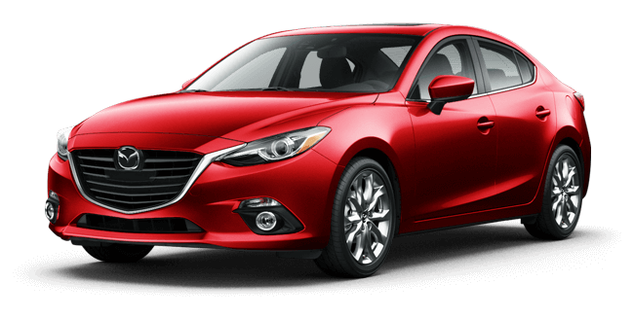
MAZDA MINNEAPOLIS DJ ENDORSEMENT
Program Overview
Mazda has had some great success breaking through the clutter on radio with DJ Endorsements, so we created a program to run in Minneapolis during 3Q16
We felt that Endorsements would be a great way to promote the brand as well as get audiences excited about Mazda’s display at the Minnesota State Fair.
Our recommendation featured 3 personalities at top stations in Minneapolis
Each station covered a different portion of the target demo
KEEY-FM’s Country audience is slightly older and divided equally between men and women
KFXN-FM provides the older end of the male sports loving audience
KSTP-FM’s Hot AC format attracts the older end of the female audience

Slide 3
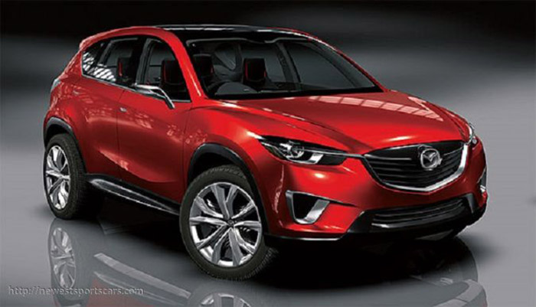
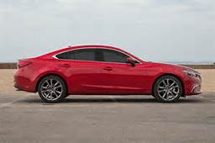
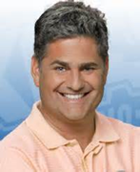
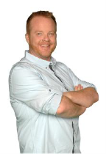
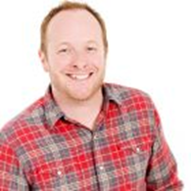
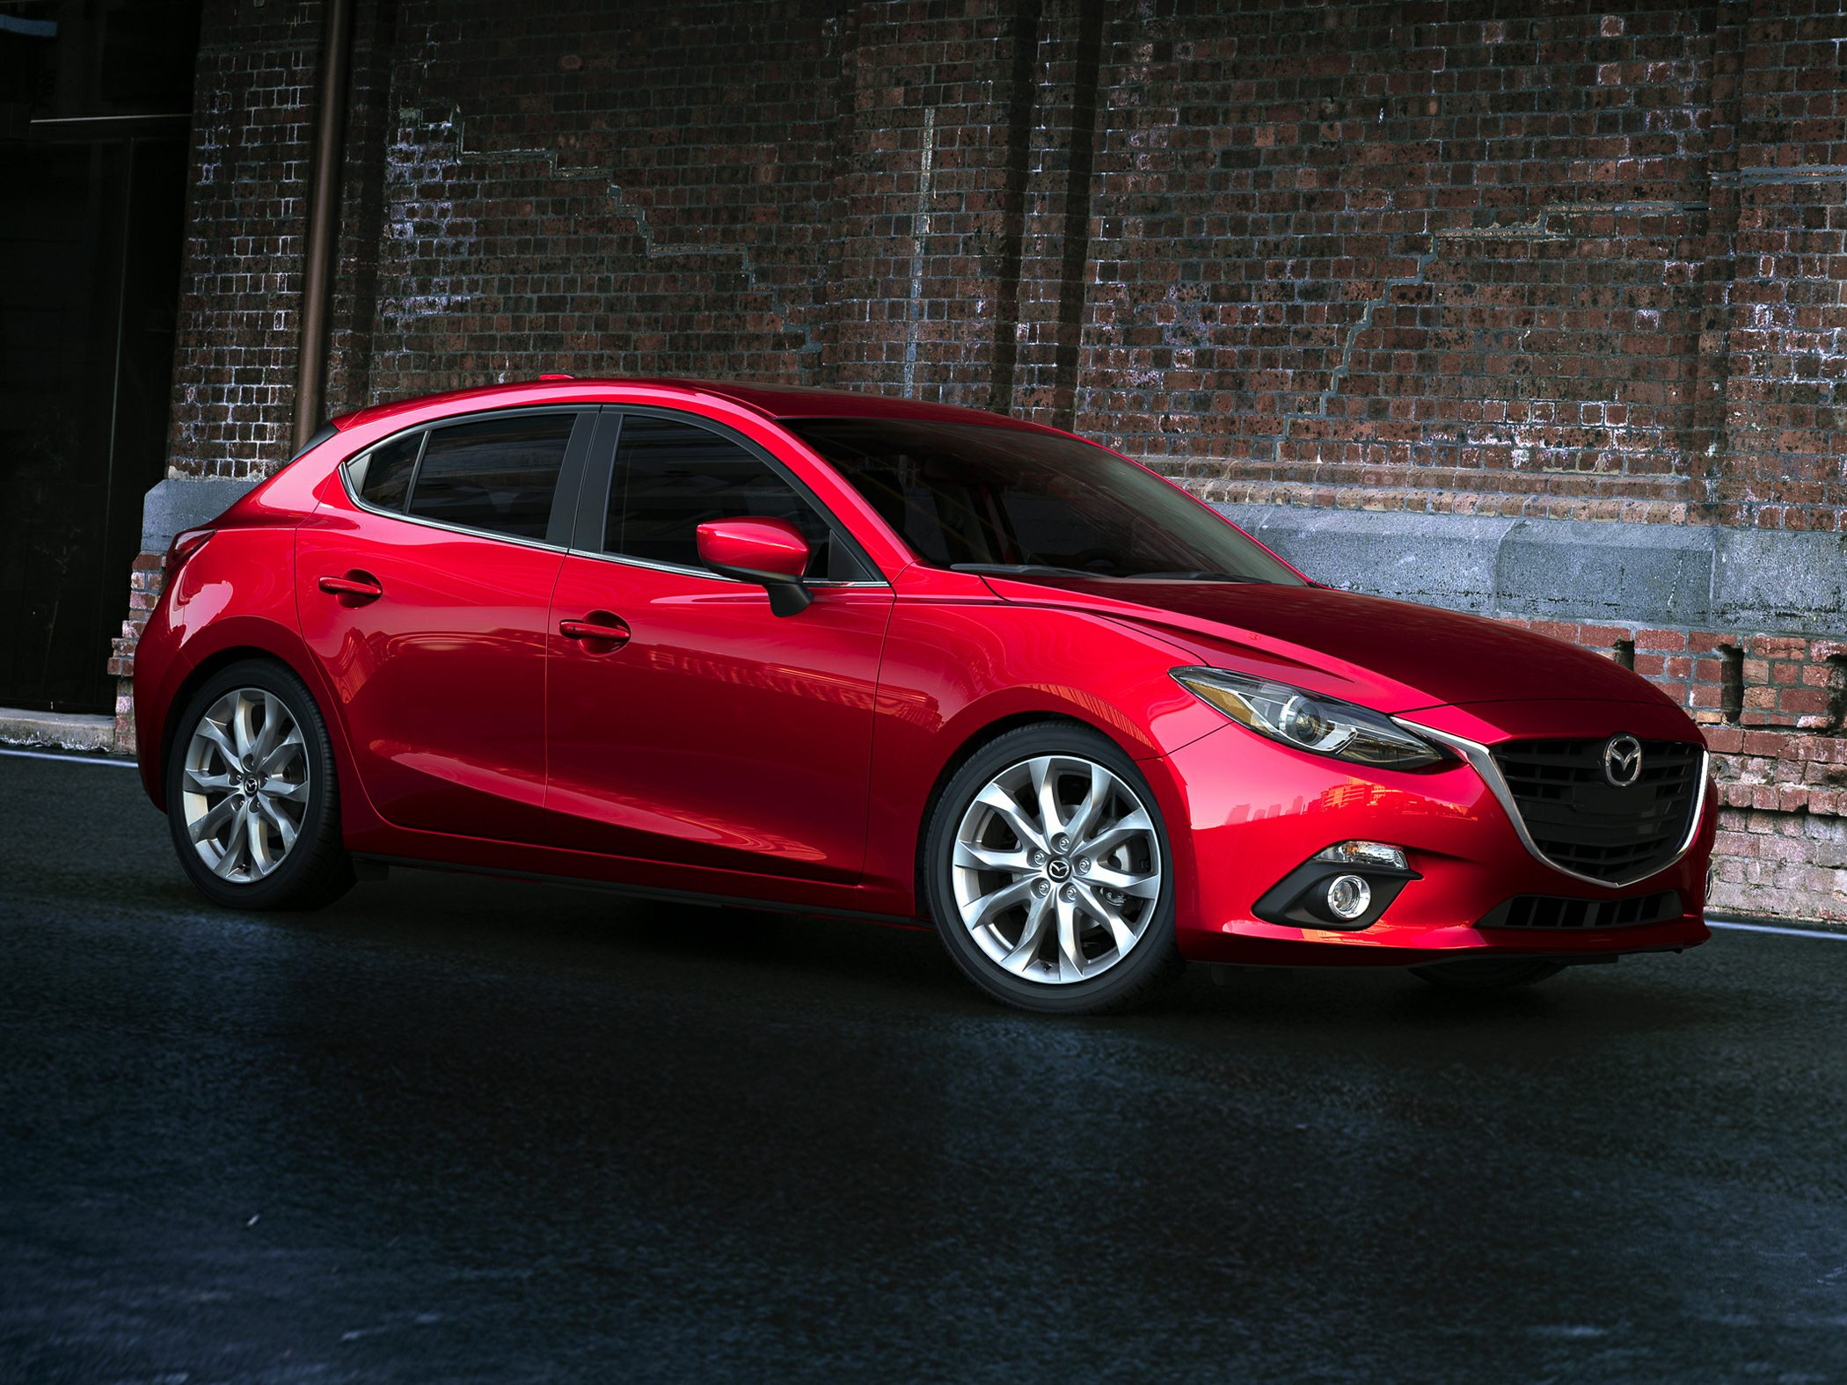
MAZDA MINNEAPOLIS DJ ENDORSEMENT
Program Overview
We gave each of the DJ’s a brand new Mazda to drive for six weeks. Each day they talked LIVE about their Mazda experience and Minnesota State Fair
We matched the Mazda vehicle that would fit best with the DJ’s lifestyle.
Muss from KEEY-FM drove a 2016 CX-5
Paul Allen from KFXN-FM drove a 2016 Mazda6
Fish from KSTP-FM drove a 2016 Mazda3

Slide 4
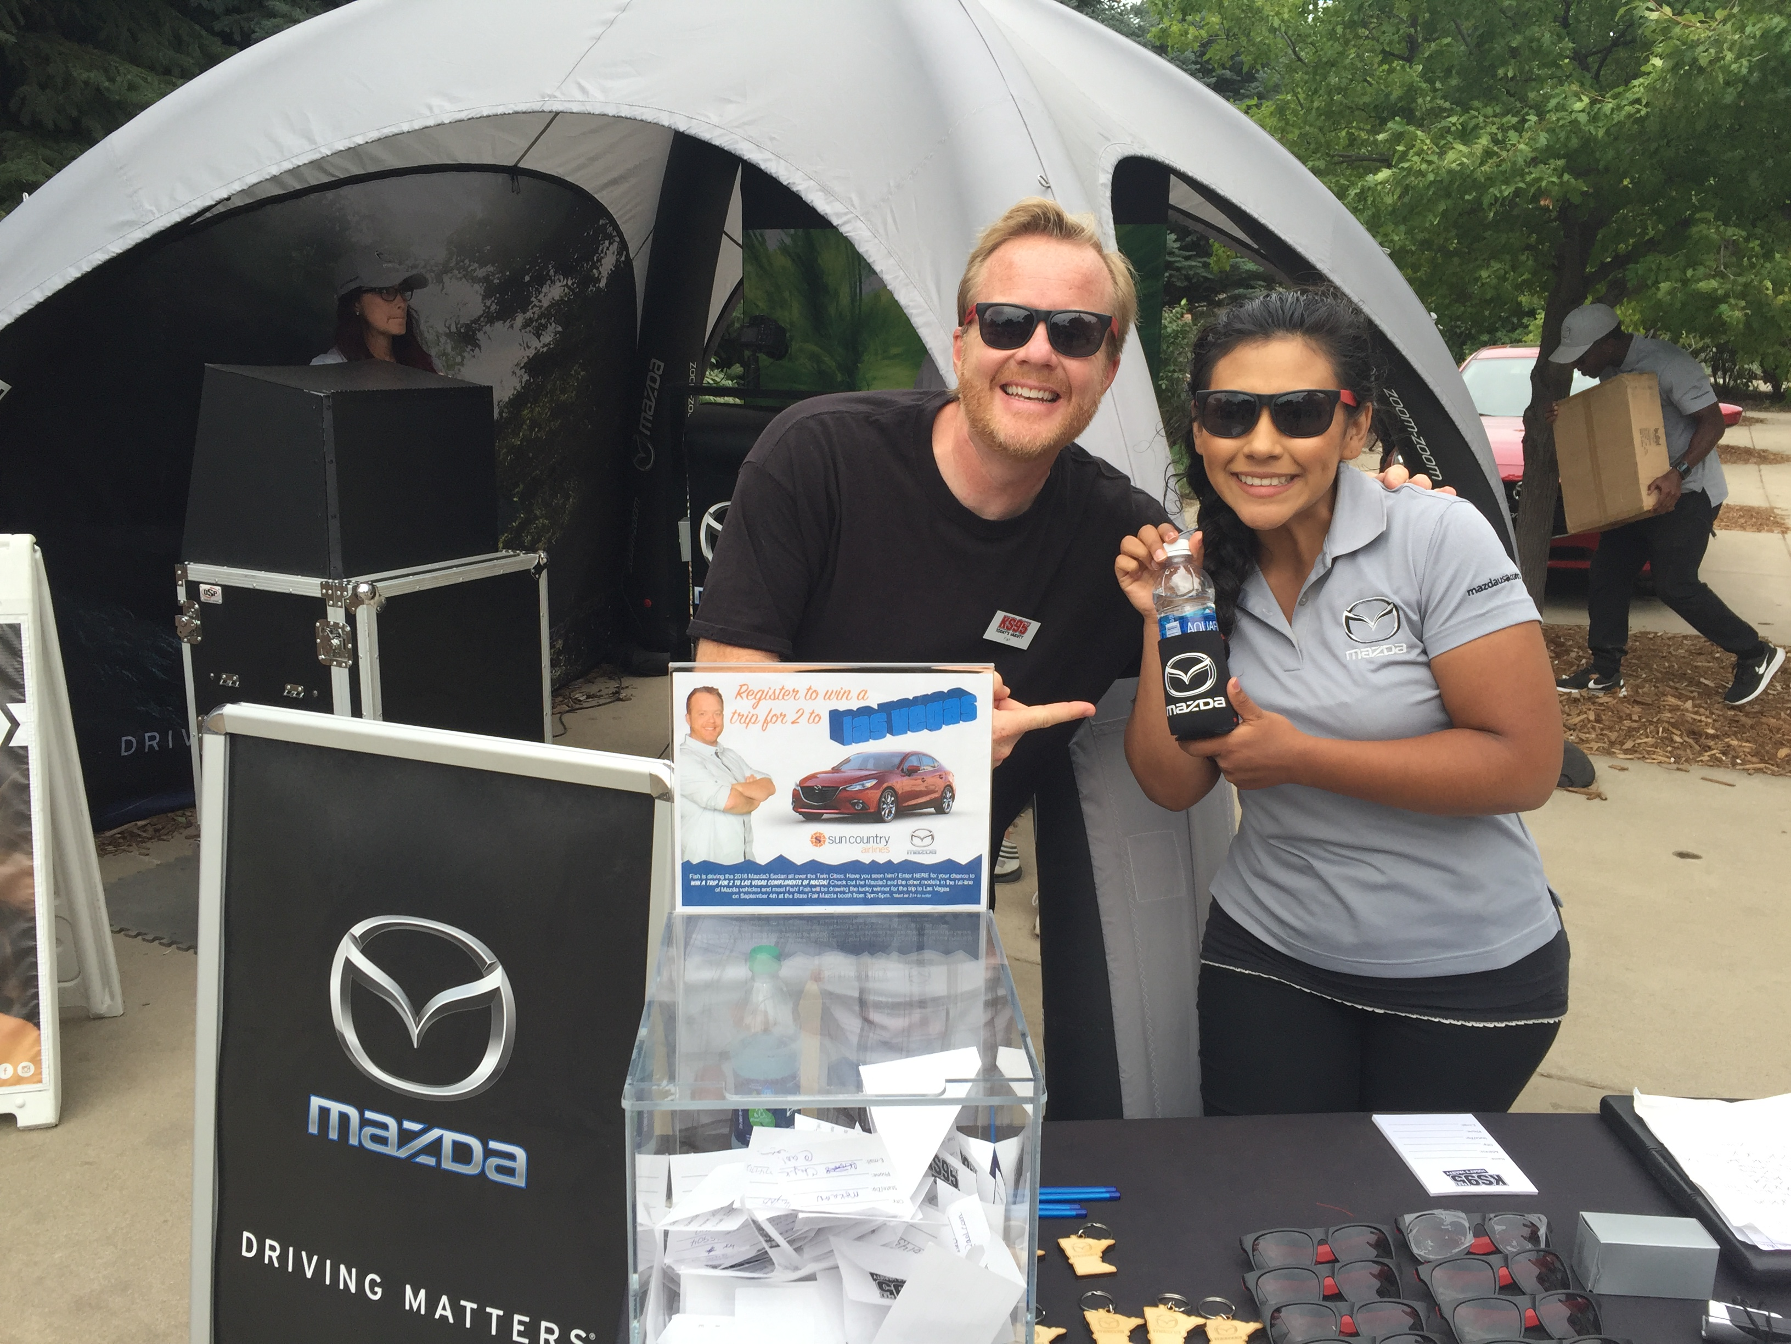
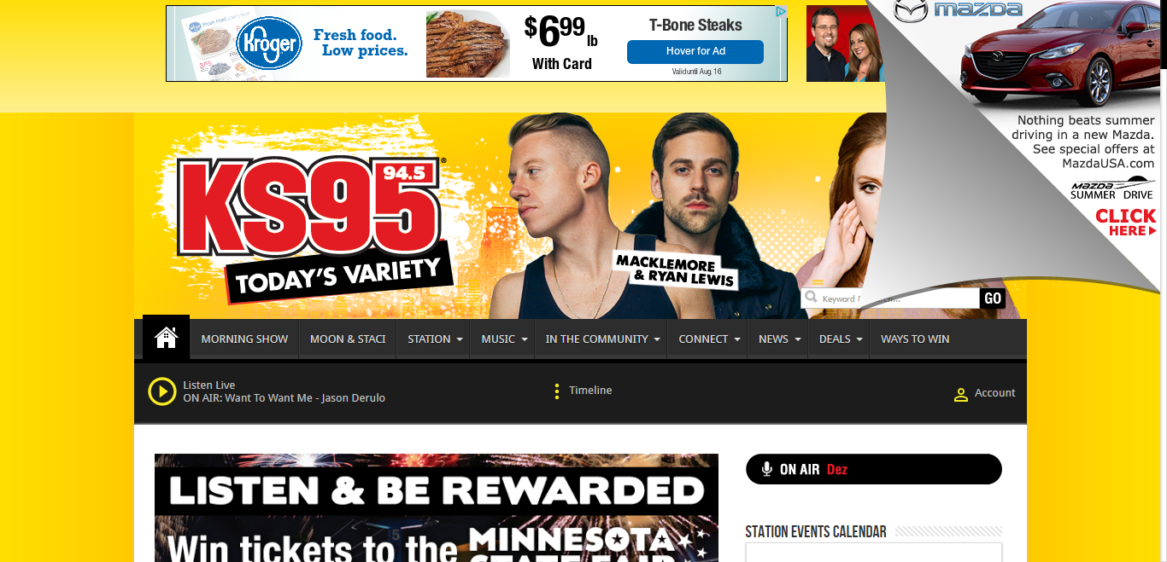
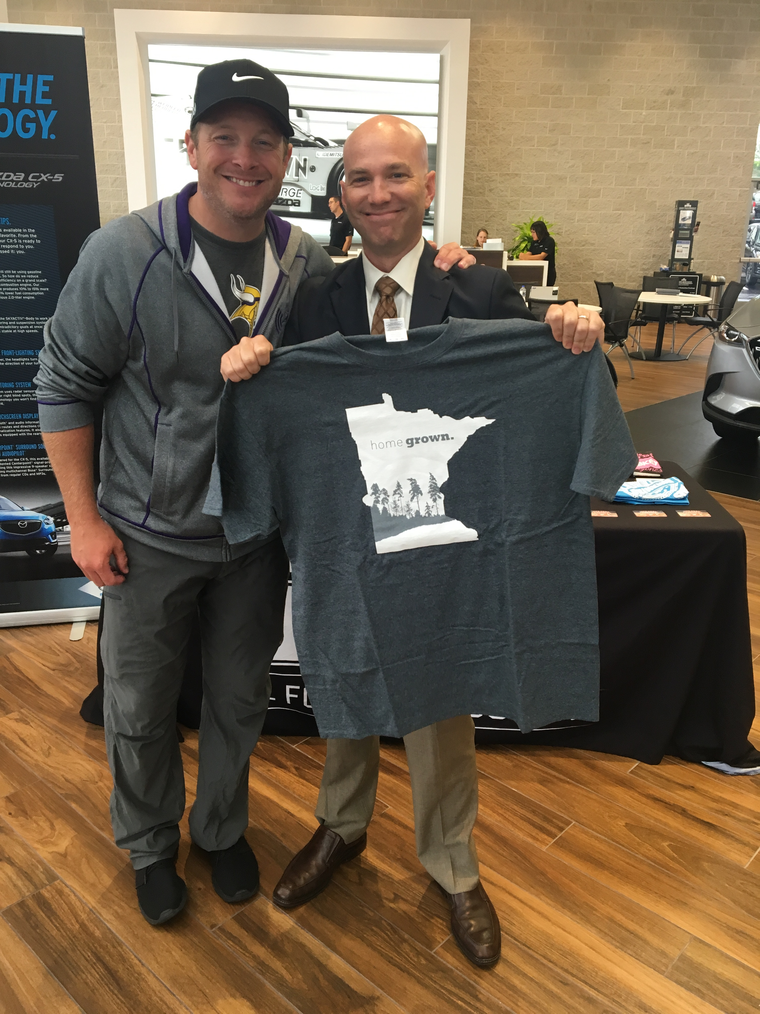
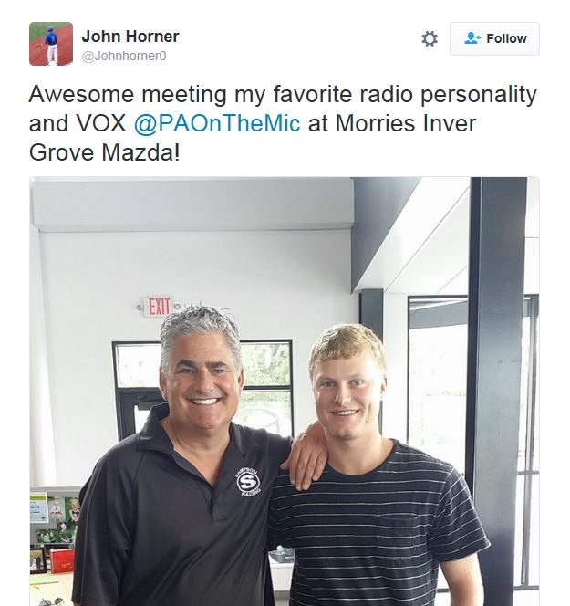
MAZDA MINNEAPOLIS DJ ENDORSEMENT
Program Overview
In addition to Daily DJ Endorsements each week, additional elements were added to make it a multi-media program
Peel-back ads and naming rights to the iHeartRadio station ALT 93.3
Social media via DJ Facebook Posts and Tweets
Six appearances by each station at each of the Twin Cities Area Mazda dealers
Appearance by KSTP-FM at the Mazda booth at the Minnesota State Fair

Slide 5
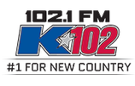
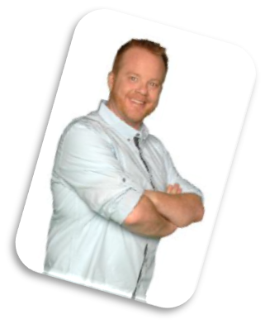
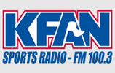
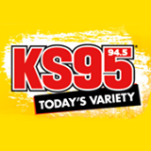
MAZDA MINNEAPOLIS DJ ENDORSEMENT
DJ Selection
We chose highly visible DJ’s from the top stations in Minneapolis
Muss from the top Country station in Minneapolis – KEEY-FM
Paul Allen from the #1 rated Midday show in the market – KFXN-FM
Fish from the KS95 Morning show on the #2 station – KSTP-FM
KEEY-FM (Country)
Muss
Afternoons (3P-7P)
KFXN-FM (Sports)
Paul Allen
Middays (9A-Noon)
KSTP-FM (Hot AC)
Fish
Of the KS95 Morning show
Mornings (5:30A-9A)

Slide 6
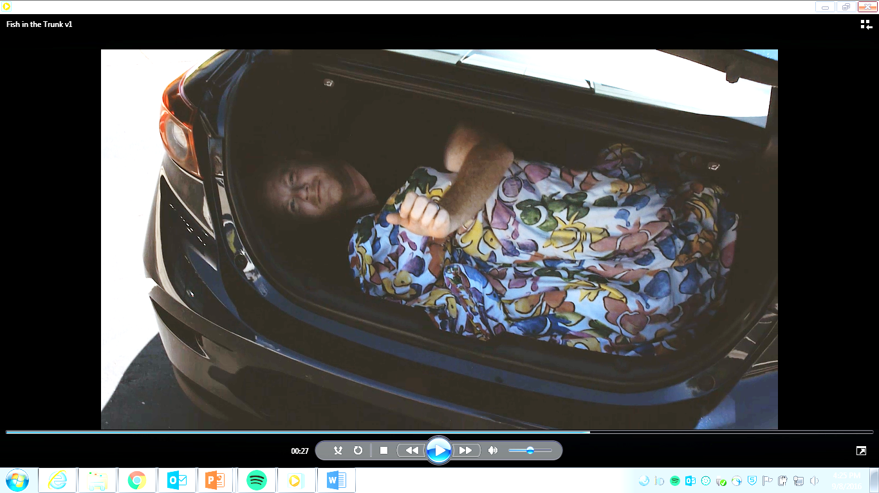
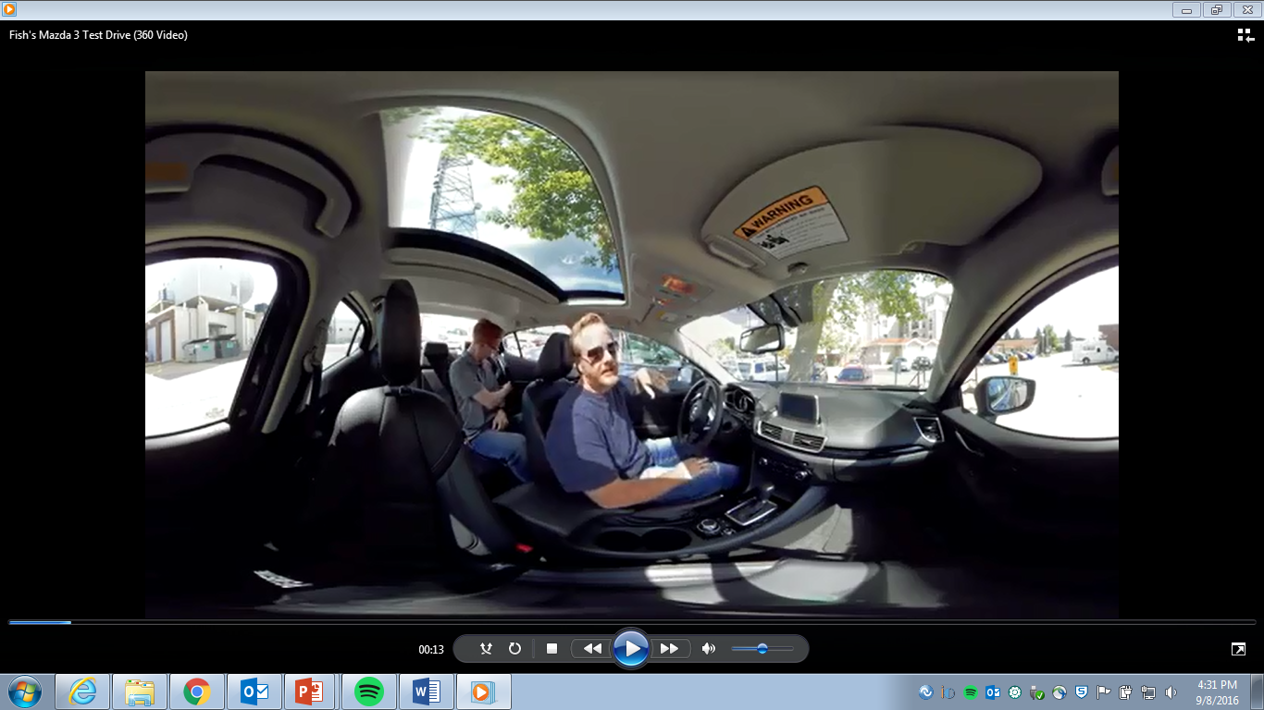
MAZDA MINNEAPOLIS DJ ENDORSEMENT
Kick Off
The DJ’s picked up their new Mazda’s at the dealers and spoke about their experience in their endorsement spots.
KSTP-FM and KFXN-FM shot a “walk through” video with the personality showing off the highlights of their vehicle. These video’s were posted on the website to create a “virtual test drive” for listeners.
Throughout the 6 week campaign
DJ shared their experiences and discoveries of their new Mazda vehicles with their audience on air and posted photo’s of the vehicles on social media.

Slide 7
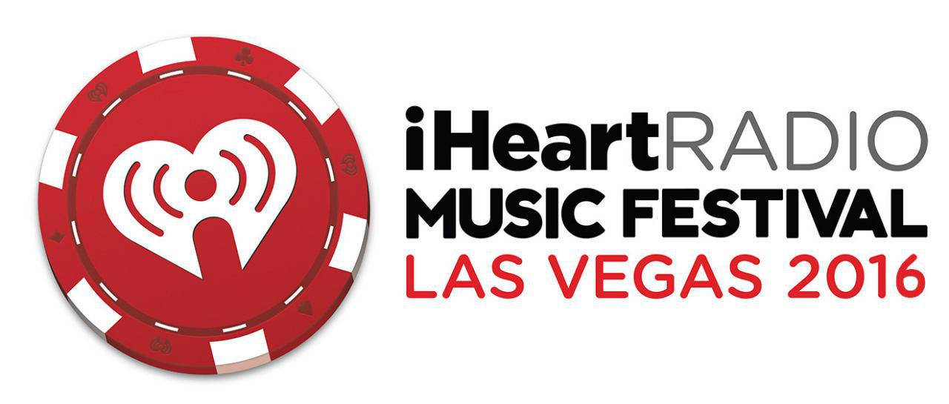
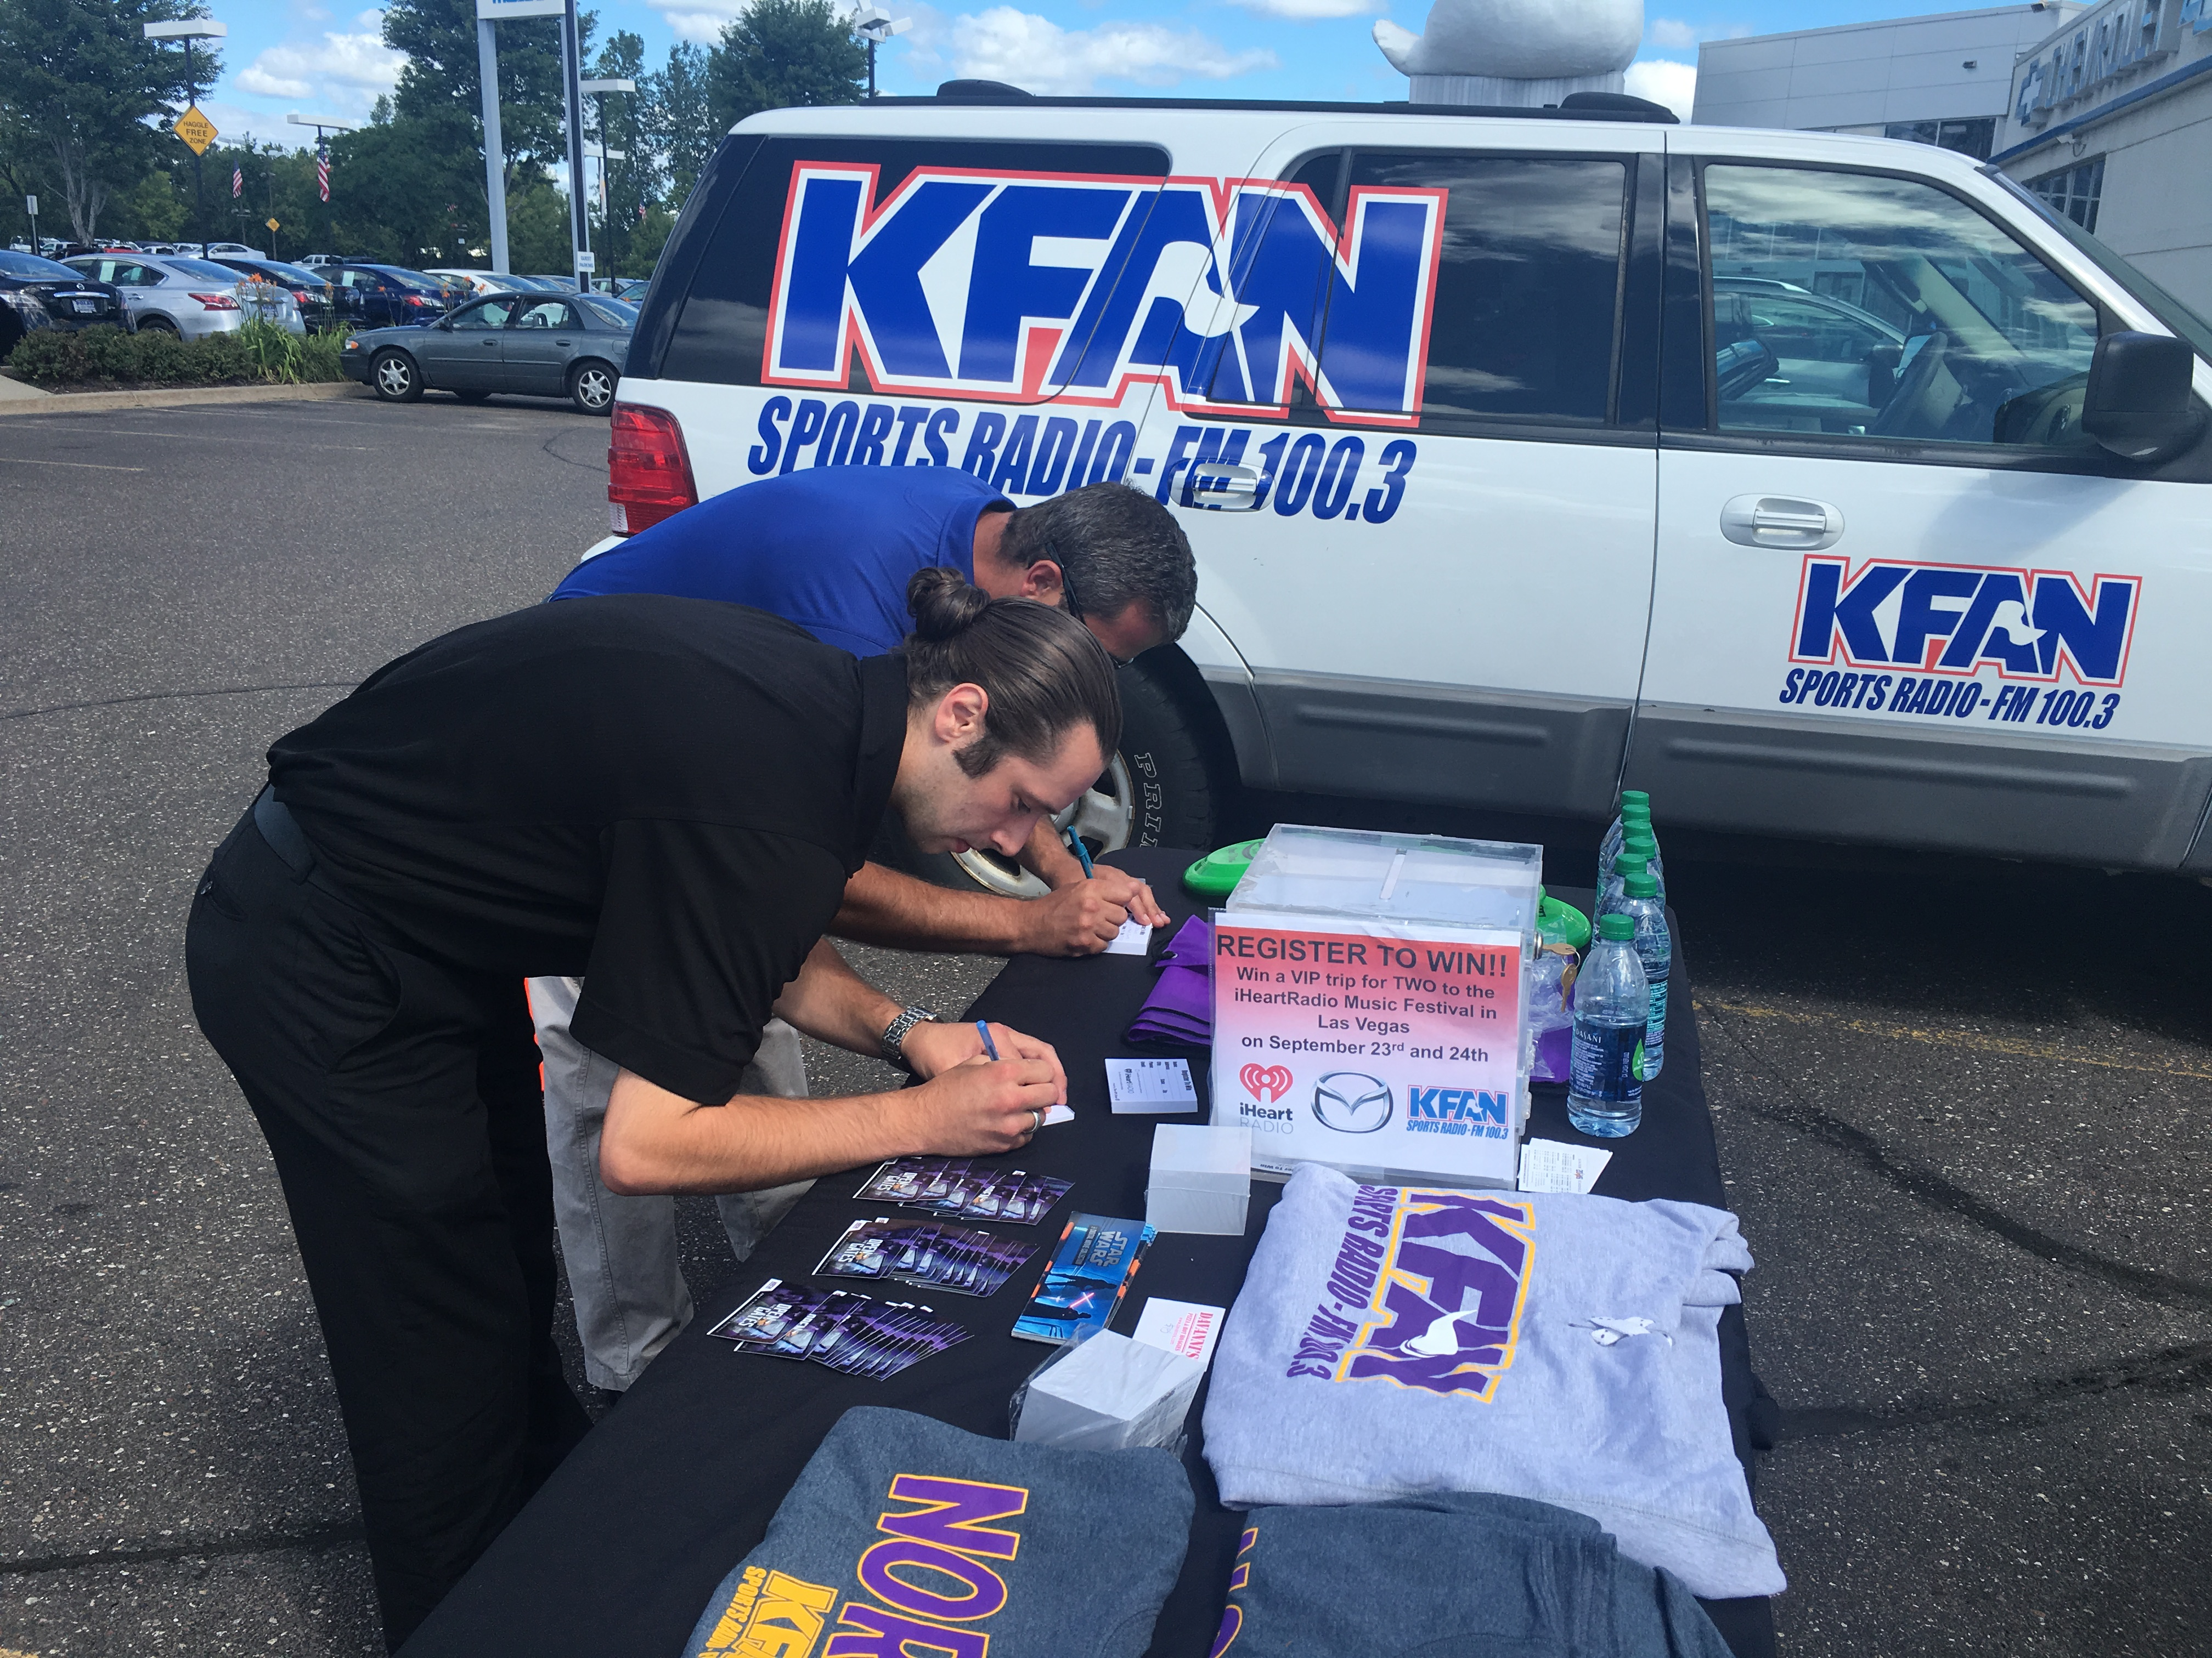
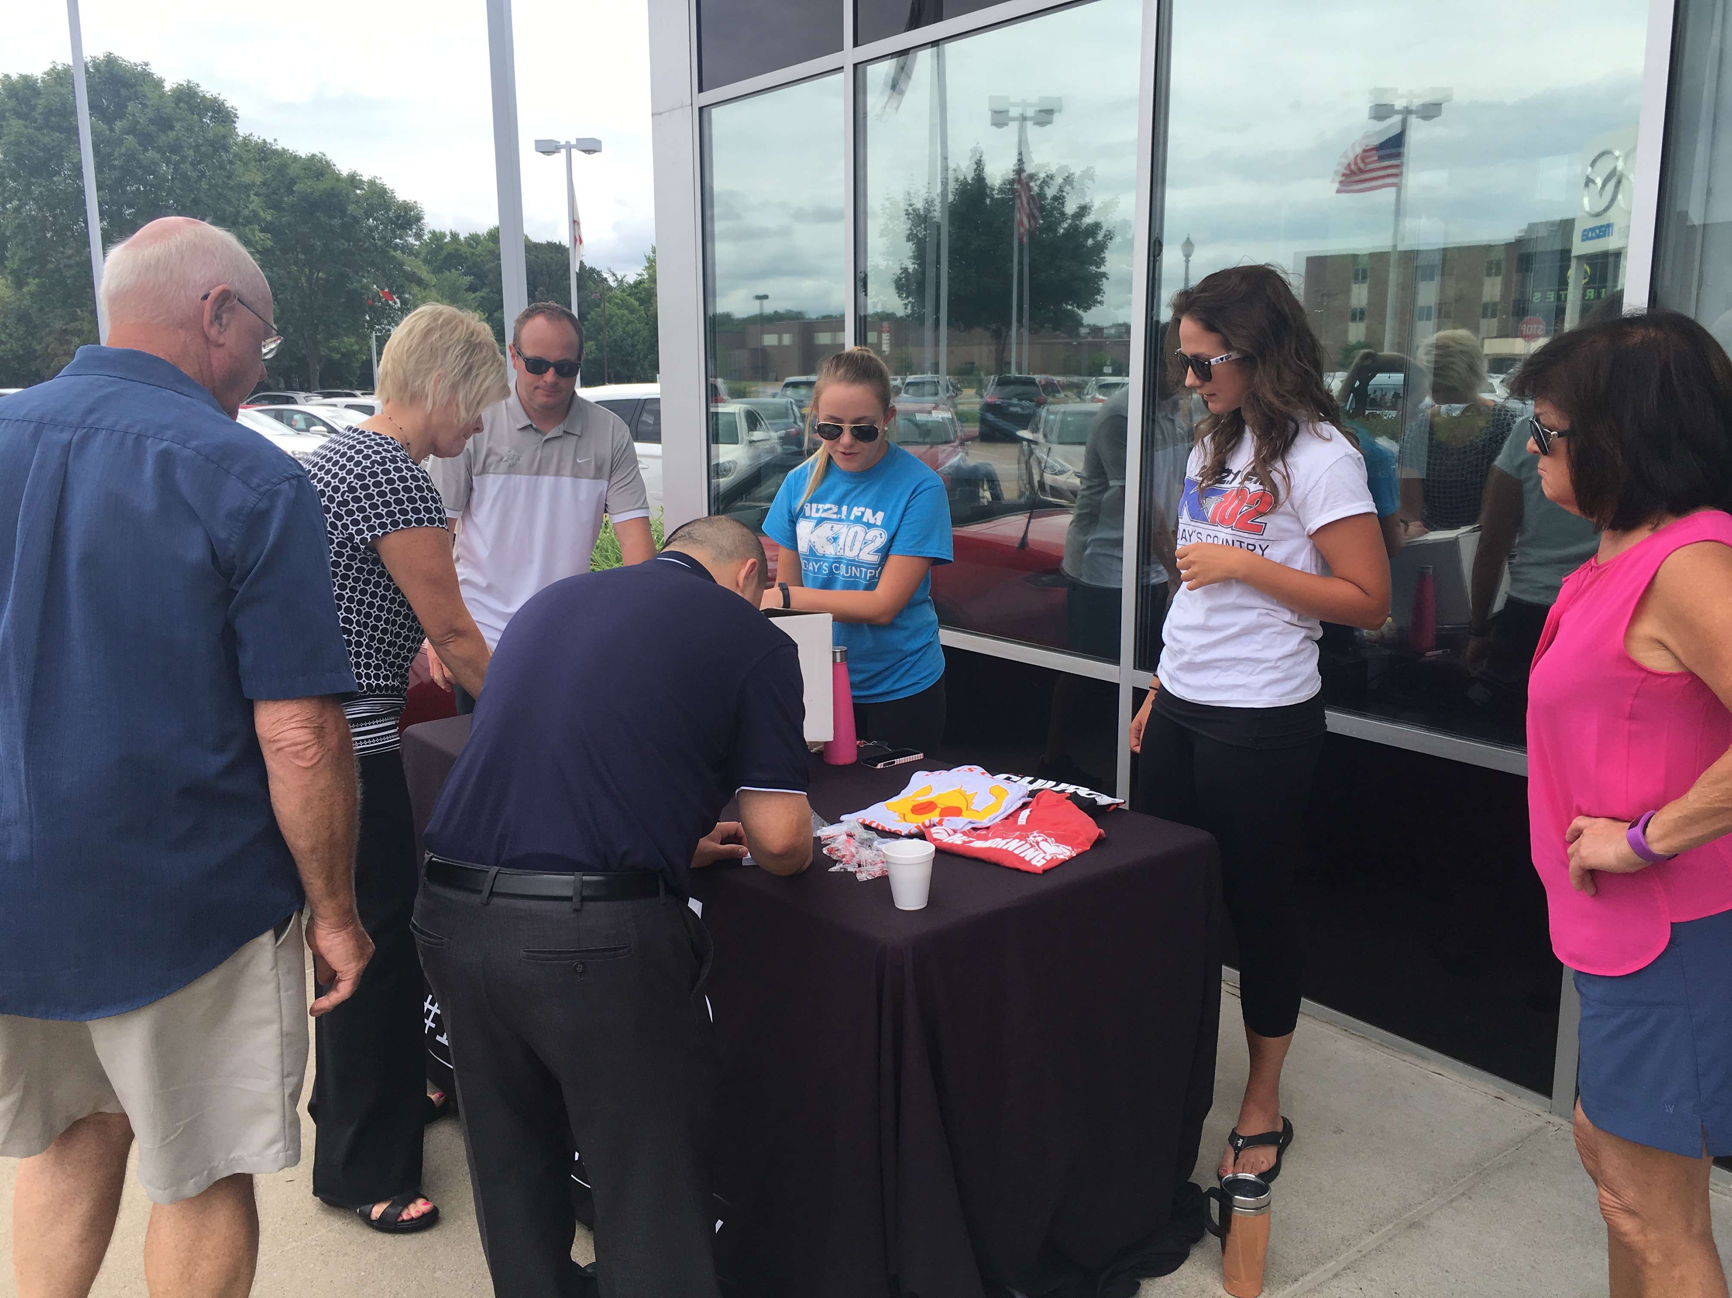
MAZDA MINNEAPOLIS DJ ENDORSEMENT
iHeartRadio Music Festival 2016
At each of KEEY-FM and KFXN-FM’s six remotes, listeners registered to win a trip of a lifetime – a pair
of tickets to the iHeartRadio Music Festival! The trip included round-trip airfare, a two night hotel stay and a pair of tickets to the festival happening September 23rd and 24th in Las Vegas!
Mazda received:
Twelve total two hour remotes where listeners could enter to win
45 Live and recorded promotional announcements
Event posting on stations events page
Social media postings on Facebook and Twitter

Slide 8
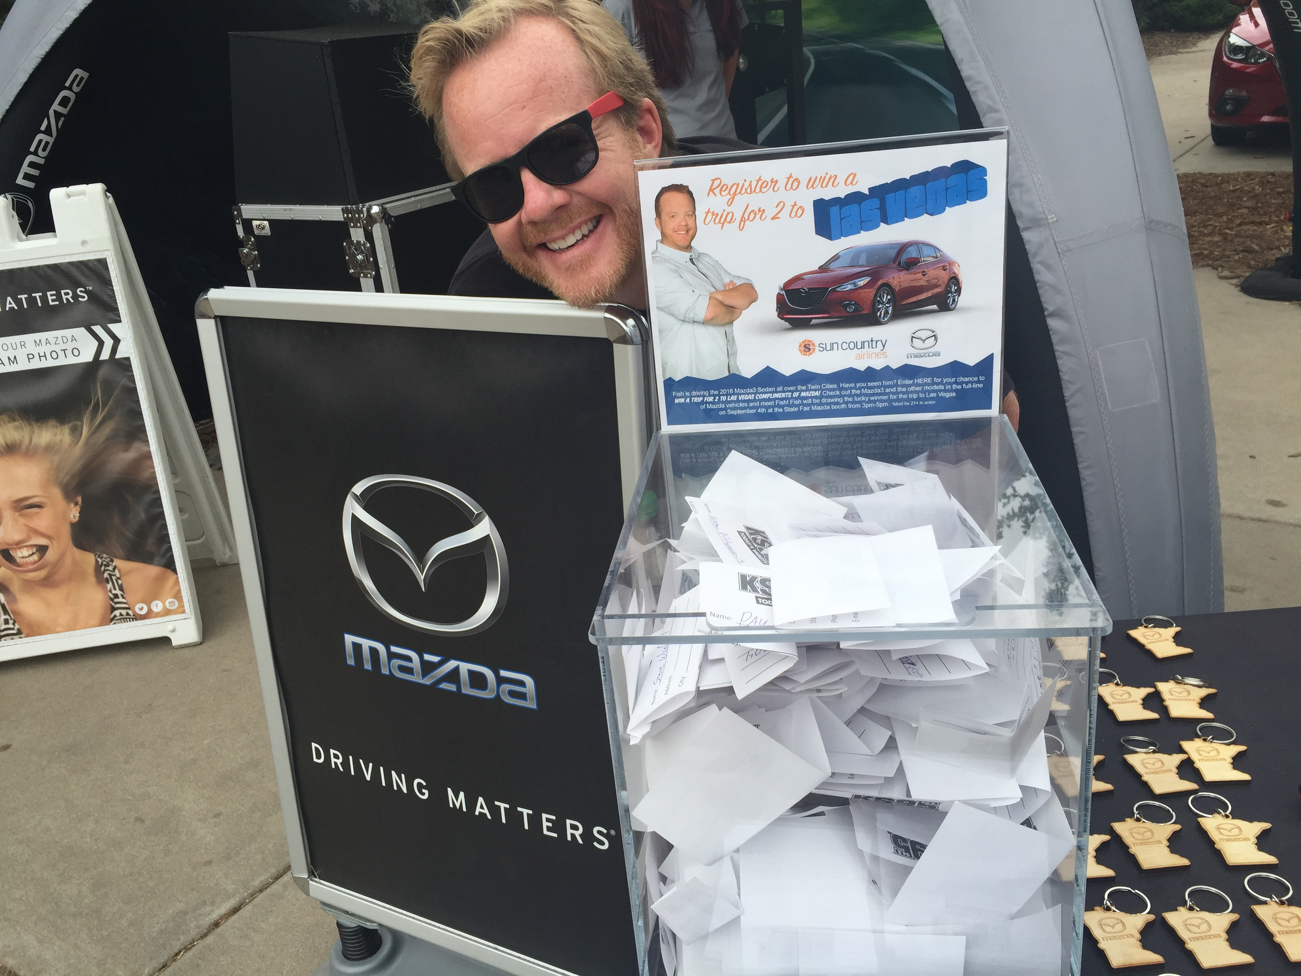
MAZDA MINNEAPOLIS DJ ENDORSEMENT
KSTP-FM’s Trip for two to Las Vegas!
At each of the seven remotes, Fish and KSTP-FM
registered listeners to win a trip for two to Las Vegas.
Prize included round trip airfare for two and a three
night hotel stay in Sin City, courtesy of Mazda! The
grand prize winner was picked at the Mazda booth at
the Minnesota State Fair!
Mazda received:
Seven two hour remotes where listeners could enter to win
49 Live and recorded promotional announcements
Event posting on stations events page
Social media support

Slide 9
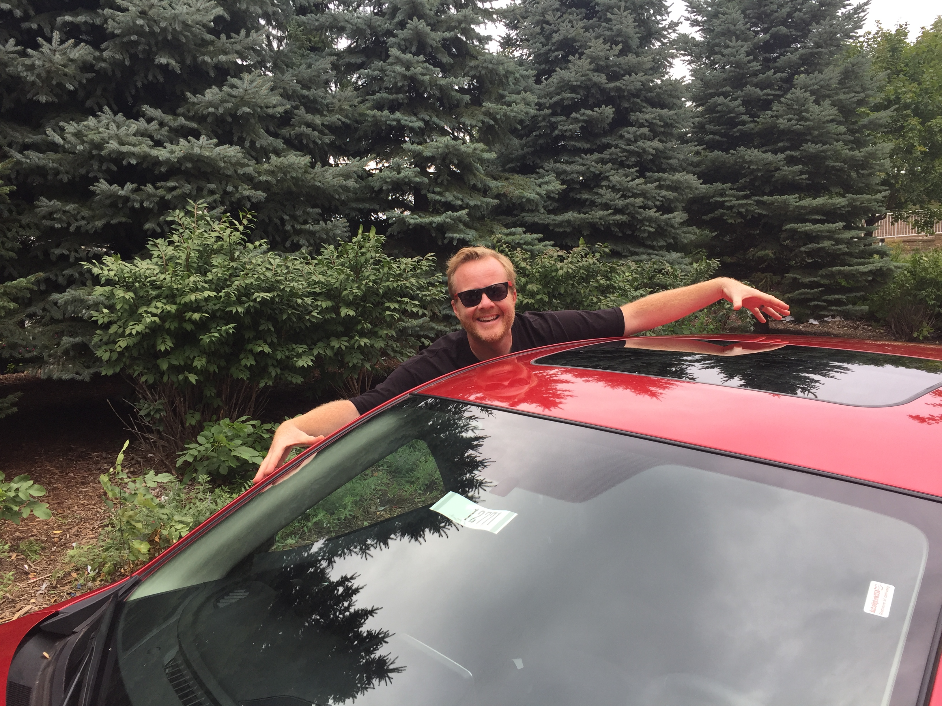
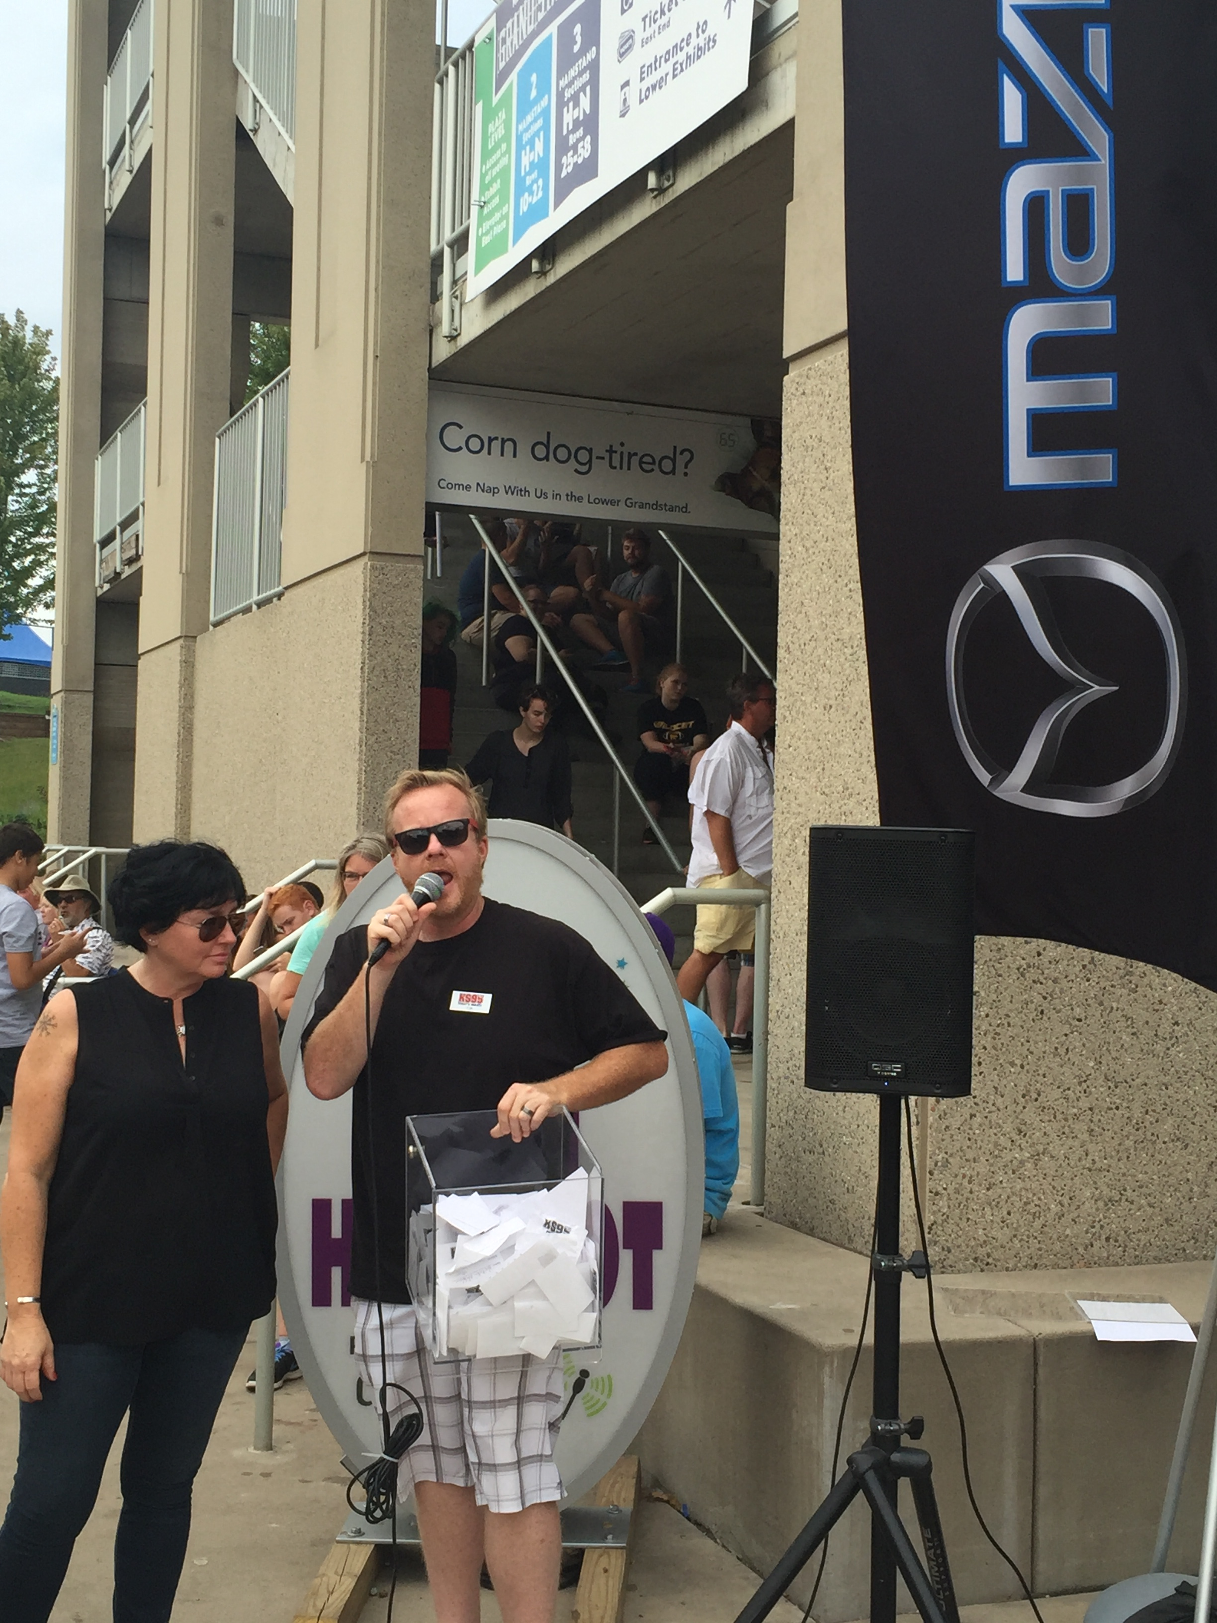
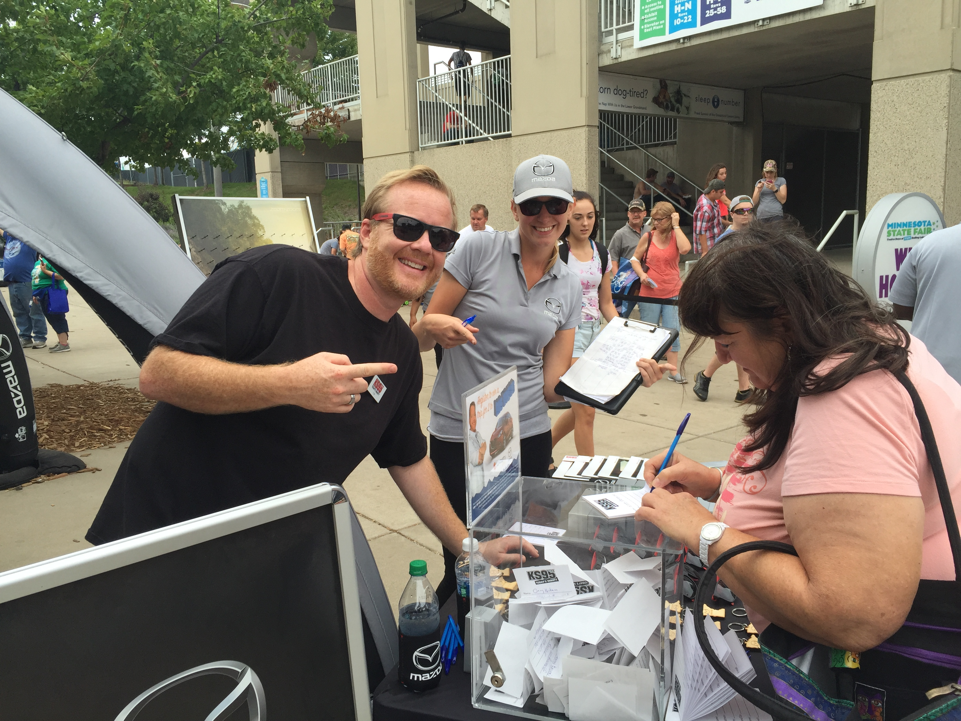
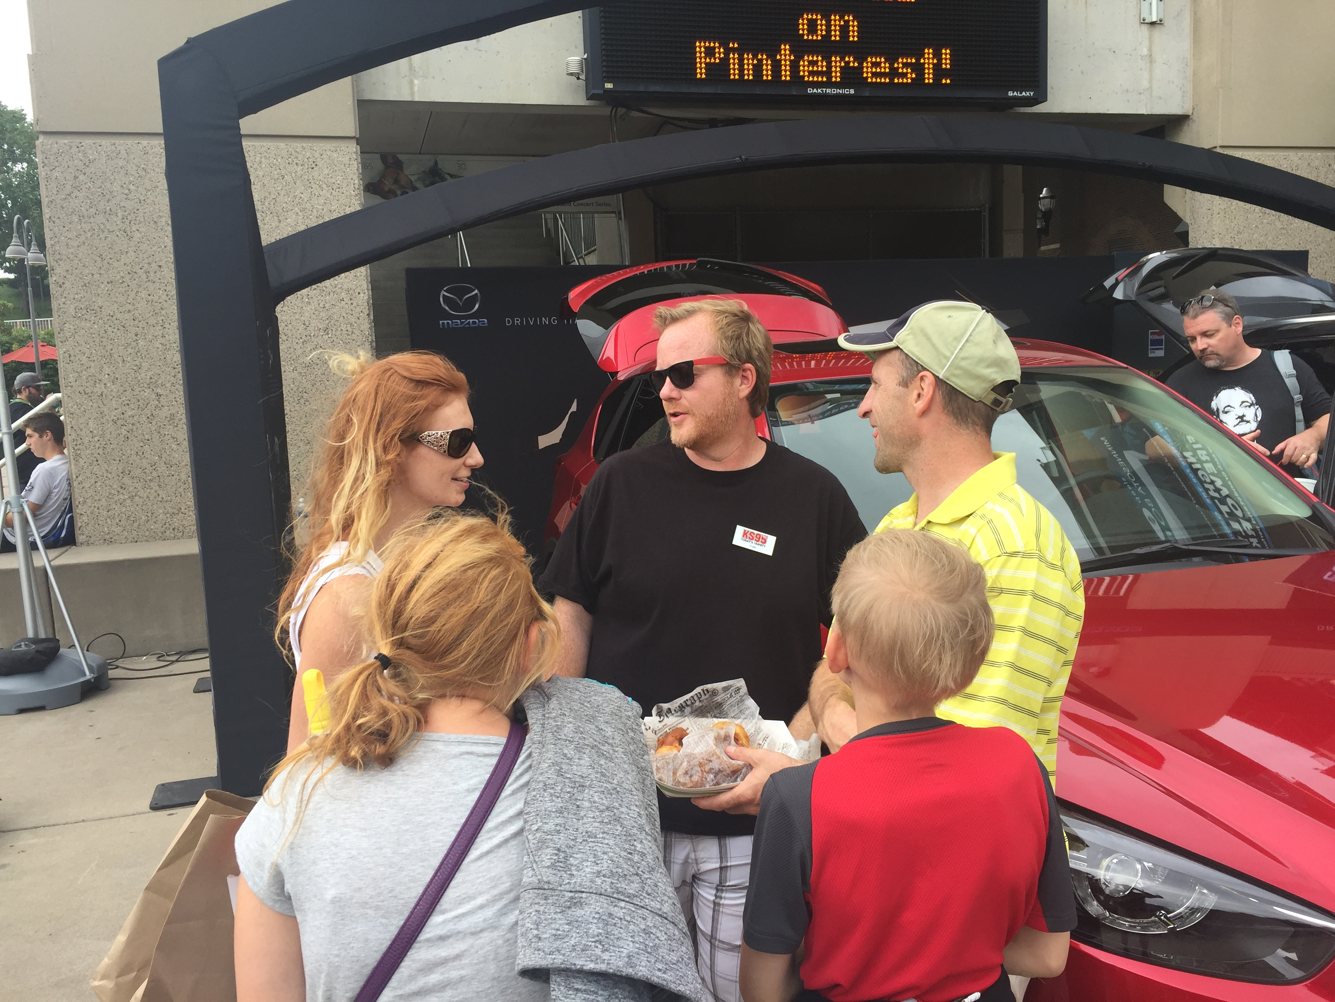
MAZDA MINNEAPOLIS DJ ENDORSEMENT
Minnesota State Fair
Mazda had a display at the 2016 Minnesota State Fair
Event took place at the Minnesota State Fairgrounds August 25th – September 5th, 2016
Fish from the KSTP-FM Morning Show was at the Mazda booth on Sunday, September 4th from 3p-5p and picked the winner of the Las Vegas trip!

Slide 10
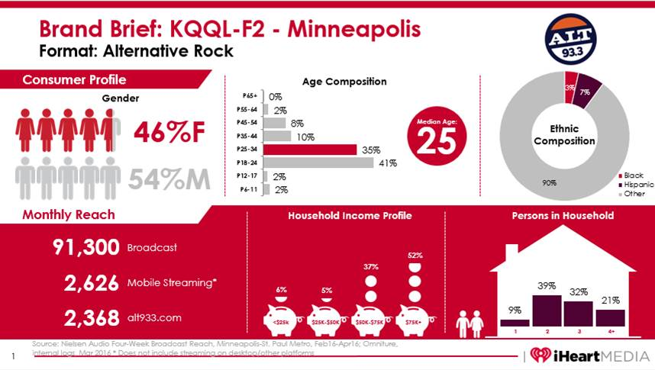
MAZDA MINNEAPOLIS DJ ENDORSEMENT
ALT 93.3 Studio Naming Rights
As added value, iHeartMedia gave Mazda the Studio Naming Rights to KQQL-F2
The Twin Cities Area Mazda Dealers receives 1 ID tag every hour of the day from 8/1/16 – 12/25/16 for a total of 7,056 on-air and streaming mentions!

Slide 11
MAZDA MINNEAPOLIS DJ ENDORSEMENT
Results
Over the course of the six week promotion, Minneapolis radio listeners were inundated with Mazda branding. They heard and saw…
180 different Live Endorsements Spots (3 DJs on 3 stations over 6 weeks)
440 recorded :60 and :30 Mazda Radio Spots
That’s 620 spots generating 10,554,800 12+ impressions!!
3,528 on-air and 3,528 streaming mentions on ATL 93.3 (KQQL-F2)
That’s 7,056 spots generating 960,794 12+ impressions!
3 Radio Stations Made 6 Appearances at 6 dealers over 6 weeks
Plus one appearance with KSTP-FM’s Fish at the Mazda booth at the Minnesota State Fair.
3,425,163 Impressions from digital and social media
From Peel-back Ads, Social Media (Twitter and Facebook) and Event Listings
1,707,200 impressions from 94 Mazda promotional announcements
KEEY-FM and KFXN-FM’s iHeartRadio Music Festival (45) and KSTP-FM Las Vegas Trip giveaway (49)
Total Campaign Impressions: 16,647,957

