Slide 1
WHQT-FM/Lionsgate: Single Mom’s Club Promotion 3/3/14 – 3/16/14

Slide 2
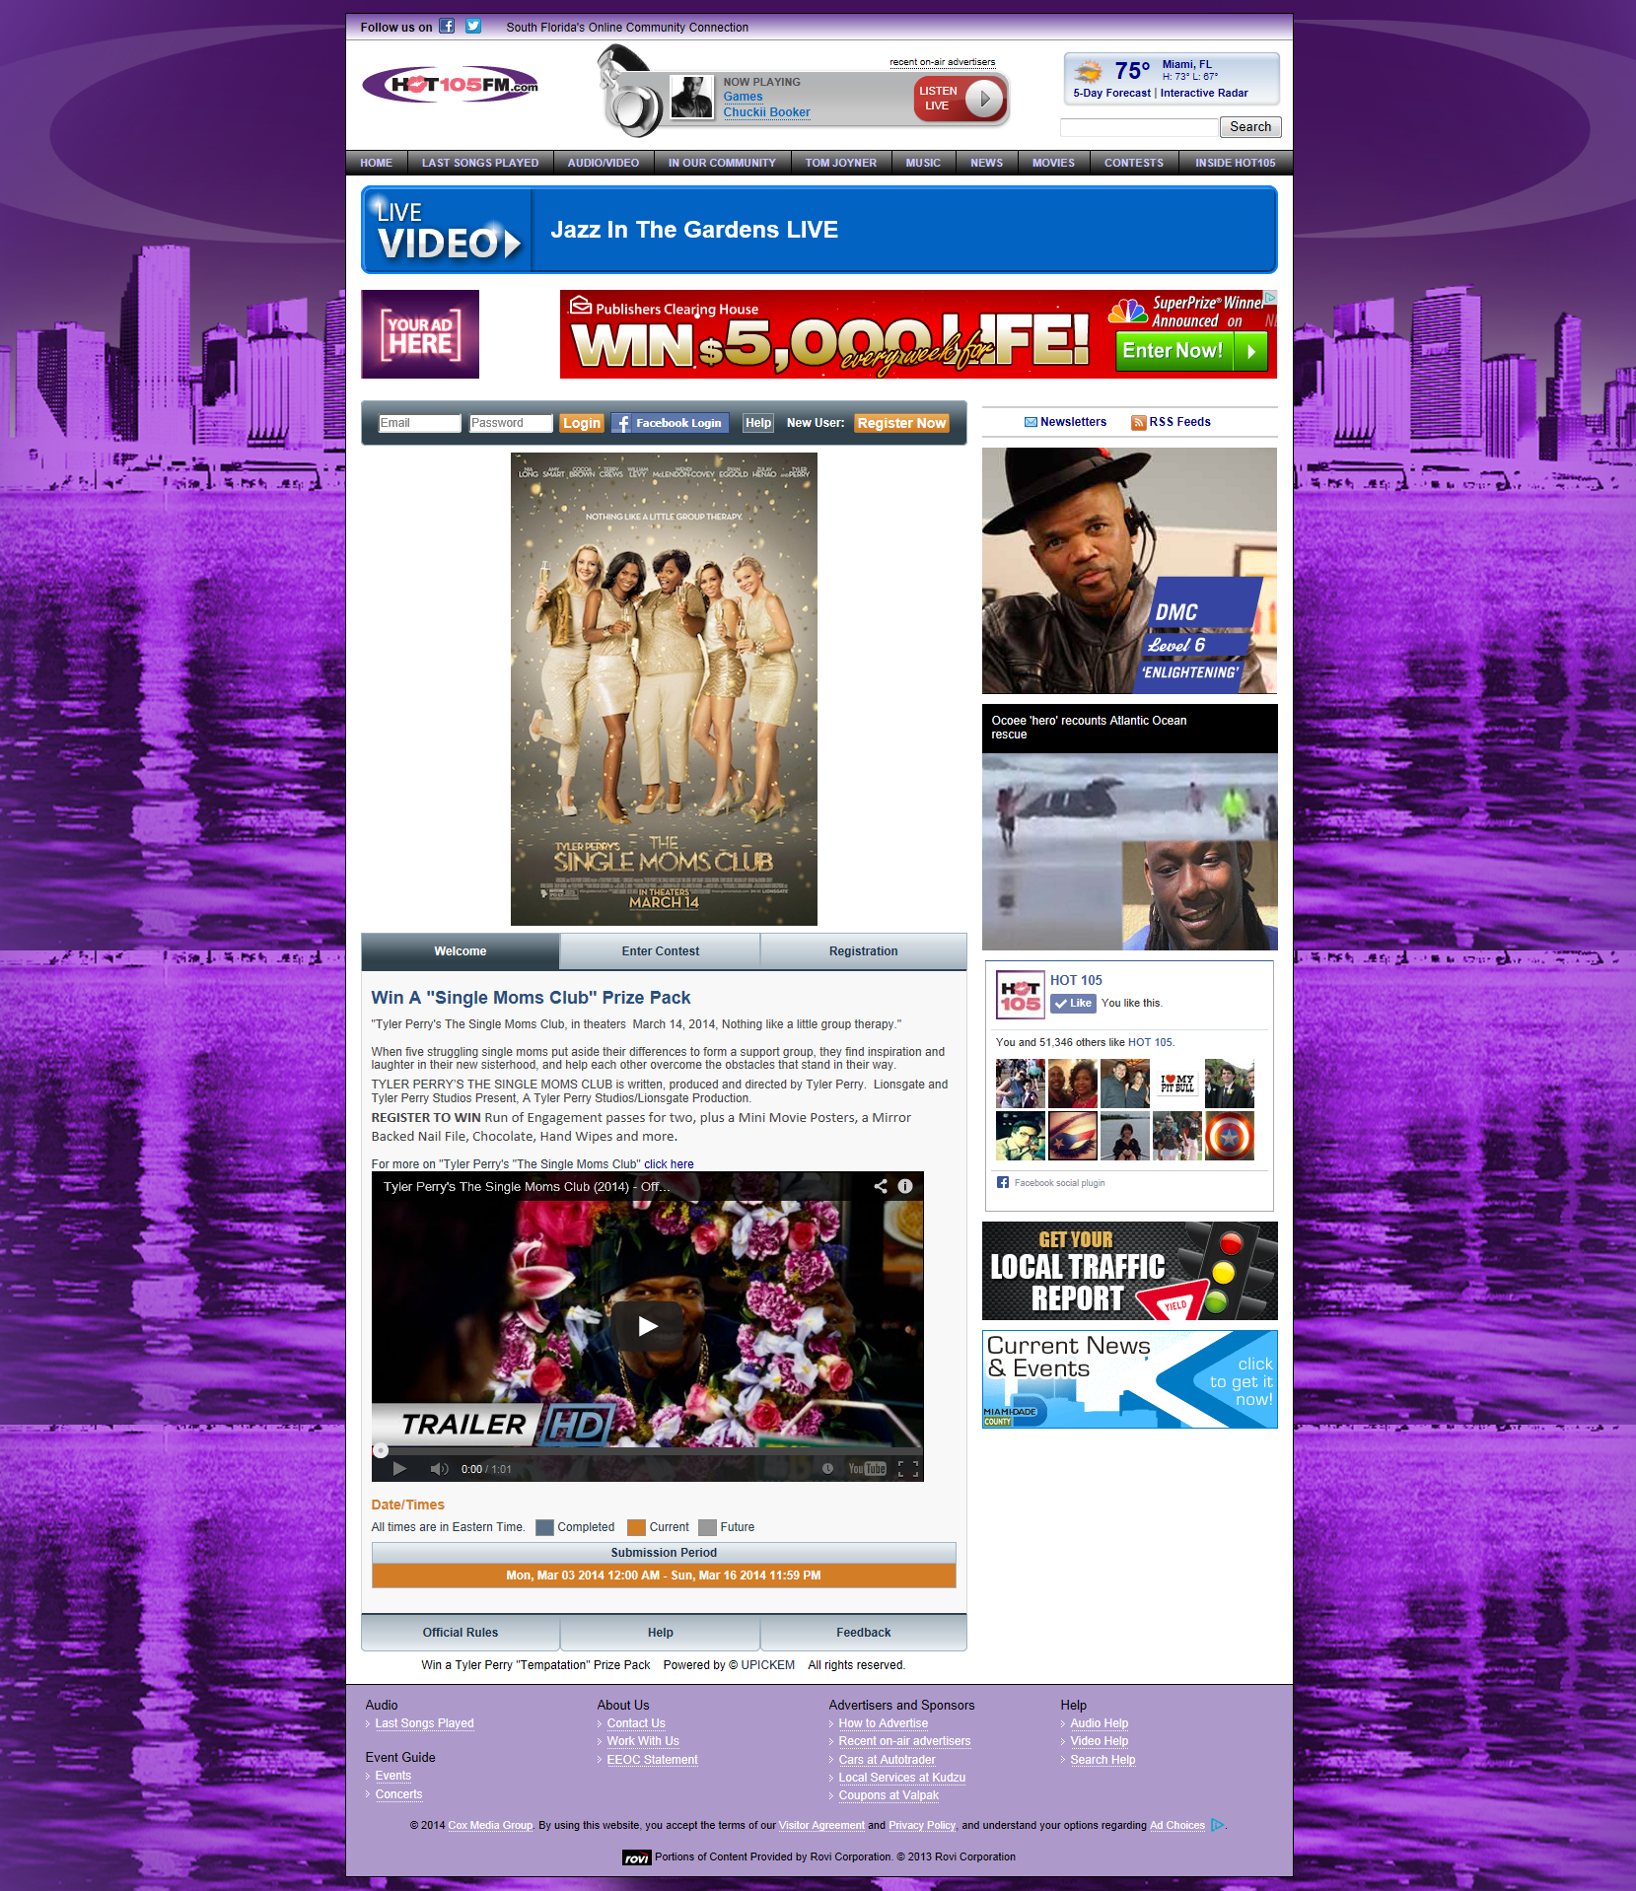
WHQT-FM/Lionsgate: Single Mom’s Club Promotion 3/3/14 – 3/16/14

