Slide 1
Mazda Charlotte
DJ Endorsement Recap
March 24 to May 04, 2014
Mindshare Promotions

Slide 2
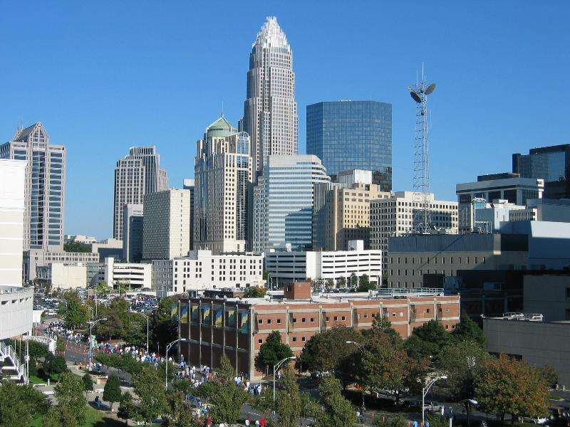
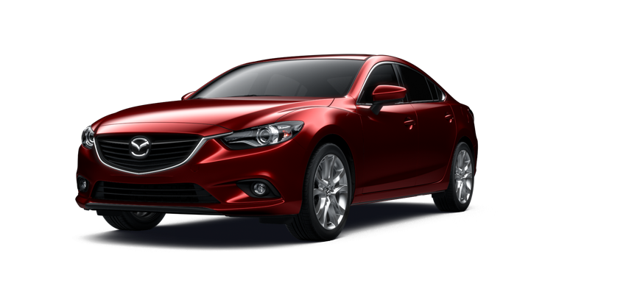
Mazda Charlotte DJ Endorsement
Program Overview
Mazda needed a way to break through the clutter in Charlotte North Carolina during 2Q14.
After exploration, it was decided to work with some of the top Radio DJ’s to have them endorse the Mazda 3, Mazda CX-5 and Mazda 6 with SkyActiv Technology to their audience.
Radio DJs are trusted advisors to their audience and a recommendation from them is more akin to Word Of Mouth from a friend than it is to Advertising.
We gave each of the DJ’s got a brand new Mazda to drive for six weeks. Each day they talked LIVE about their Mazda experience on the air.
We matched the Mazda nameplates with the DJ whose audience best matched our target

Slide 3
Mazda Charlotte DJ Endorsement
Program Overview
The Garage Team Mazda and Mindshare Local Promotions negotiated a 6 week Radio DJ Endorsement Program on behalf of the Charlotte Mazda Dealers
We selected the top three available DJ’s from each of the two ownership groups in the market, CBS and Clear Channel
Between the two ownership groups, 8 of the top 10 and 10 of the top 15 stations were represented
This could be bring economy of scale as stations would share resources
The original concept was to have one of the groups win in a competition, but pricing and additional budget allowed us to execute both programs.

Slide 4
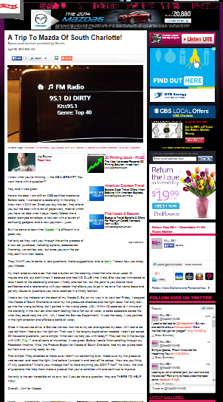
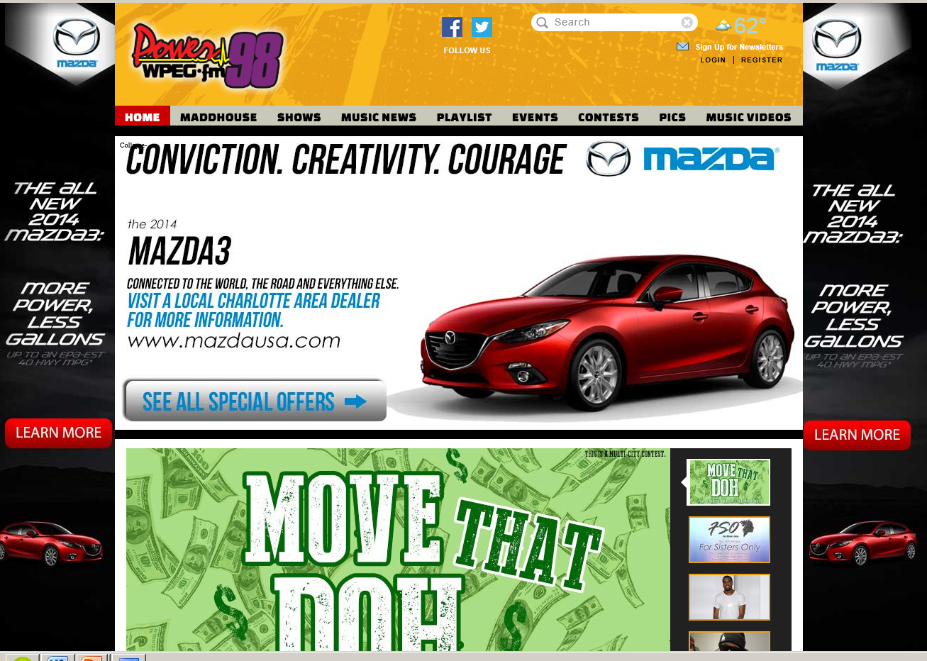
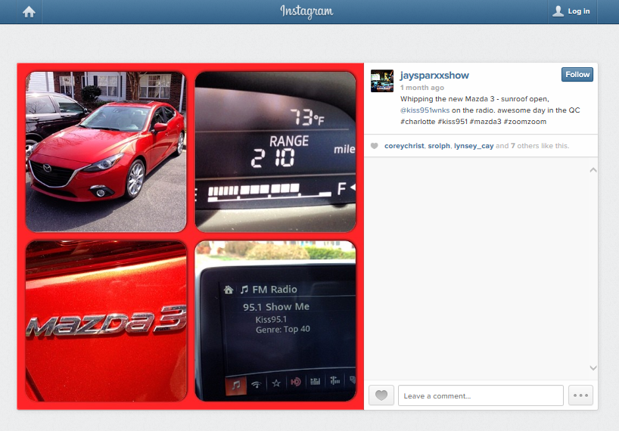
Mazda Charlotte DJ Endorsement
Program Overview
In addition to Daily DJ Endorsements each week, additional elements were added to make it a multi media program
Website Display advertising, home page take overs, preroll video and streaming
Social media via DJ Facebook Posts, Tweets, Instagram and E-Mail blasts
Weekly remote station appearances at each dealership
Contests to drive traffic to the dealerships and www.mazdausa.com

Slide 5
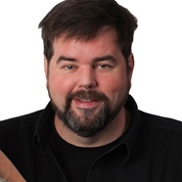
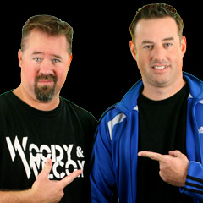
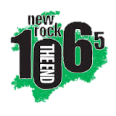
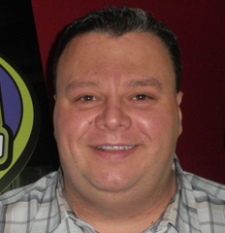
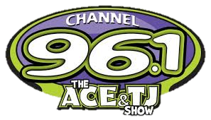
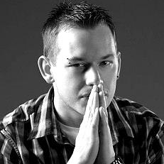
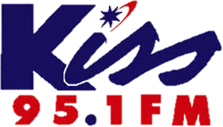
Mazda Charlotte DJ Endorsement
DJ Selection
We chose top DJ’s from the top three stations in each group
A variety of formats, day parts and personalities were selected to provide a wider audience for Mazda
CBS Radio
WSOC-FM (Country)
Big Jim Slade from the Tanner In The Morning Show (6A-10A)
WPEG-FM (Urban)
Vonyetta, Middays (10A-2P)
WNKS-FM (CHR)
Jay Sparxx, Evenings (7P-12MID)
Clear Channel Radio
WEND-FM (New Rock) Both Woody & Wilcox from the Morning Show (6A-10A)
Dual Endorse (2 Cars!!)
WHQC-FM (CHR)
Boomer, Afternoon Drive (4P-7P)
WKKT-FM (Country) Casey Carter, Middays (10A-2P)

Slide 6
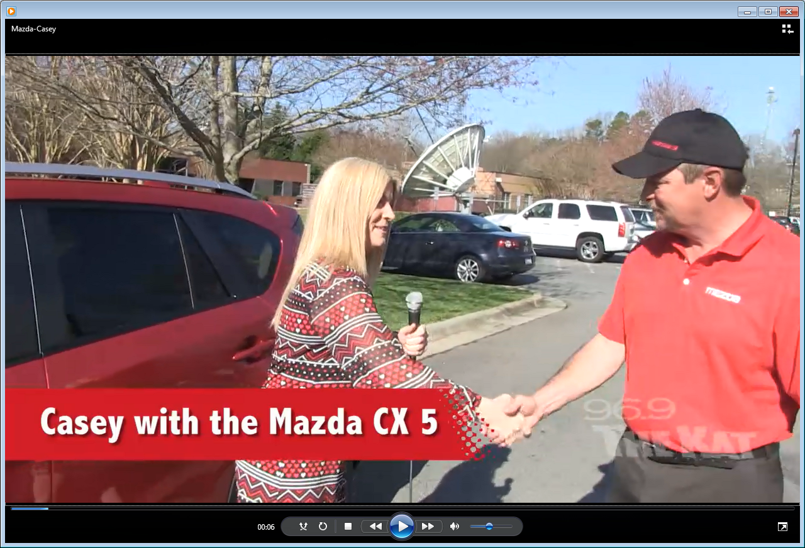
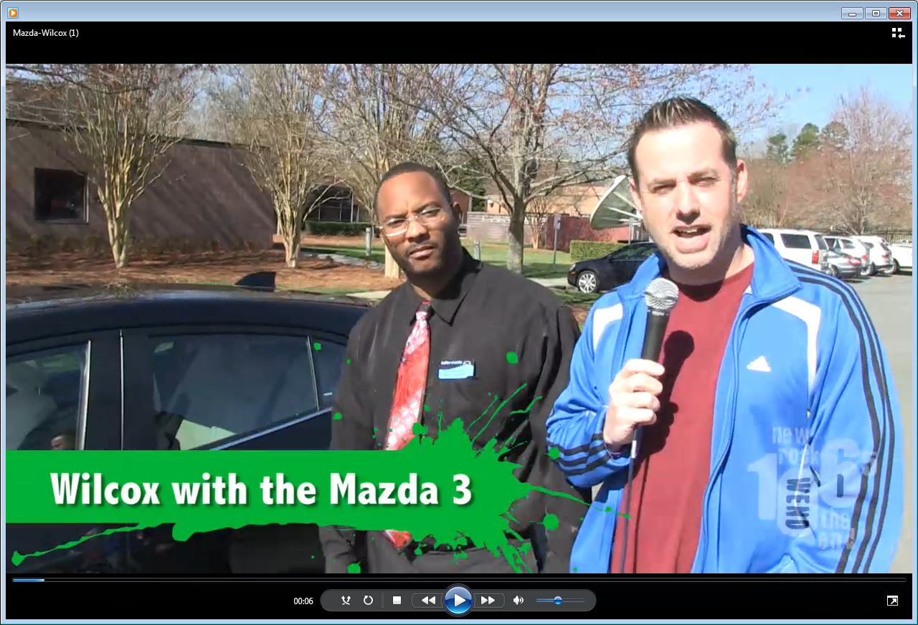
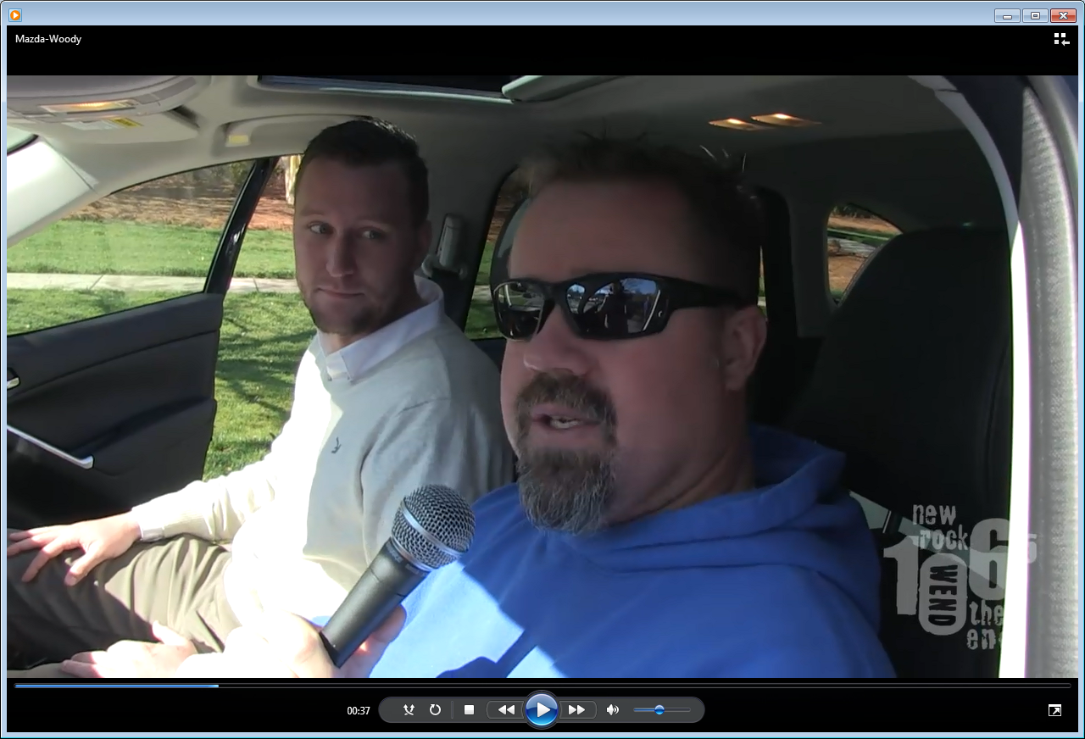
Mazda Charlotte DJ Endorsement
Kick Off
The program began with a Mazda specialist delivering each of the vehicles to the DJ at the station.
Video was shot during the “walk through” and posted on the website to create a “virtual test drive” for listeners.
That next Monday, all 7 of the DJ’s began to share their experiences during live :60 segments on their program.
They also updated the video, sharing their experiences and discoveries of their new Mazda vehicles with their audience on air and on line.

Slide 7
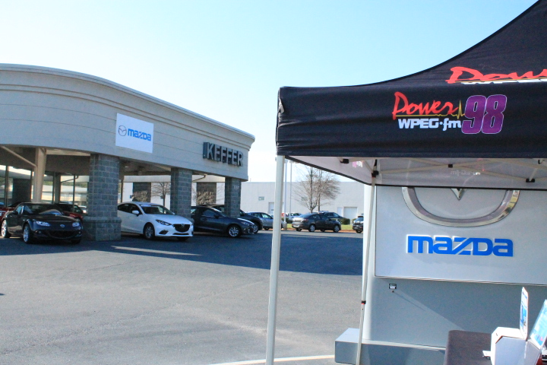
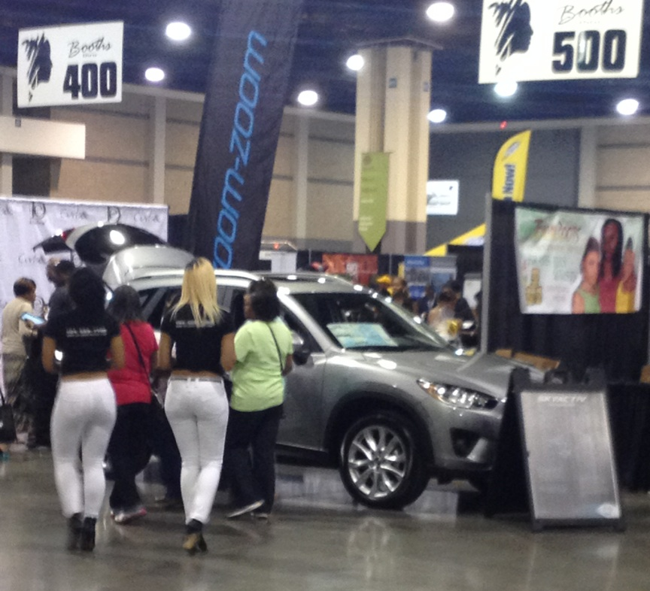
Mazda Charlotte DJ Endorsement
Program Overview
Each station group did a traffic driving promotion
CBS
Each CBS station conducted a 2 hour appearance at each of the 5 Mazda dealer locations in Charlotte with concert tickets for listeners taking test drives
Mazda sponsored of the following events with on site vehicle display
“For Sisters Only” 5/3 @ The Charlotte Convention Center
“Southern Girls Night Out” 4/9 @ Coyote Joe’s.

Slide 8
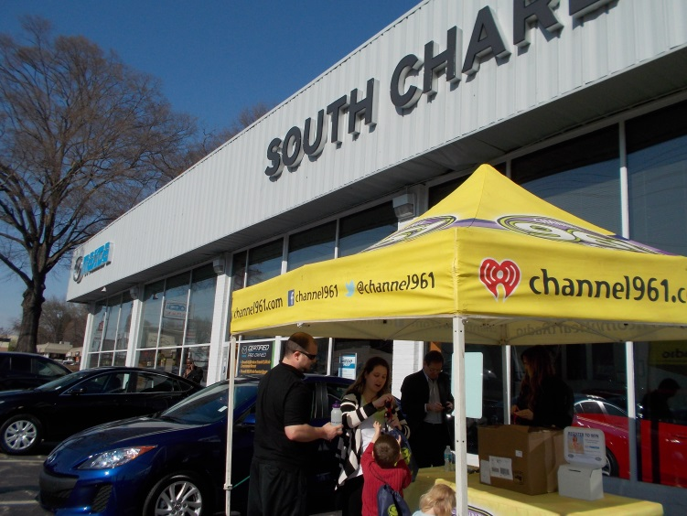
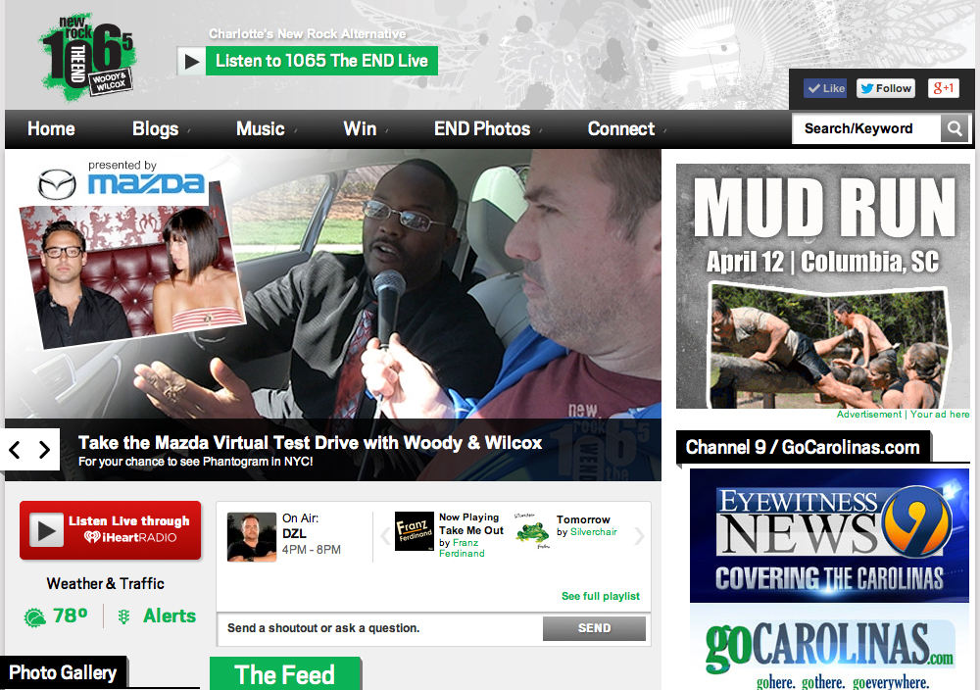
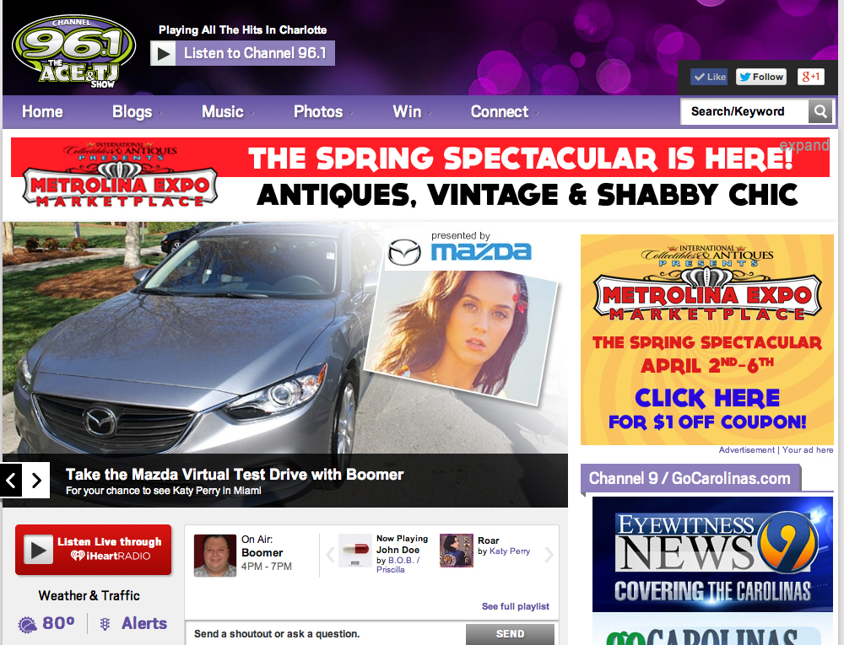
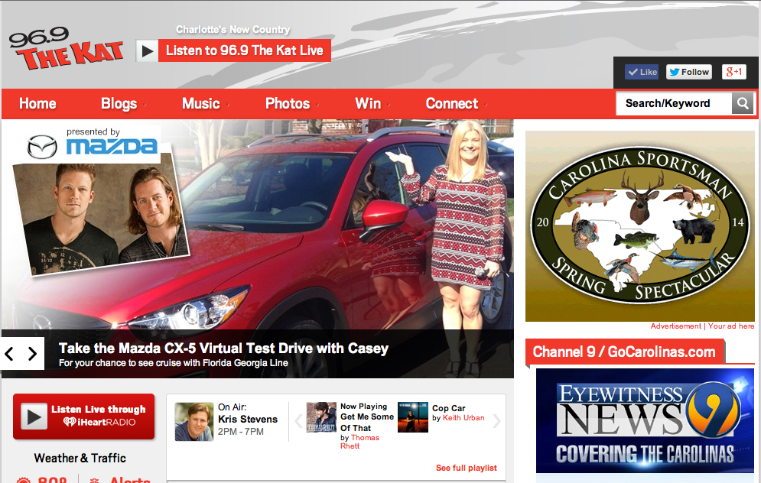
Mazda Charlotte DJ Endorsement
Program Overview
CLEAR CHANNEL
Each of the 3 Clear Channel stations conducted an on site at all 5 dealers
At these events they registered listeners to win fun prizes
WHQC offered a trip for 2 to Katy Perry’s 4th of July Concert in Miami
WKKT qualified listeners on site and online for a cruise hosted by the band Florida Georgia Line
WEND registered listeners at dealers and after taking a “virtual test drive” to win a trip to NYC to see Phantogram

Slide 9
Mazda Charlotte DJ Endorsement
Results
Over the course of the six week promotion, Charlotte radio fans were inundated with Mazda branding
They heard and saw…
270 different Live Endorsements Spots (7 DJs on 6 stations over 6 weeks)
1,188 recorded :60 and :30 Mazda Radio Spots
That’s 1458 spots generating 5,765,000 A18-49 impressions!!
1290 radio promotion announcements generating 6,494,000 A18-49 impressions!!
30 Radio Station Appearances (One per week at 5 dealers over 6 weeks)
###,### Digital impressions including from a myriad Display Banners, Home Page Takeovers, Pre Roll Video, Contest Entry Pages and Streaming Audio
Mazda appeared at 2 major station events (sponsored by Mazda)
Mentions in ## Social Posts by DJ’s like Facebook, Twitter and Instagram

Slide 10
OVERALL … #,###,### A18-49 MazdaGross Impressions were made on Charlotte residents during the DJ Endorsement program!

Slide 11
“Thanks for all your hard work on this. I've heard a number of positive comments about their endorsements and I have to believe it's having an impact.”
- Charlotte Mazda Dealer
Wednesday, April 30, 2014 7:28 PM

Slide 12
“From a sales standpoint we had a positive story in April, so the DJ program should be considered one of the contributing factors. There was a 40% increase YOY”
- Cliff Dittmore, Garage Team Mazda
Thursday, May 1, 2014 11:55 AM

Slide 13
Thank you

