Slide 1
MORTDECAI Promotion with WDUV and WXGL
Q1 2015

Slide 2
MORTDECAI Promotion WDUV Web Contest with on-air promotion Recap

Slide 3
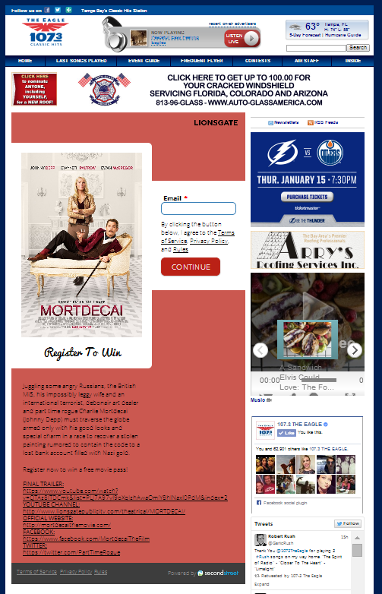
MORTDECAI Promotion WXGL Web Contest with on-air promotion Recap

