Slide 1
Tyler Perry’s The Single Mom’s Club RECAP March 10-14, 2014

Slide 2
KLVE 107.5FM promoted Lionsgate Tyler Perry’s “The Single Moms Club” through social media. KLOVE’s facebook users were encouraged to enter to win a “Single Mom’s Club Night Out” with 3 of her friends. KLVE’s Promotion Team gave away goodie bags & posters of the new movie. KLVE asked listeners and followers to register to win Grand Prize. The Grand Prize winner received a Spa Day at Yolanda Aguilar Beauty Institute & Spa with 3 of her friend and tickets to go see “The Single Mom’s Club” courtesy of Regal Theaters. In addition, the winner also receives mini movie posters, and other movie memorabilia.
The Single Mom’s Club Promotion

Slide 3
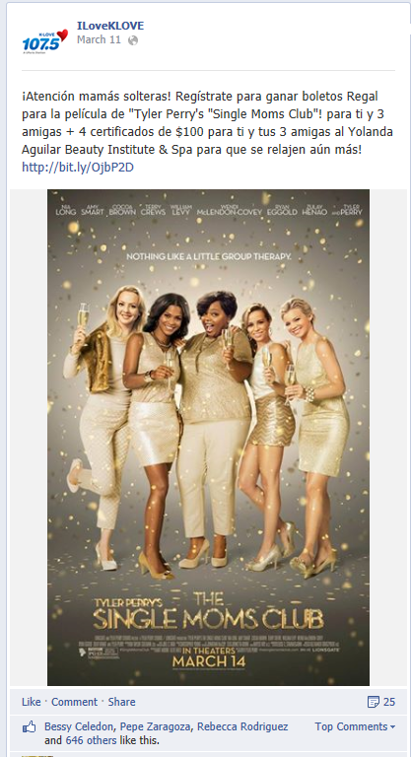
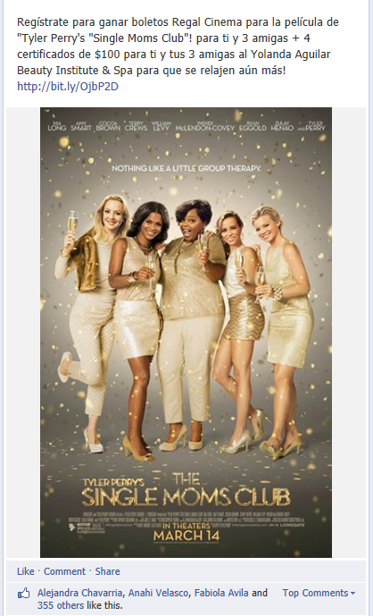
10x Live Mentions 2x FB Posts 2x Tweets 44,344 Impressions from FB Posts 372 Entries! Over 1000+ followers “Liked” the postings on KLVE’s page.
KLVE Social Media

Slide 4
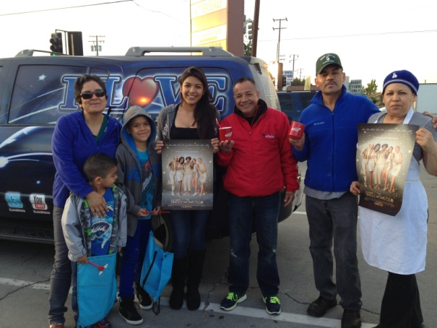
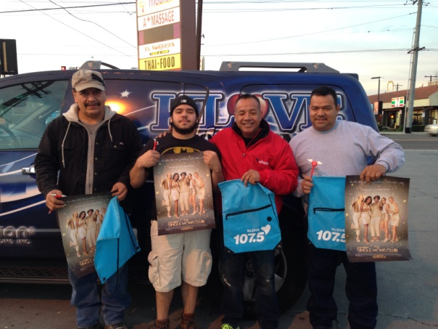
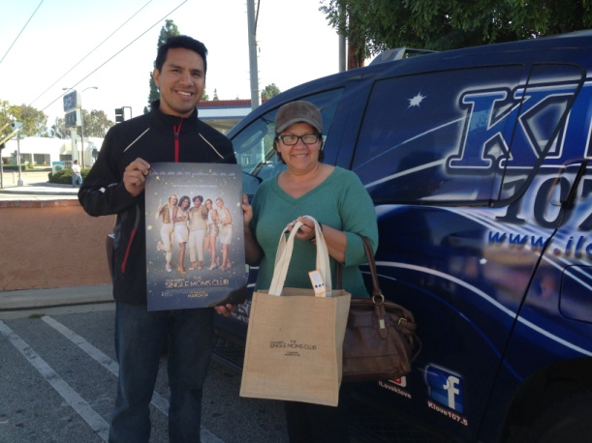
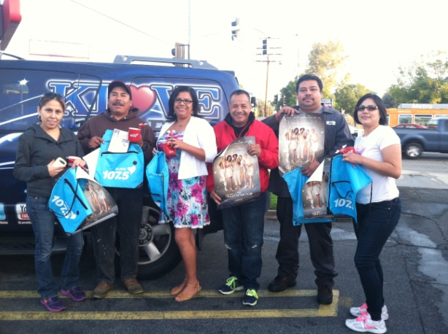
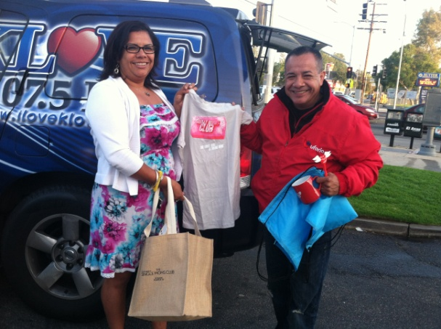
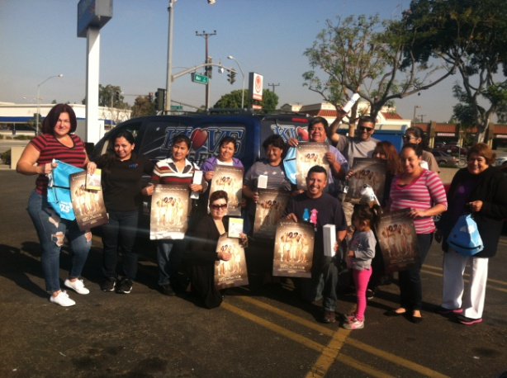
Single Moms Club Street Activations
March 10-14, 2014
KLVE Promotions team went out on the streets and informed the community about Tyler Perry’s new movie, Single Mom’s Club that it is about release. The people were very excited to receive their posters, goodie bags, chocolates, mugs, and t-shirts…especially some of the ladies that met up with us because they related to the title of the movie. Everyone had such a wonderful time just hanging around, having a fun time, and receiving their wonderful gifts.

Slide 5
KLVE promoted Tyler Perry’s new movie The Single Mom’s Club On Air Live. Omar & Argelia let the listeners know where the KLVE Promotions Team was going to be at so that they can receive their gifts courtesy of Tyler Perry’s new movie: The Single Mom’s Club.
KLVE Air Checks
Air Check #1
Air Check #4
Air Check #2
Air Check #5
Air Check #3

