Slide 1
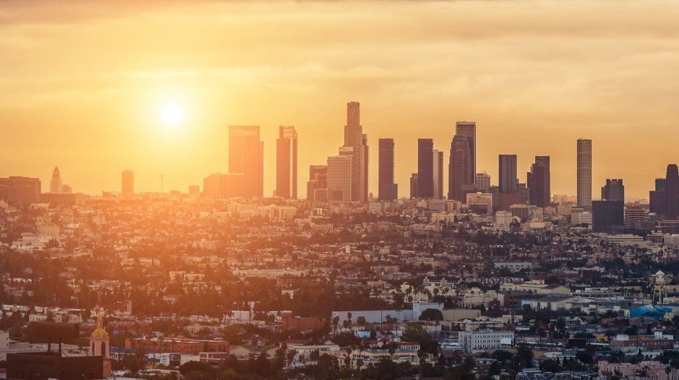
HUGGIES ACTIVATION RECAP
Huggies Activations 04.20.16

Slide 2
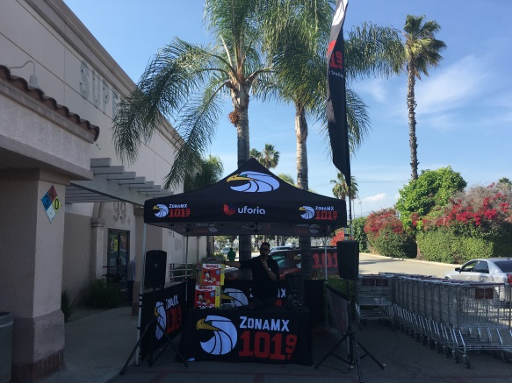
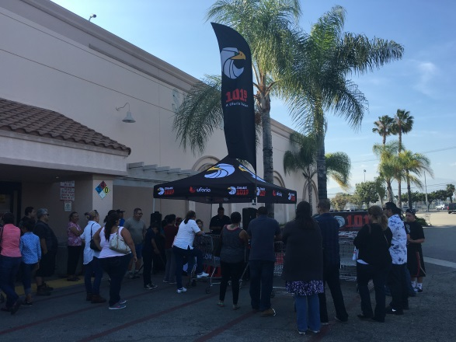
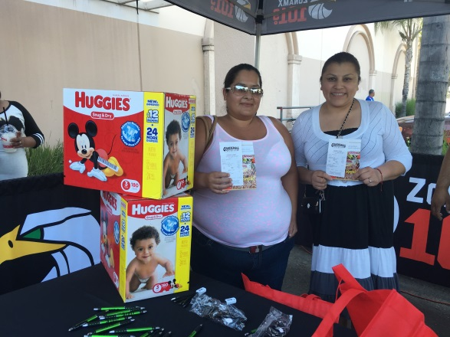
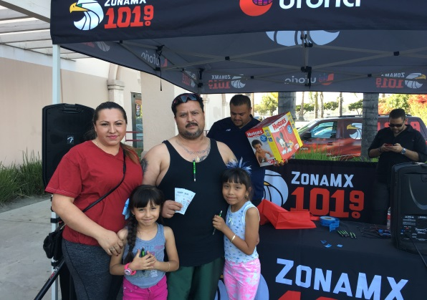
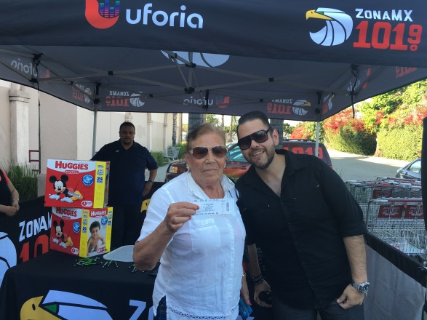
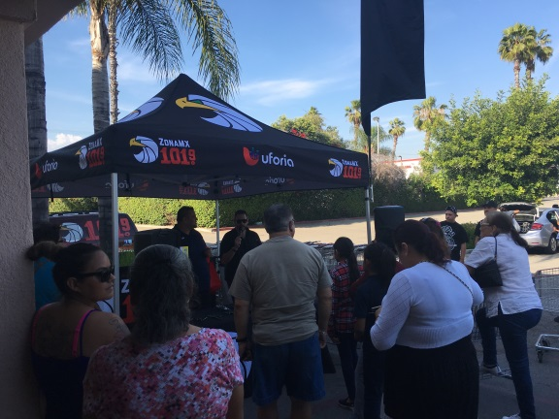
Huggies Activations 05.11.16
4pm-6pm, Cardenas; 2001 S Garey Ave. Pomona,CA 91767
Live Call In
101.9FM and Huggies teamed up to bring a great promotion to the city of Pomona! Our listeners were invited to Cardenas market for the opportunity to win station prizes, LA Dodger tickets and $25 dollars Cardenas market gift cards. The community was very involved with our promotion and our on-air personality kept everyone entertained.

