Slide 1
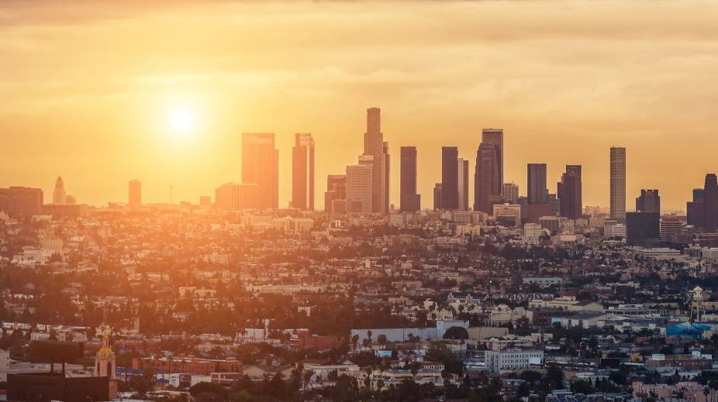
HUGGIES ACTIVATION RECAP
Huggies Activations 04.20.16

Slide 2
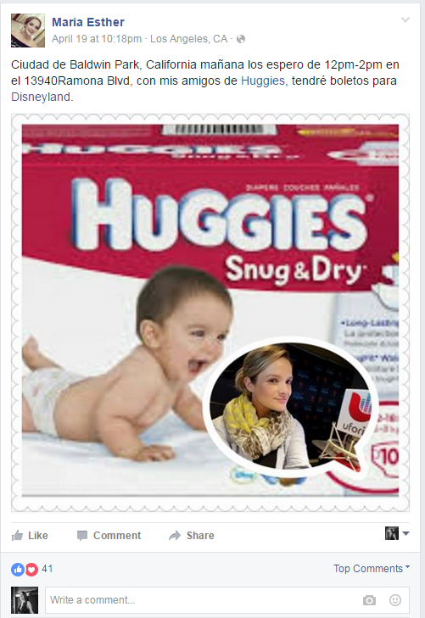
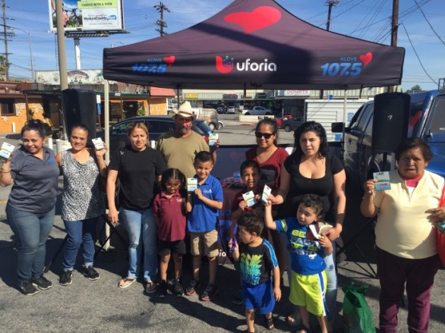
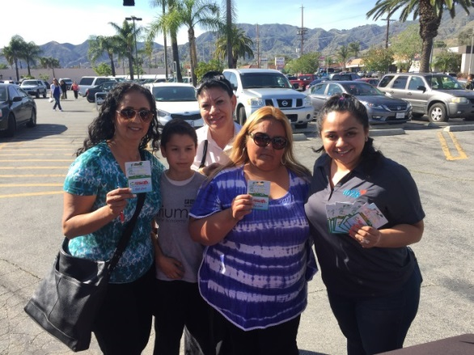
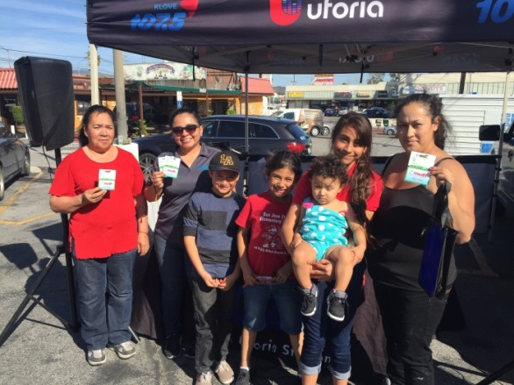
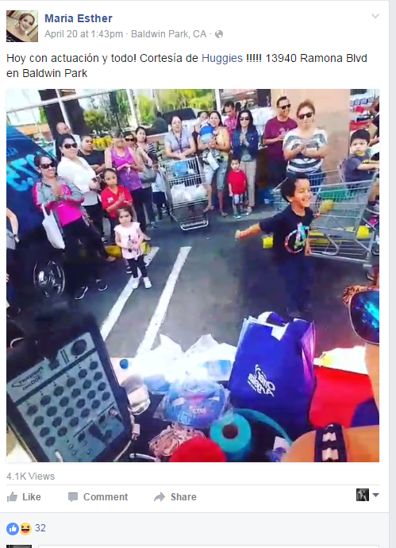
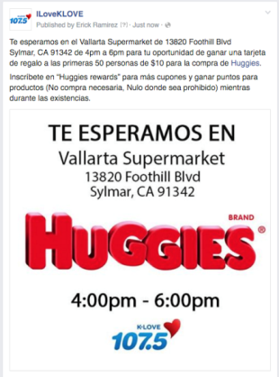
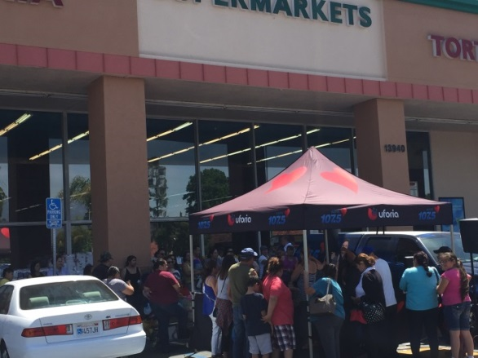
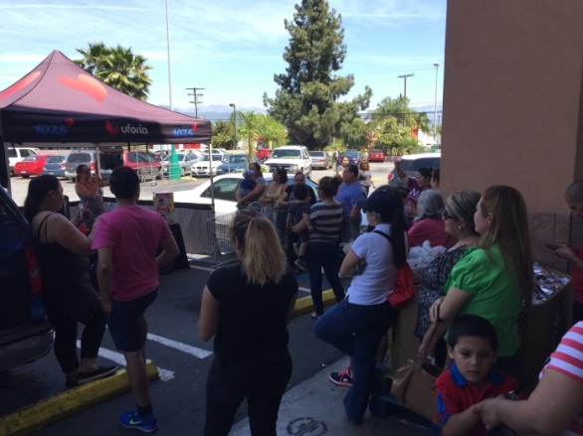
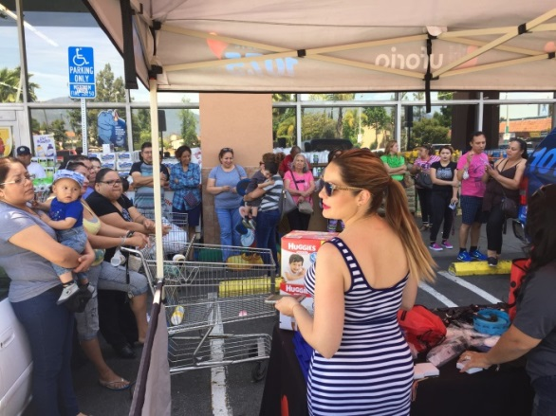
Huggies Activations 04.20.16
Vallarta Supermarket - 13820 Foothill Blvd, Sylmar, CA 91342 @ 4pm-6pm
Vallarta Supermarket - 13940 Ramona Blvd., Baldwin Park, CA @ 12pm-2pm
Insert Audio
S
Y
L
M
A
R
B
U
E
N
A
P
A
R
K
More than 80 people showed up during the Huggies KLVE activations, to meet Maria Esther. Our promotions teams engaged the crowd with games, music, and prizes such as station premiums and Huggies gift cards to promoted Huggies, overall a great Success!

