Slide 1
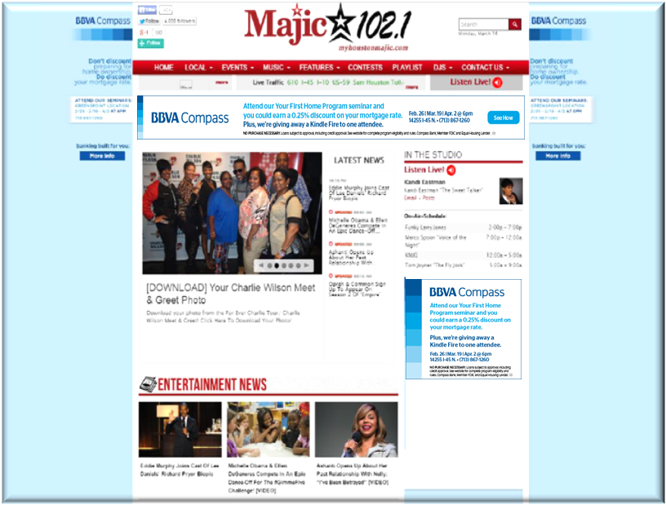
BBVA Compass ~ First Home Buying Program
Digital Recap
E-Blast to over 45K opt in recipients
Website Interstitial Banner
Homepage Takeover: Wallpaper, 970x90, 300x600, 300x250
Creative | Ad server impressions | Ad server clicks | Ad server CTR
Wallpaper | 21194 | 32 | 0.15%
BBVA_300x250 | 23739 | 1 | 0.00%
BBVA_300x250 (copy) | 23739 | 1 | 0.00%
BBVA_300x600 | 80988 | 35 | 0.04%
BBVA_970x90 | 22189 | 5 | 0.02%
BBVA - Interstitial | 57232 | 2792 | 4.88%
BBVA Mobile Interstitial | 76272 | 0 | 0.00%
Total | 305,353 | 2,866 | 0.94%

Slide 2
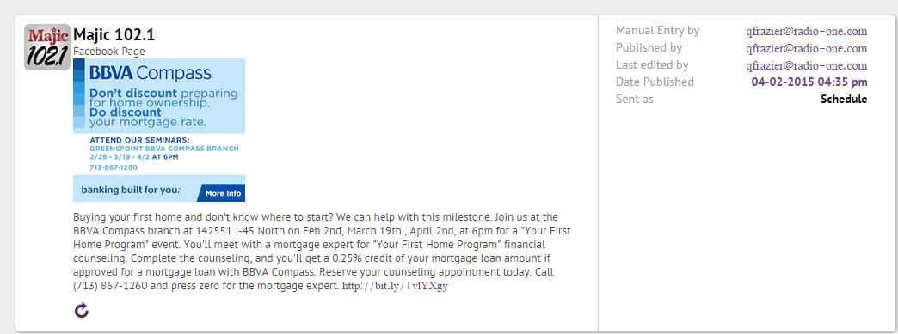
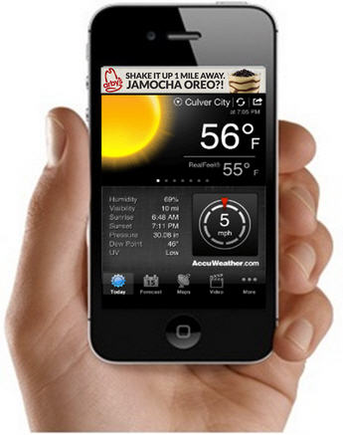
Social Media
11 Fb Postings
22 Clicks
10 Shares
72 Likes
11,681 Reach
Campaigns | Advertiser | Imp | Clicks | CTR
BBVA_INTETRSTITIAL|KMJQ2.24-4.2_AV | BBVA Compass | 28,979 | 2,195 | 7.57

