Slide 1
invites you to experience

Slide 2
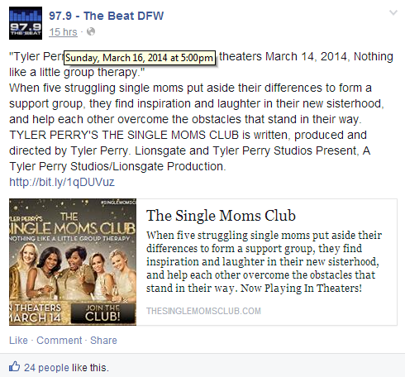
Social Media Presence-Facebook

Slide 3
Social Media Presence-Facebook

Slide 4
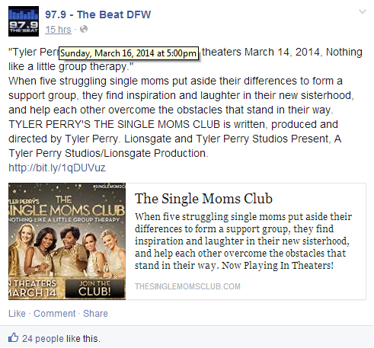
Social Media Presence-Facebook

Slide 5
Social Media Presence- Twitter

Slide 6
Social Media Presence- Twitter

Slide 7
Street Hit Photos

Slide 8
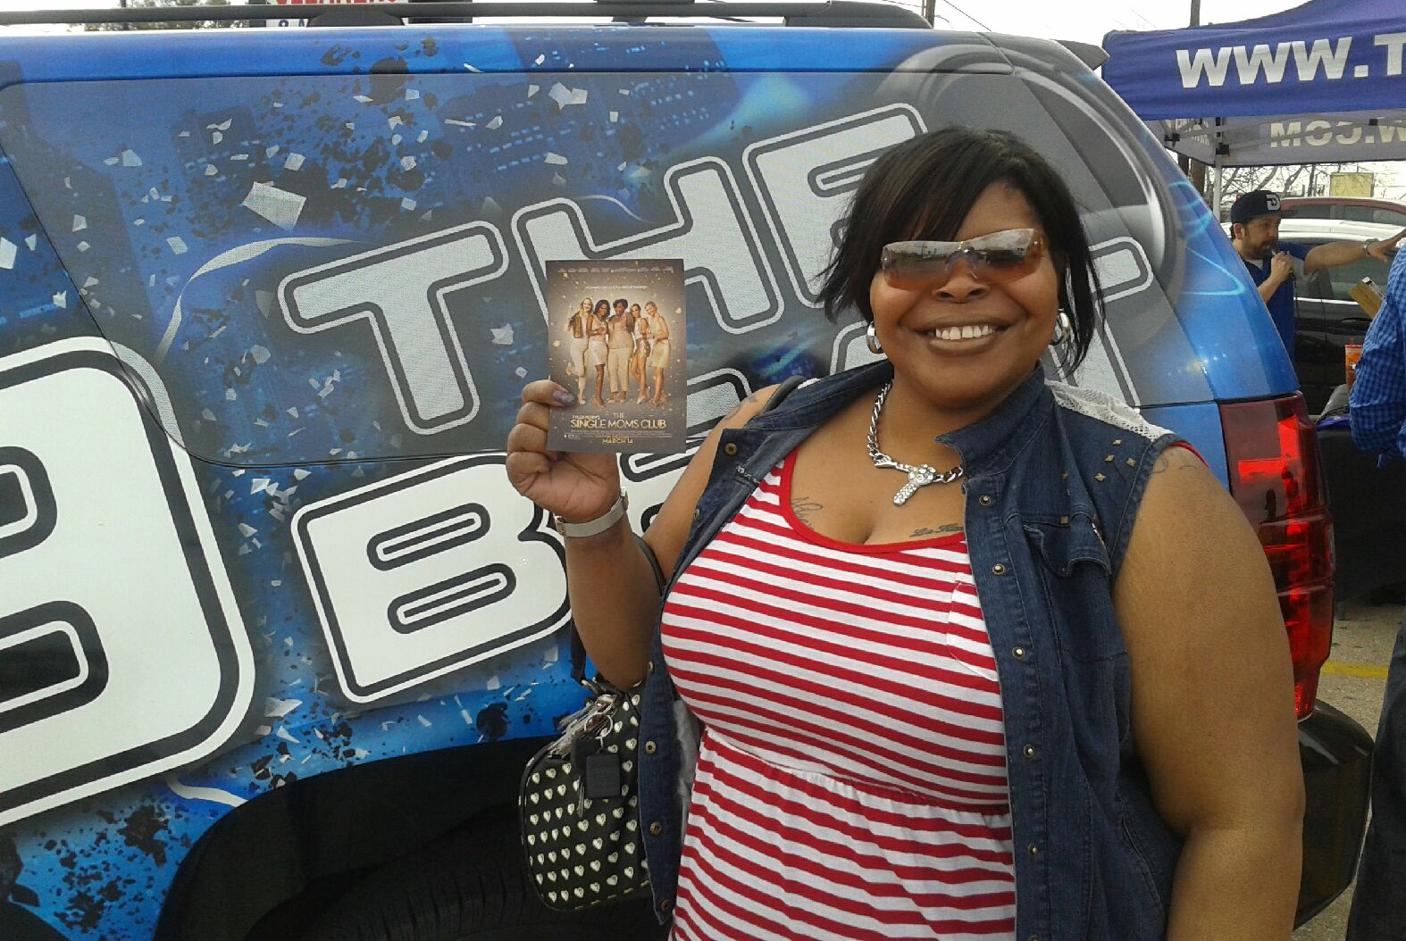
Street Hit Photos

Slide 9
On-Air Presence
Aircheck #1
Aircheck #2
Aircheck #3

Slide 10
Thank your for your partnership!

