Slide 1
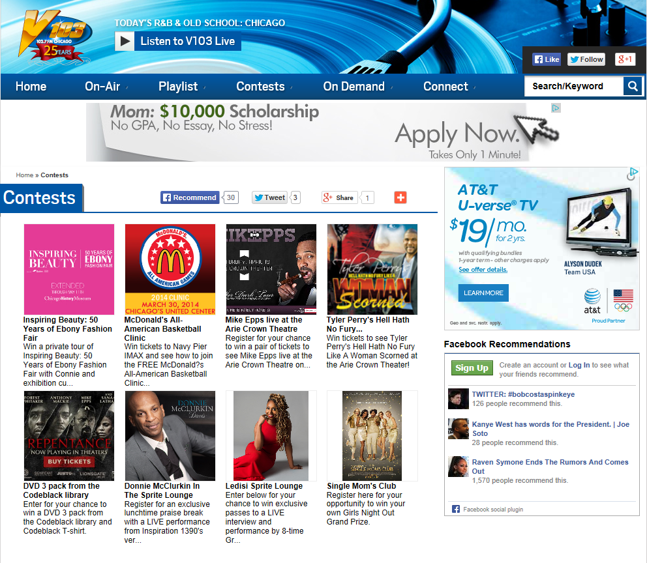
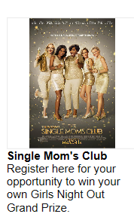

Slide 2
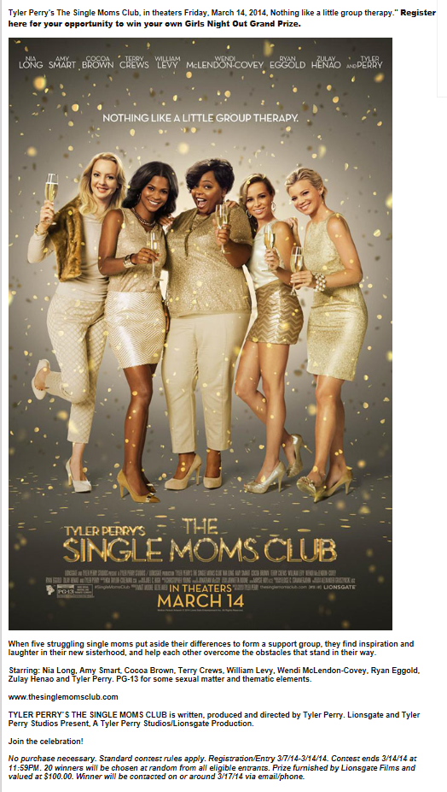
V-103
CONTEST PROMOTIONAL ANNOUNCEMENT

Slide 3
TYLER PERRY’S
THE SINGLE MOMS CLUB
ADDED VALUE HAIR SALON RECORDED PROMOS
3.6.14 – 3.8.2014
CONTEST METRICS
GRAND PRIZE WINNER
THANK YOU
312.540.2125
barbaragueno@clearchannel.com

