Slide 1
AMP Street Team Appearance at Foodtown/Huggies with Shoboy Recap
DATE: Saturday – July 23rd
TIME: 2-4 PM
LOCATION: C Town – 272 Maple Street, Perth Amboy, NJ 08861

Slide 2
Summary
92.3 AMP worked to maximize exposure and bring our listeners to
Foodtown on Saturday July 23rd from 2pm-4pm to see Shoboy and the AMP Street
Team and to enter to win great prizes.
Huggies Appearance Included:
On-site:
Energetic Street Team
On-Air personality
92.3 AMP Van
Prize Wheel
Card games
Great music, utilizing our 1000+ song playlist!
On-Air
Huggies appearance would be supported on air with 26x :10 second on-air promos the week of the appearance
Online:
For two weeks before the street team appearance, your event/promotion will be on 923amp.cbslocal.com events page
Net talent Fee = $500
LISTEN

Slide 3
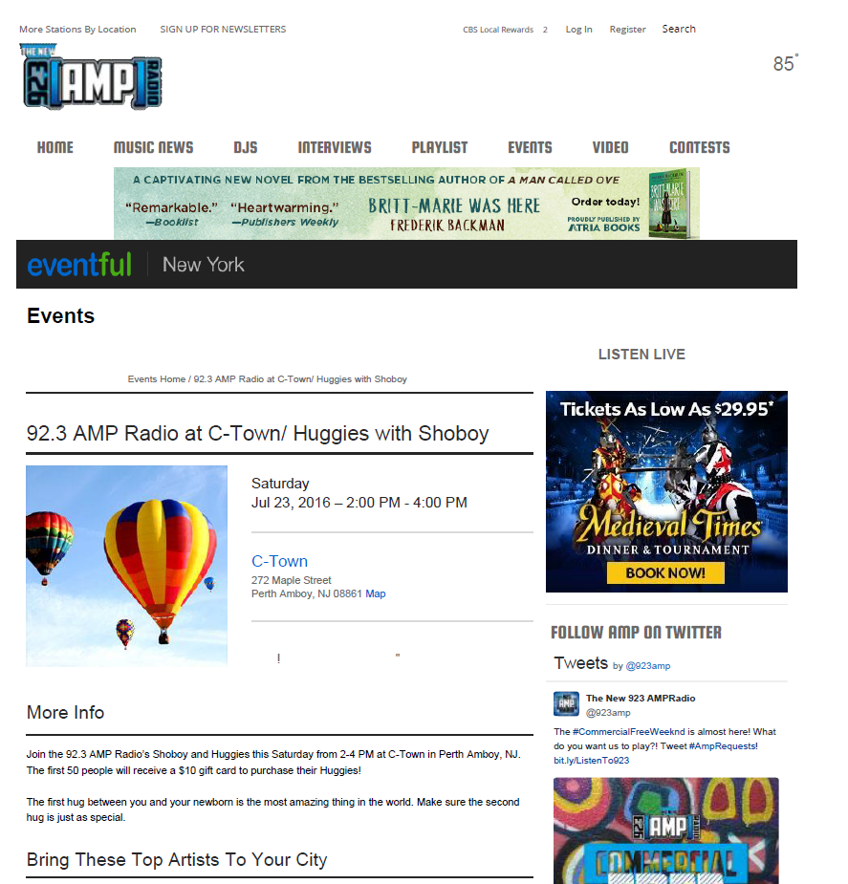

Slide 4
Edgar “Shoboy” Sotelo
Energetic, passionate and candid, Edgar “Shoboy” Sotelo is a leading star in the world of broadcast radio and host of 92.3 AMP Radio’s “Shoboy in the Morning” show on WBMP.
Recognized as one of radio’s brightest rising stars, Shoboy arrives in NYC via a steady climb through some of the top radio markets in the US. His career began in Los Angeles, hosting a Sunday night show. From there, he headed north to San Francisco as PM drive host of La Kalle; then on to the morning drive show at CBS Radio’s Mega107.5 in Dallas-Fort Worth where the “Shoboy en la manana” program was the top-rated show in the market.
Along the way, Shoboy picked up some impressive awards, winning as an individual, (the 2011 NAB Marconi Award for Spanish Format Personality of the Year; the Edison Research 30 under 30 – 2012, 2013; nominations for Radio Ink’s Medellas de Cortez Radio Personality of the Year Award and the Monitor Latino 2014 Radio Personality of the Year) and sharing in Mega 107.5’s win for the 2012 Marconi Award for Spanish Radio Station of the Year.
Shoboy has a tremendous passion for community involvement so his show not only features an innovative fusion of music, comedy, entertainment but also community empowerment.
Shoboy and his co-host Nina are excited to bring New York City their unique take to Top 40 radio!

Slide 5
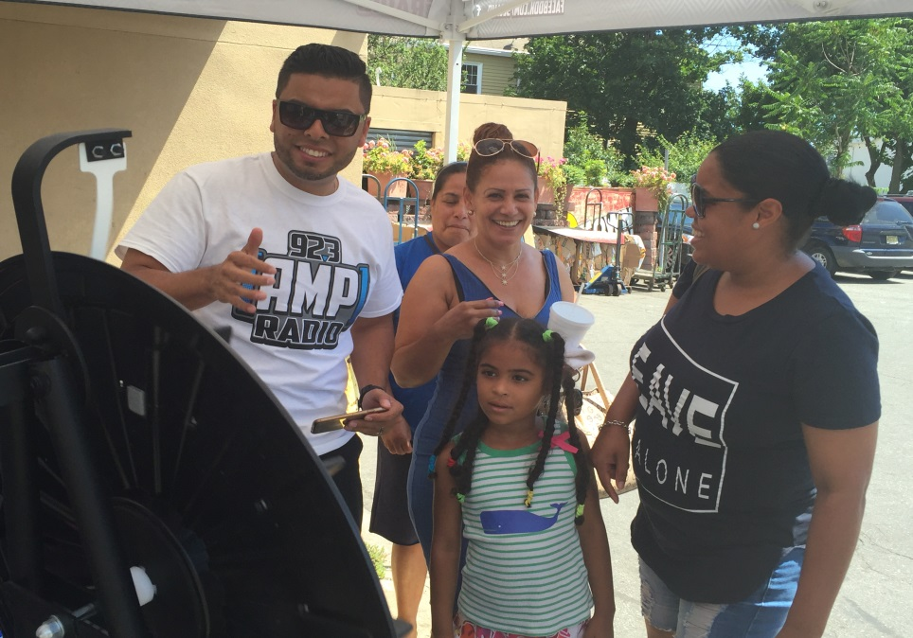
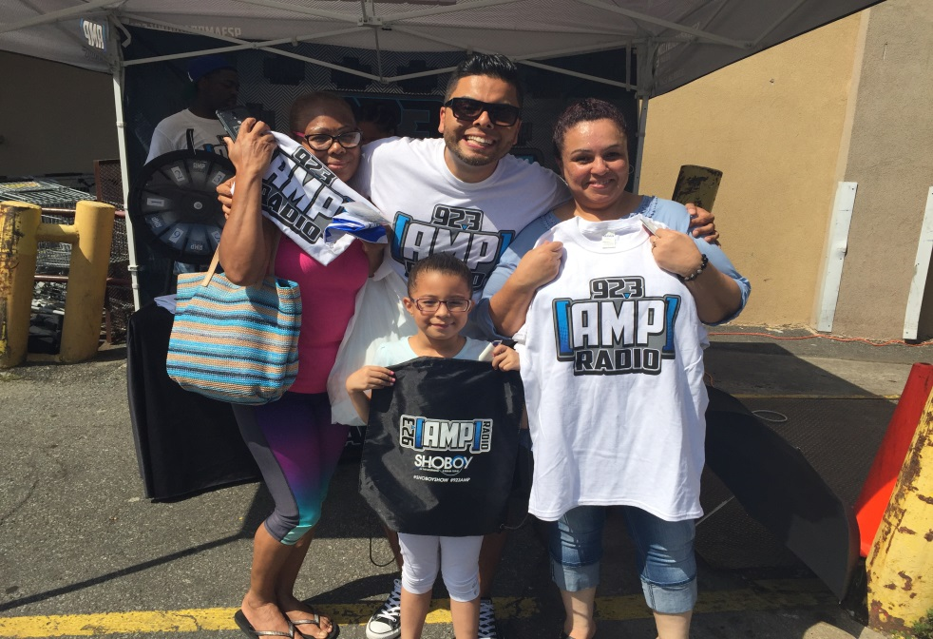
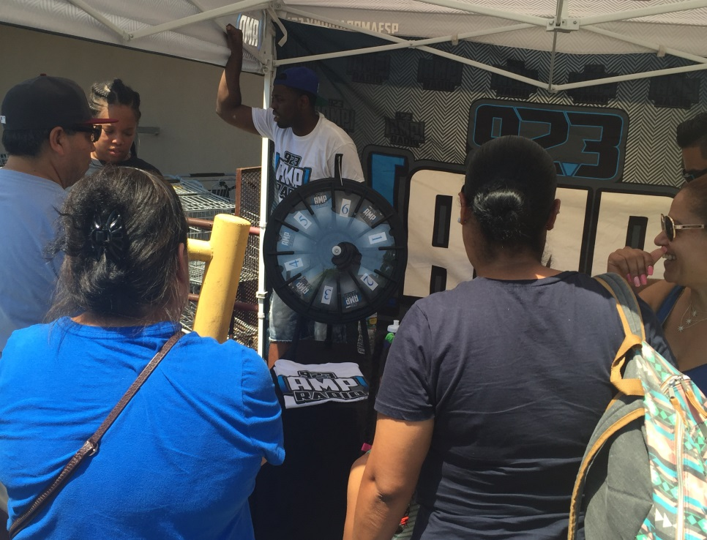
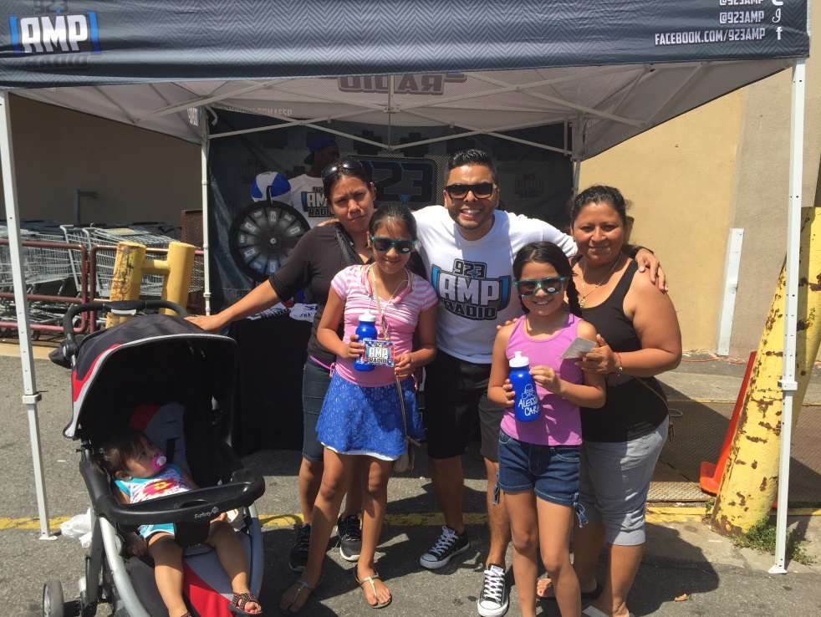
LISTEN

